Slide 1


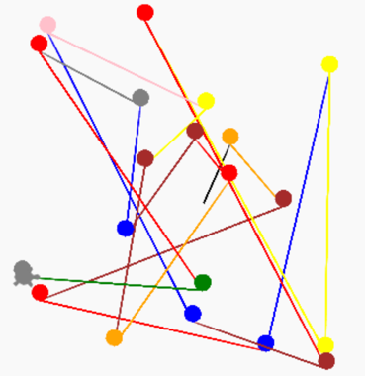

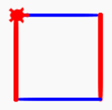
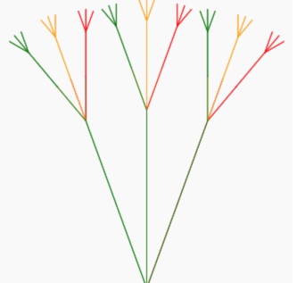

Journey Map for Beginning Python
Start
Parents do this stuff
def square(myColor, x, y):
Trinket Account
Picking Up Speed!
Function
Parameters
Turtle Square
Honestly, a
bit boring here
Flower Power
Remote control
Drawing Fun!
Lists
for i in range(1.4):
colors = ['red', 'orange',
Easy Street
Variables
Keys to the Kingdom!
Random Numbers
Power of
Colors
Loops
Crazy Land!
Function
Powered!
At Your Command
Conditionals
Input
Calling Yourself
Finnish
if i %2:
Recursion
You Rule!
def side():
Next
Beautiful
Trees
Intermediate Python
Feedback: Dan.McCreary@gmail.com

