Slide 1
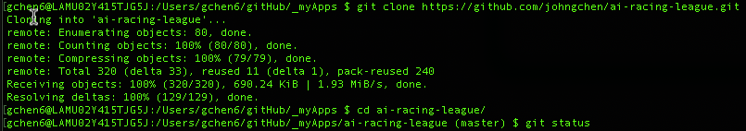
Git and GitHub
Activity:
Join GitHub.com; Fork the original project; Clone it to your own PC; Hack the code and have fun
Questions:
How to join GitHub.com
How to fork a repository
How to raise a new issue
How to make some quick and dirty changes on GitHub
How to contribute back to the project
How to install git on your PC
How to make code changes on your PC
https://github.com/join
Go to https://github.com/CoderDojoTC/ai-racing-league, click on “fork”
Go to https://github.com/CoderDojoTC/ai-racing-league, click on “issues”, then “New issue”
Go to your forked project, e.g. https://github.com/johngchen/ai-racing-league, click the file you want to edit, click the pen icon , make changes, then “Commit changes”
Go to your forked project, click on “New pull request”
Mac: already installed, type git --version to verify; Windows: https://git-scm.com/download/win
$ git clone https://github.com/johngchen/ai-racing-league.git
$ cd ai-racing-league/
$ touch myDemo.txt
$ git status
$ git add .
$ git commit -m "just a demo”
$ git push
Useful info:
https://gist.github.com/arttuladhar/5887559
https://gist.github.com/jedmao/5053440
https://git-scm.com/docs
https://www.atlassian.com/git/tutorials

Slide 2
GitHub – A Tool For Source Control
git | The command line interface
gitHub | The central repository hosted on internet

Slide 3
Install git to use locally, or interact with GitHub
Setting your Git username/email for every repository on your computer
myUserName@myComputer: $ git config --global user.name Mona Lisa
myUserName@myComputer: $ git config --global user.email Mona.Lisa@optum.com
myUserName@myComputer: $ git config --global -l
user.name=Mona Lisa
user.email=Mona.Lisa@optum.com
Create a GitHub Account to have access to the GitHub repository
https://github.com/join
Help https://help.github.com/en
Set up Git
Create a repo
Fork a repo
Mac | already installed, type git --version to verify
Windows | https://git-scm.com/download/win, or use git bash

Slide 4
GitHub – Fork a Repository
Use “Fork” to make your own copy (your own repository) of an existing repository
To play with/hack the code
To contribute back, submit a pull request to the original owner
Your repository is also in the GitHub repository on internet
Use ”New pull request” to send your changes to dmccreary (original owner) for his approval to accept (or not).
Use “Clone or download” to find the URL of a repository

Slide 5
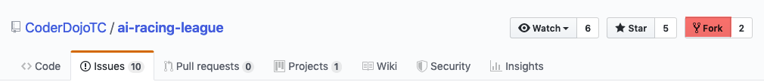
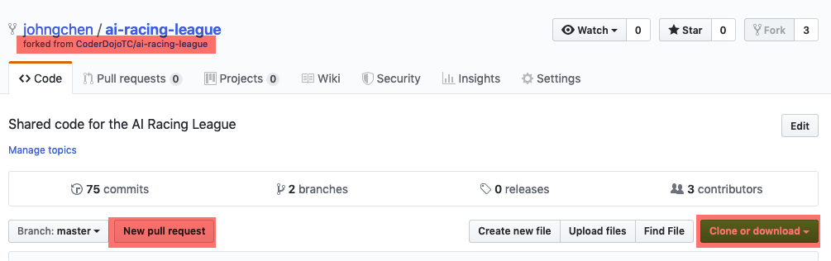

Slide 6
GitHub – Raise a new issue
Report an issue or a bug
Describe the issue
Specify the version/branch where the issue is found
Describe how to reproduce
Describe the expected behavior
Attach relevant logs
Maybe suggest how to fix (or fix it yourself)

Slide 7
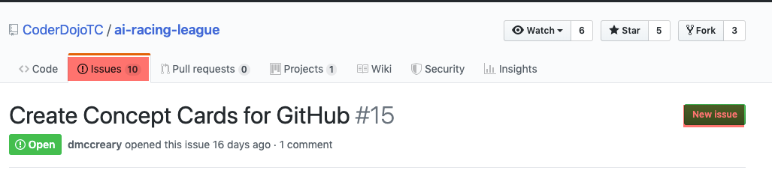
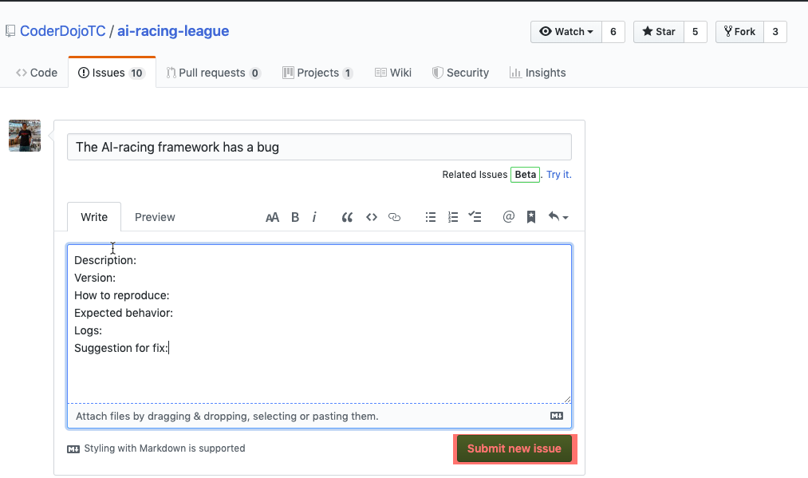

Slide 8
GitHub – Quick and Dirty Changes
The best way is to clone the code and work on your own computer
But for quick and dirty changes, you can change it on GitHub directly

Slide 9
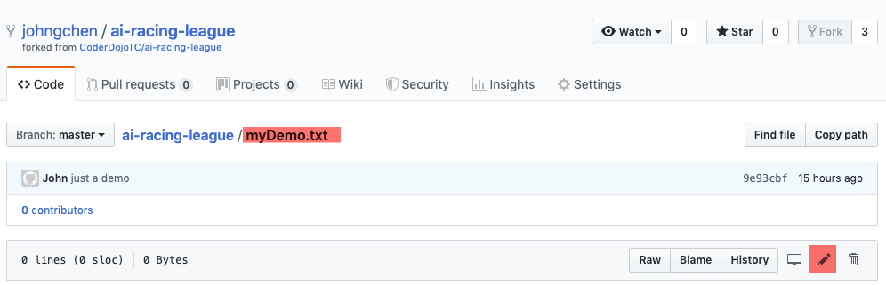
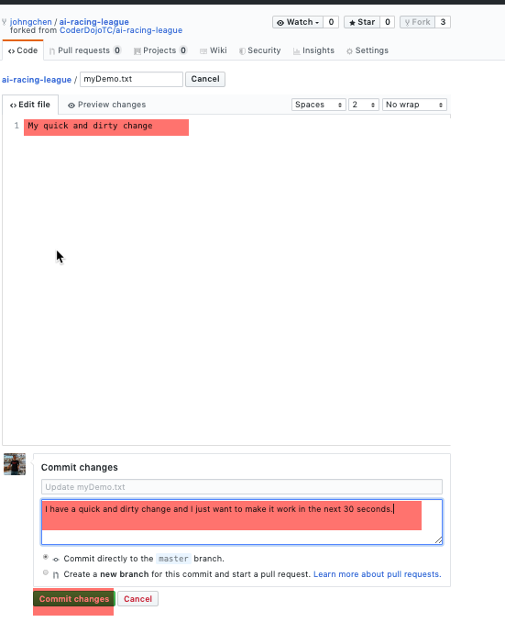

Slide 10
Git – work on your own computer
git clone: make a copy of the source code to your computer
If you are new to gitHub, just work on the master branch, otherwise
git branch: make yet another copy of the source code on your computer
git checkout: switch to the branch to work on it
…. edit your code using vi or your favorite IDE
git add: add the changes you make to git to be tracked
git commit: commit changes to your local repository
git push: push your changes to your github fork

Slide 11
myUserName@myComputer:/gitHub/_myApps $ git clone https://github.com/johngchen/ai-racing-league.git
myUserName@myComputer:/gitHub/_myApps $ cd ai-racing-league/
myUserName@myComputer:/gitHub/_myApps/ai-racing-league $ touch myDemo.txt
myUserName@myComputer:/gitHub/_myApps/ai-racing-league $ git status
myUserName@myComputer:/gitHub/_myApps/ai-racing-league $ git add .
myUserName@myComputer:/gitHub/_myApps/ai-racing-league $ git commit -m "just a demo"
myUserName@myComputer:/gitHub/_myApps/ai-racing-league $ git push

Slide 12
Git – Some Useful Info
https://gist.github.com/arttuladhar/5887559
https://gist.github.com/jedmao/5053440
https://git-scm.com/docs
https://www.atlassian.com/git/tutorials
www.google.com

