Slide 1
Mission and Values
The mission of the AI Racing League is to create and deliver educational materials that will make fun AI training accessible to everyone.
We place a special focus on students from disadvantaged communities including women and minorities.
We work as a sub-project of the CodeSavvy not-for-profit organization, and we adhere to their guidelines for quality and security of our students.
This means that all our volunteers have background checks, and we limit the student to mentor ratios to no more than three students per mentor. We are committed to equal opportunity mentoring. We strive to recruit, train and retain the best mentors we can find.

Slide 2
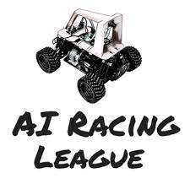
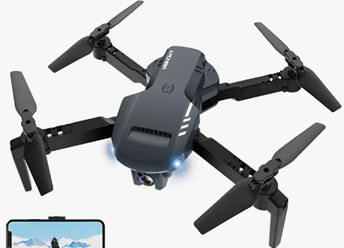
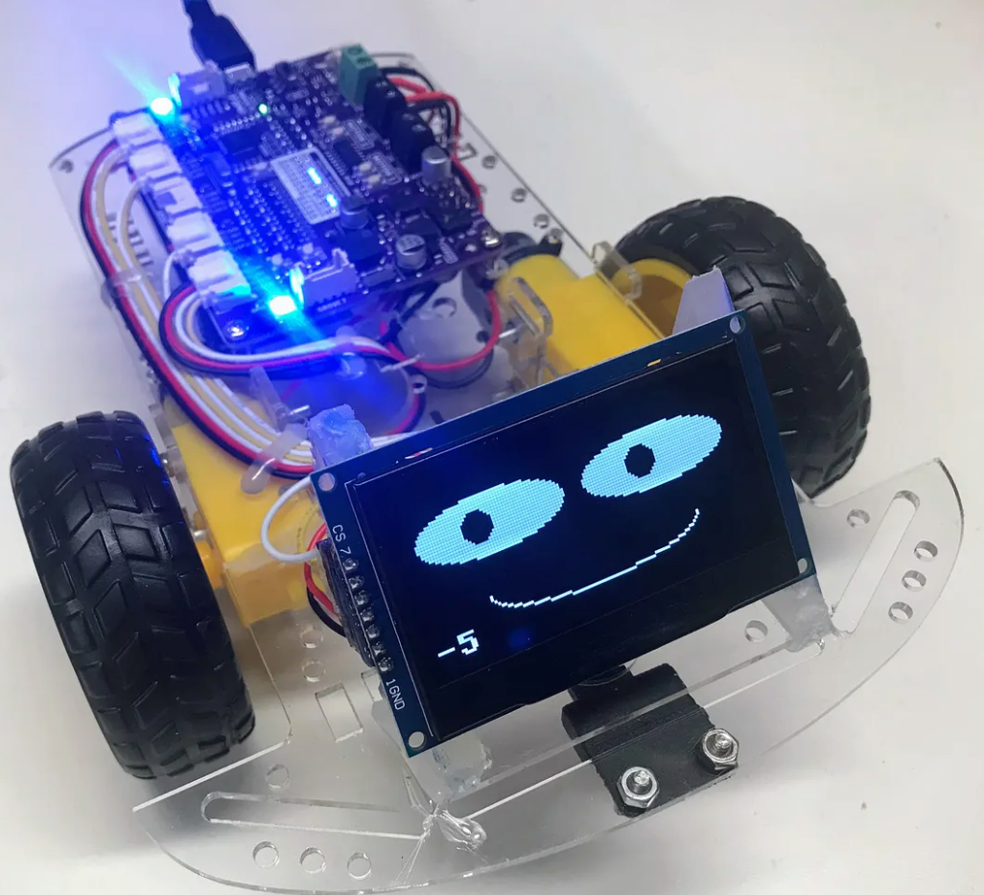

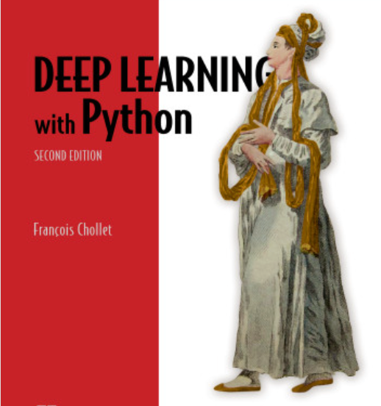
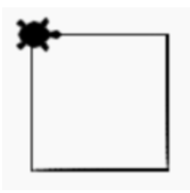
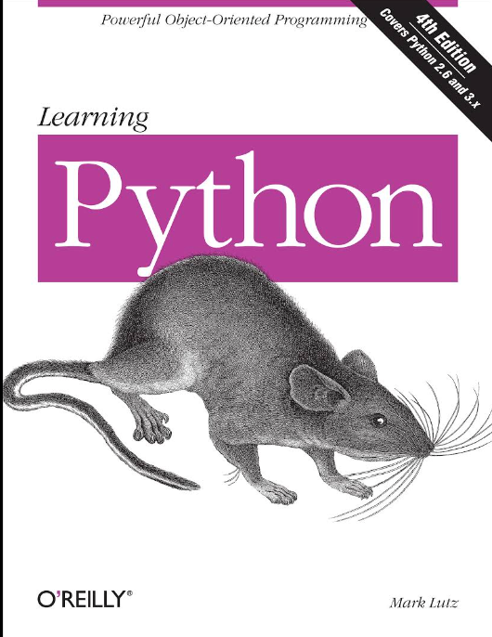
More Fun, Relevant, Cost Effective
Fun
Drone
RC Car
Python Robot
($19 to $40)
Mark Lutz
Business Relevant
Python, Data Literacy, Machine Learning

