Slide 1
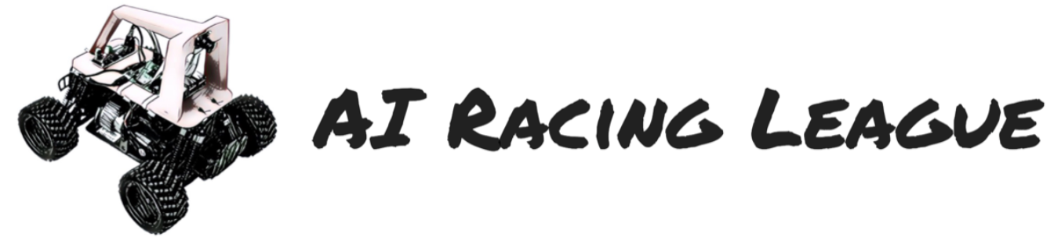
AI Racing League Journey Map
Dan McCreary

Slide 2
3x2 ratio
Setup
Calibration
Drive
Manual
Gather
Images
Transfer Images
To GPU
Build
Model
Transfer
Model
to Car
Drive
Auto

Slide 3
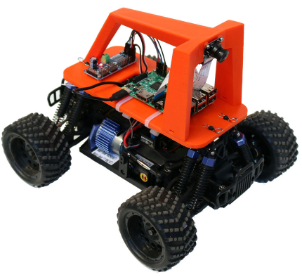
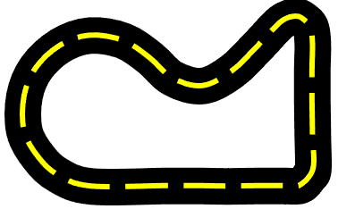
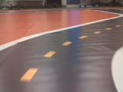
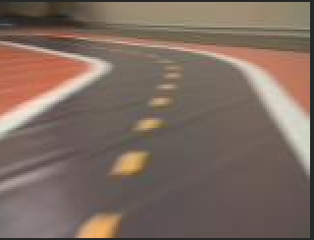
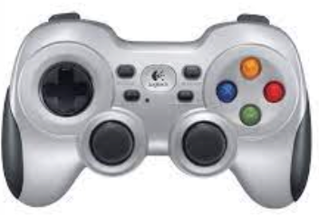
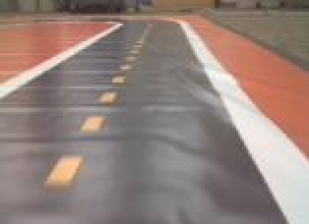
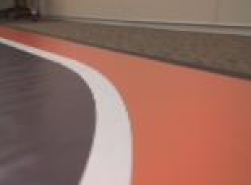
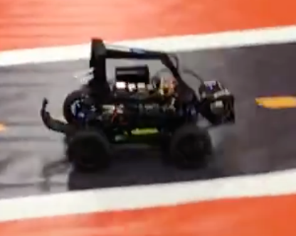
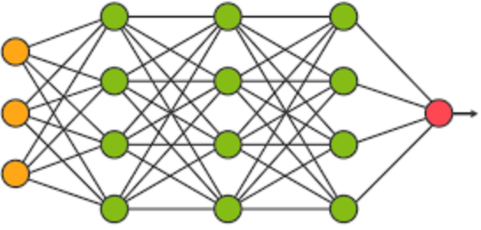
Event Journey Map
Setup
Drive Practice
Gather 20K Images
Calibrate
$ donkey calibrate
STEERING_LEFT_PWM
STEERING_RIGHT_PWM
THROTTLE_FORWARD_PWM
THROTTLE_STOPPED_PWM
THROTTLE_REVERSE_PWM
Car
GPU
GPU
Car
Copy Images to GPU
Build Model on GPU
Copy Model to Car
Auto Drive!

Slide 4
