Slide 1
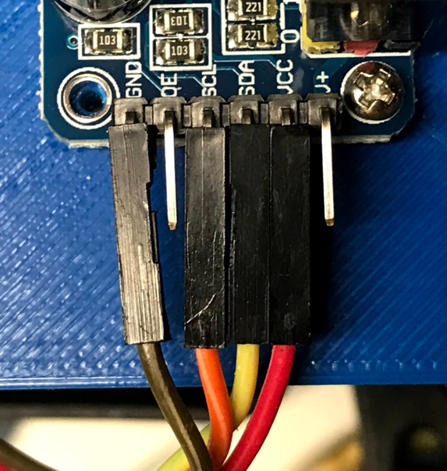
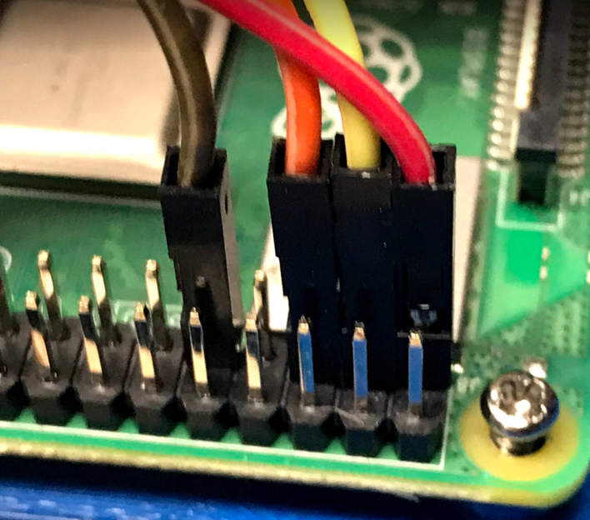
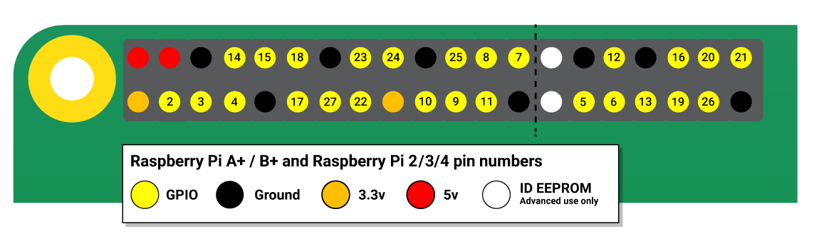
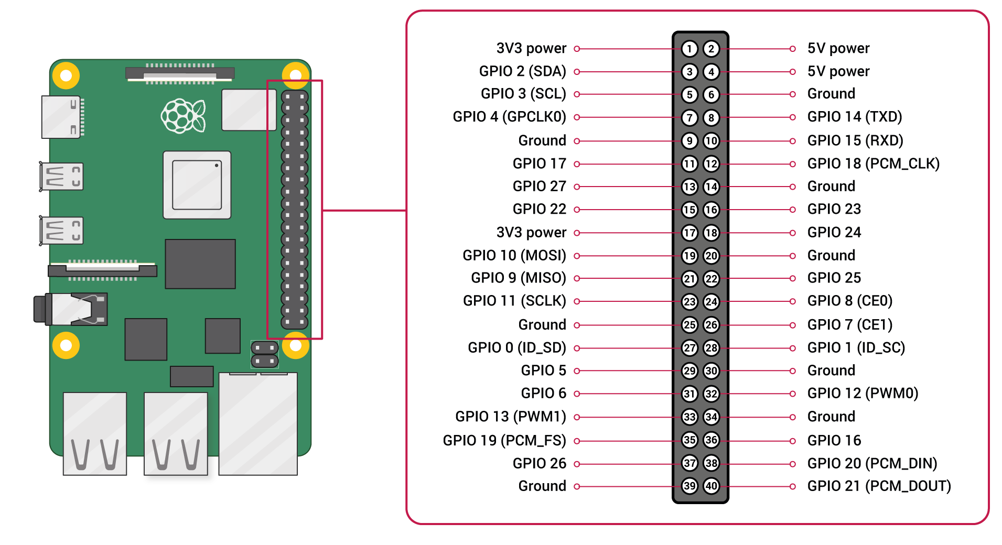
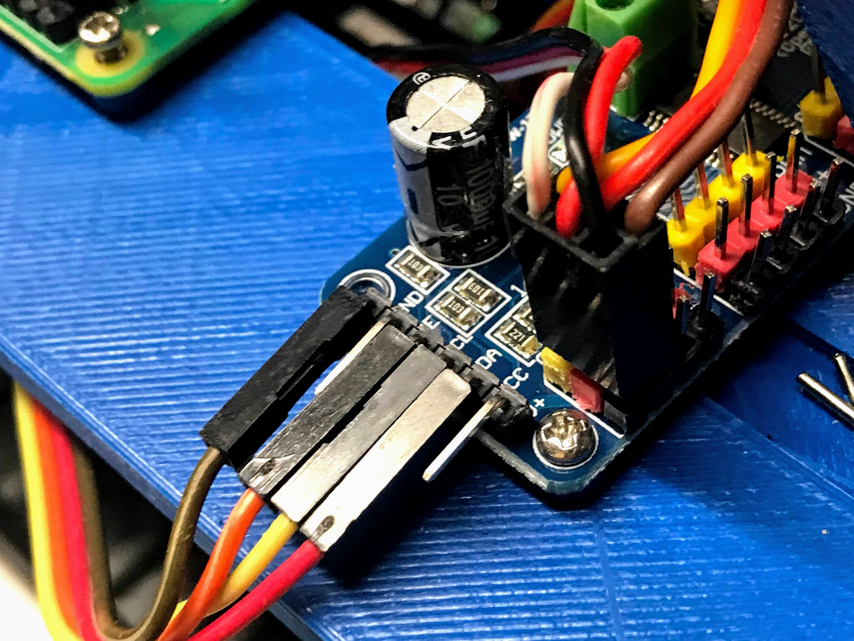
Connecting PWM PCA 9685 Cards
Top Left Corner
GND (black) – from the Pi to the PWM
VCC (red) – +3.3 volts of power from the Pi’s GPIO to the PWM
SDA (yellow) – Data signal from the Pi’s GPIO to the PWM
SCL (orange) – Clock signal from the Pi’s GPIO to the PWM
Tip: look for red LED on the PWM card to verify it is connected
Notes:
https://www.raspberrypi.org/documentation/usage/gpio/

