Slide 1
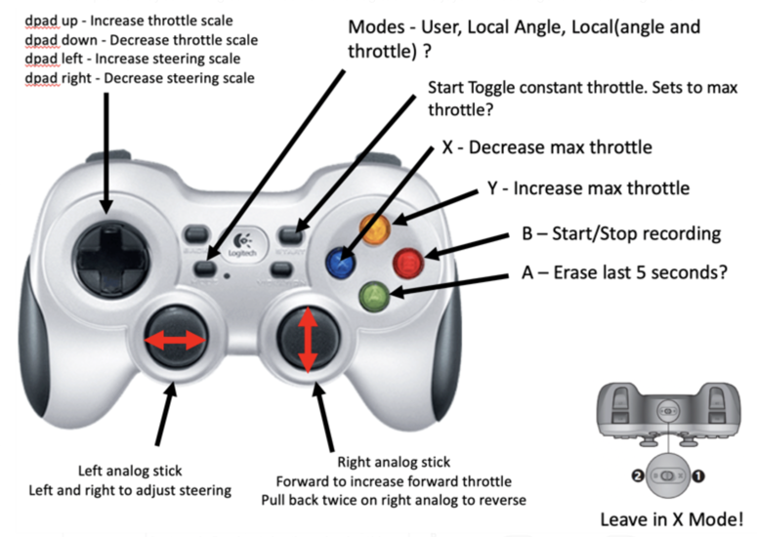
Command Reference Card
Install DonkeyCar Software
$ mkdir project
$ cd project
$ git clone https://github.com/autorope/donkeycar
$ cd donkeycar
$ git checkout master
$ pip install -e .[pi]
$ pip install numpy --upgrade
myconfig.py
STEERING_LEFT_PWM = 450 STEERING_RIGHT_PWM = 260
THROTTLE_FORWARD_PWM = 380 THROTTLE_STOPPED_PWM = 330
THROTTLE_REVERSE_PWM = 280
Calibrate Commands
$ donkey calibrate --channel <your_steering_channel> --bus=1
$ donkey calibrate --channel 0 --bus=1 # default steering
$ donkey calibrate --channel 1 --bus=1 # default throttle
Drive Commands
$ cd ~/mycar
$ python manage.py drive
Web> mycarsip.local:8887
# Joystick
$ python manage.py drive –js
$ ping mycarsip.local
$ ssh mycarsip.local
Train and Drive With Model Command
$ donkey train --tub mytub --model ./models/mypilot.h5
$ python manage.py drive --model ~/mycar/models/mypilot.h5

