Slide 1
Arduino Journey Map

Slide 2

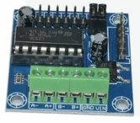
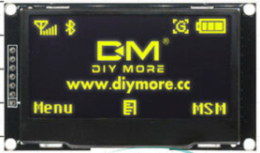
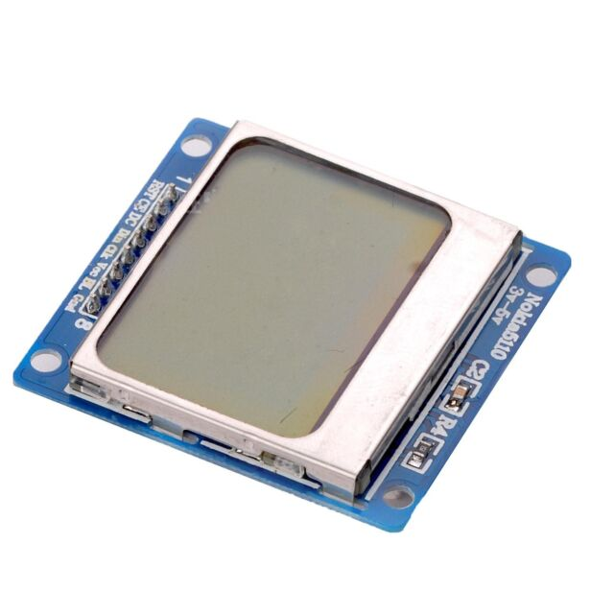
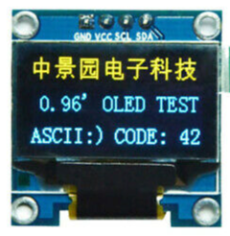
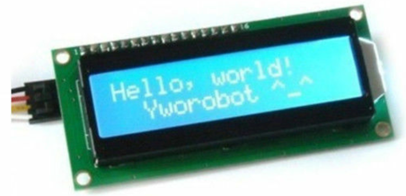

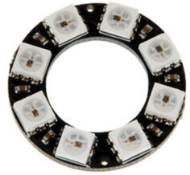
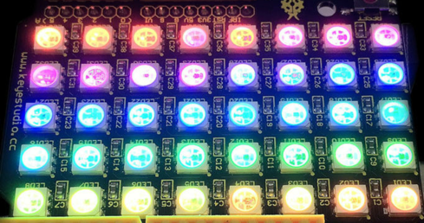
Getting Started
Debouce
Blink
Three
LEDs
RGB
LED
Pot
Button
Ping
Photo
Sensor
Temp
Sensor
Servo
Display Land
Robot Land
Motor
LCD
Nokia
5110
OLED
L293C
NeoPixel Land

