Slide 1
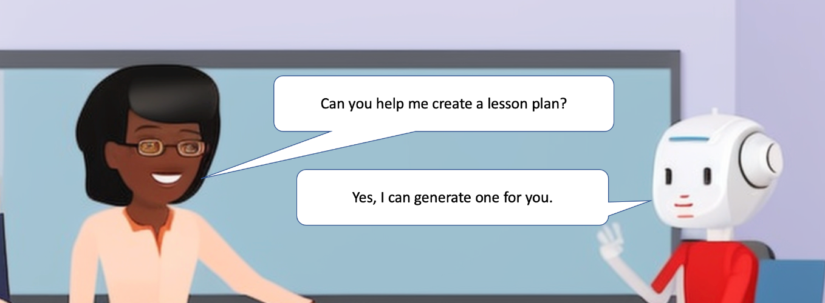
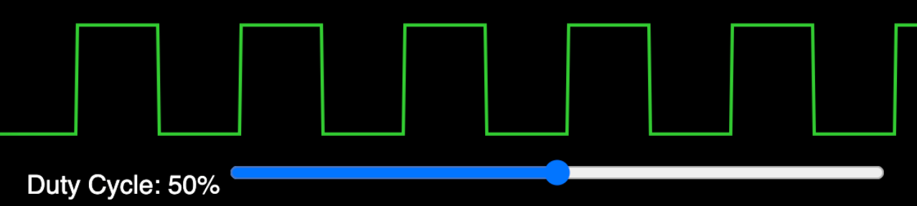
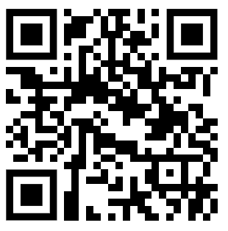
Generative AI For Teachers
Generate:
Class outlines
Classroom code of conduct
Lesson plans customized to individuals
Websites
Lesson plan creating commons licenses
Simulations
Trigonometry
Physics
Biology
Electronics
Motors
Robots
Interactive applications
Data science labs
Sample datasets
Letters to parents or administrators
Make Teaching Fun!
http://www.coderdojotc.org/chatgpt-for-teachers/

