Slide 1
Generative Art
Two Hour Course

Slide 2
Agenda
Introduction – 10 minutes
Disclaimer: NSFW images may be generated
Hands On – 30 minutes
Dall-E-2
Midjourney
Spatial Diffusion
Discussion
Breakouts:
Technical, Artistic, Business, Other

Slide 3
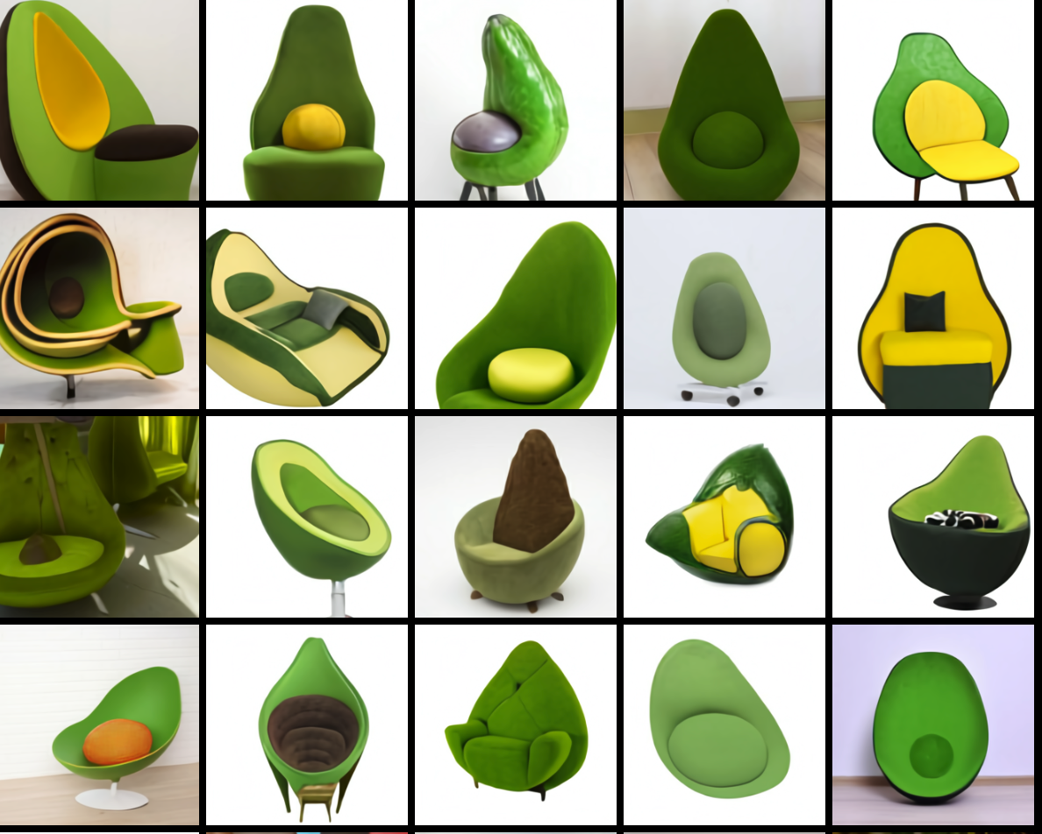
The Avocado Chair January 2021
https://openai.com/blog/dall-e/

Slide 4
DALL-E
DALL·E is a 12-billion parameter version of GPT-3 trained to generate images from text descriptions, using a dataset of text–image pairs. We’ve found that it has a diverse set of capabilities, including creating anthropomorphized versions of animals and objects, combining unrelated concepts in plausible ways, rendering text, and applying transformations to existing images.

Slide 5
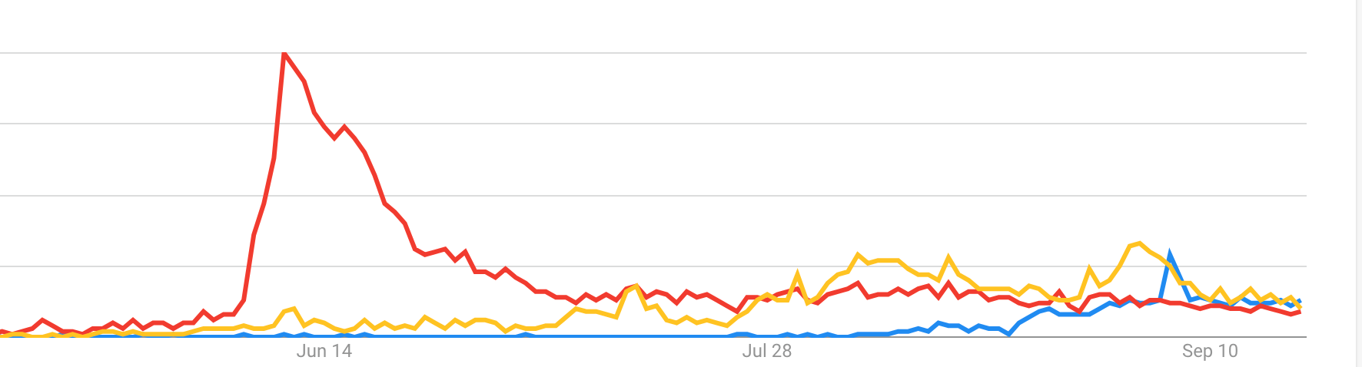
2022 - The Summer of Generative Art
DALL-E
Midjourney
Spatial Diffusion
Google Trends for: DALL-E, Midjourney, Spatial Diffusion

Slide 6
Terminology
Prompt Engineering
Image Classification
Cat or Dog
Safe or Not Safe
Style Transfer
Inpainting
Outpainting

Slide 7
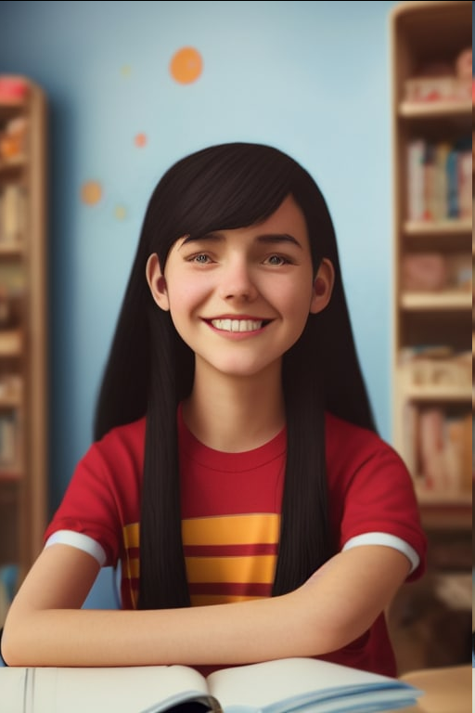
No Hands

