Slide 1
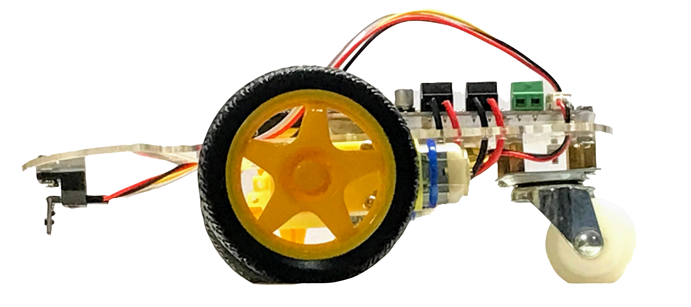
Time of Flight Sensor Vertical Angle Alignment
3° upward angle
Correct Angle
Angle Too Low
Adjusting the Time-of-Flight Sensor

