Slide 1
CoderDojo Robot Figures

Slide 2
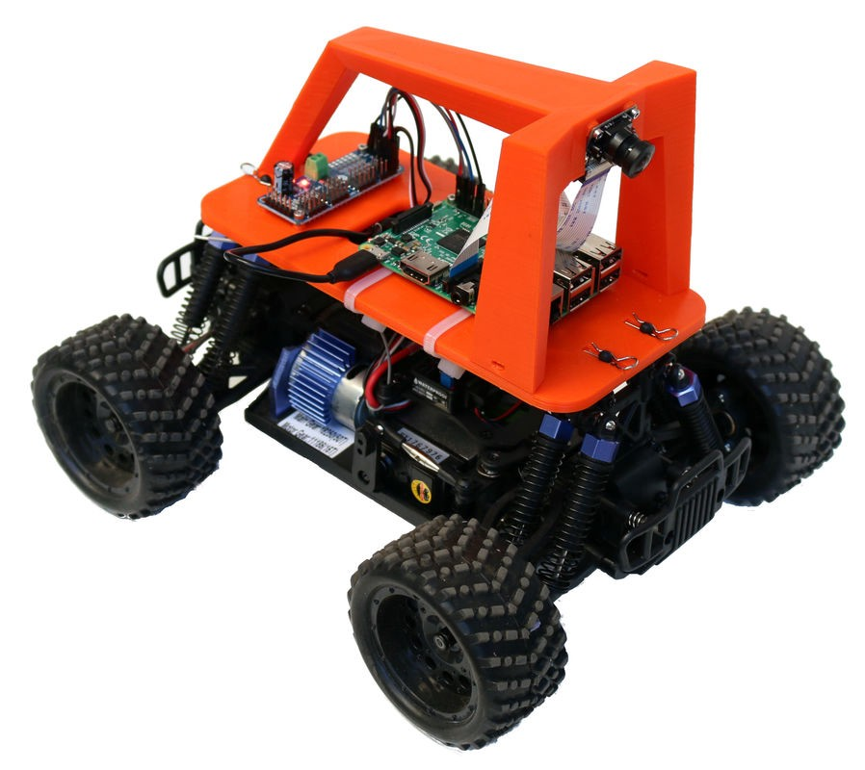

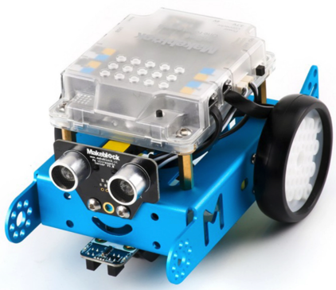
CoderDojo Robots Journey Map
AI Racine League
Custom Bot
Linux
UNIX Shell
Tune Parameters Quickly
Cameras
Computer Vision
Adjusta Bot
DonkeyCar
Machine Learning
Buttons, Encoders
RC Cars
GPUs
Fancy Color Labs
Rainbow Bot
Display Bot
Servo Bot
Blu Bot
IR Bot
LEDs
OLED, Speaker
Servo
Bluetooth
Wireless Labs
Keyboard Skills Wall
Base Bot ($25)
Collision Avoidance
Python Drive Functions
Scratch Block
Programming
Batteries and Power
Distance Sensors
Breadboards and Jumpers
PWM
Motor Drivers
mBot ($65)
Python Programming

Slide 3
Pico Robot Parts List
Part Name | Description | Price
Smart Car Chassis | Includes two 1:48 geared DC hobby motors, wheels, body, power switch and 4 AA cell battery pack. It does require soldering four wires to the motors and two to the switch. | $11
Raspberry Pi Pico | 40 pin package with headers. We solder our own headers, but you can also purchase them pre-soldered. | $4
Breadboard | ½ size 400 tie solderless breadboard with power rails (5v and 3.3v) | $2
Time of Flight Distance Sensor | GYUL530K sensor with I2C interface | $4
Motor Driver | L293 C motor driver board with 5-volt voltage regulator. | $2
 | Total: | $23.00

Slide 4
Motor Circuit

Slide 5
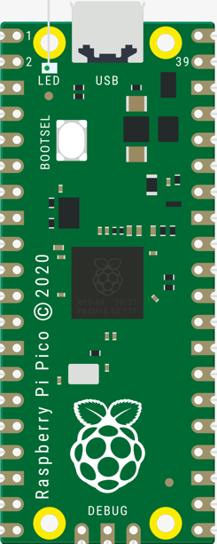
Base Bot Circuit Diagram

Slide 6
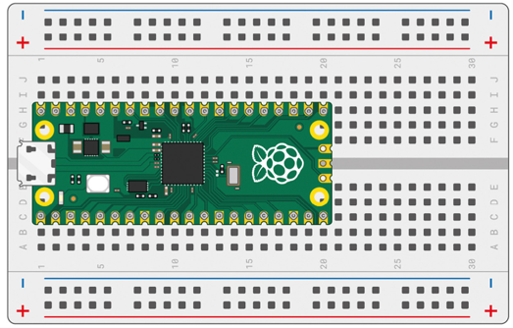

Slide 7
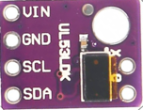
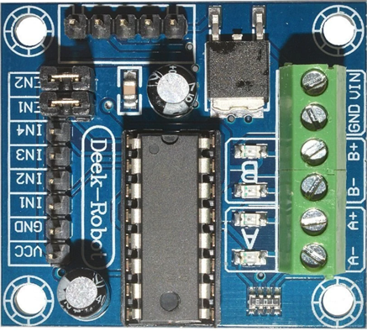
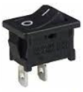
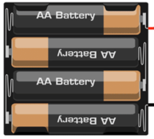
Base Bot Breadboard Connections
VL53L0X Time-of-Flight Sensor
3.3V
VBUS
VSYS
3.3 OUT
6V
Power
Switch
Motor
Motor
I2C0 SCL
L293 Mini 4 Channel
Motor Driver
I2C0 SDA
5V Power Rail

Slide 8
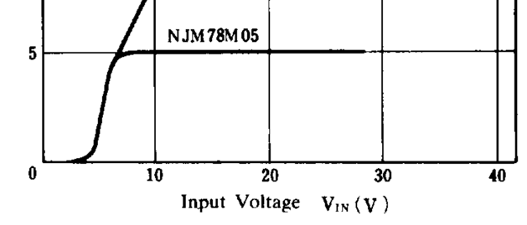
Voltage Regulator Input/Output Curve
http://solarbotics.net/library/datasheets/78M05.pdf

Slide 9
Voltage Curve Close Up
5v
6v
9v
Voltage Curve

Slide 10
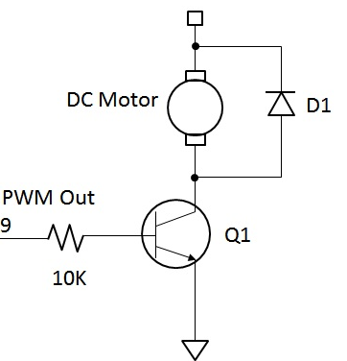
Motor Driver Circuit
Flyback diode to prevent motor from generating current that will destroy the Pico GPIO circuits.
5 Volts
200 milliamps current
NPN Transistor used to
switch the the power to the motor
GND

