Slide 1



Motor Circuit
Motor
Switch
Positive
Ground
Battery
Pack

Slide 2
H-Bridge
Switch 1
Switch 2
Switch 3
Switch 4
GND
GND

Slide 3
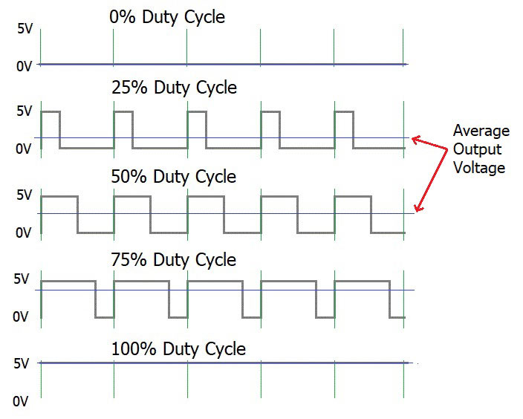
Pulse Width Modulation
Off
Slow
Medium
Fast
Fastest

Slide 4
Motor Controller
Inputs
Outputs
High Power
Motor
Controller
Motor 1
Motor 2
Microcontroller
PWM
High
Power
Low Power
PWM Signals

Slide 5
Microcontroller
Inputs
Digital Outputs
Microcontroller
Digital
Program
Analog
Data
(RAM)

