Slide 1
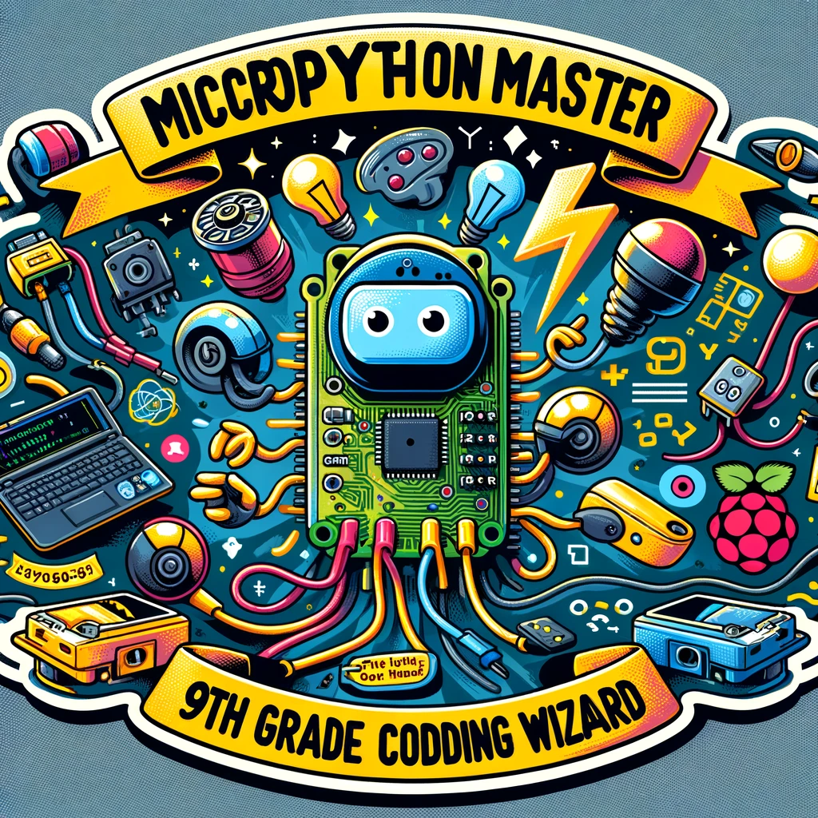
MicroPython Master
9th Grade Coding Wizard

