Slide 1
CoderDojo Robot Figures

Slide 2
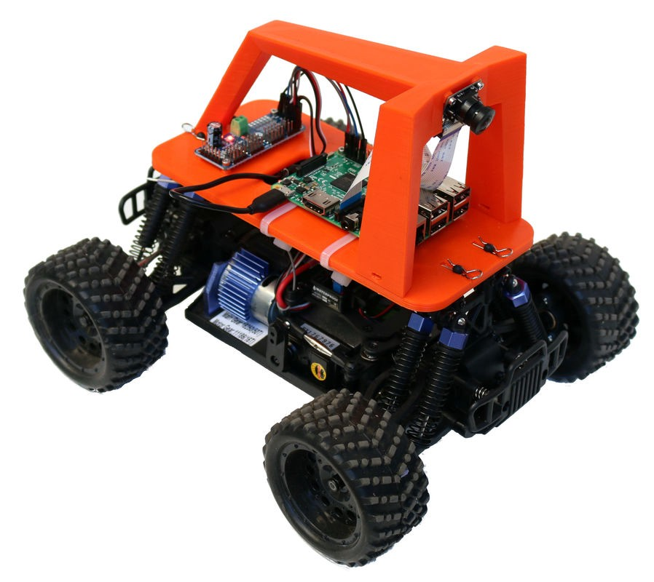

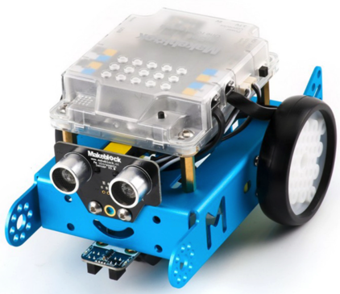
CoderDojo Robots Journey Map
Custom Bot
Param Bot
DonkeyCar
Rainbow Bot
Display Bot
Servo Bot
Blu Bot
OLED
Keyboard Skills Wall
Base Bot
Scratch Block
Programming
Collision Avoidance
Sensor
Motor Drivers
PWM
mBot ($65)
Python
Programming

