Slide 1
MicroPython Figures

Slide 2
Sensors
Microcontroller
Output Controls

Slide 3
Distance Sensor
Motor
Light Sensor
Raspberry Pi
Pico
Servo
Motion Sensor
LED
Sound Sensor
Display

Slide 4
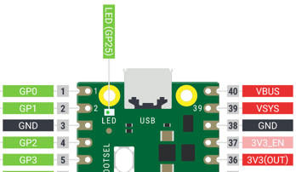
SDA
VCC
SCL
GND

