Slide 1
MicroPython Lessons General Figures

Slide 2

myCallbackFunction():
led.toggle()
Timer Object

Slide 3
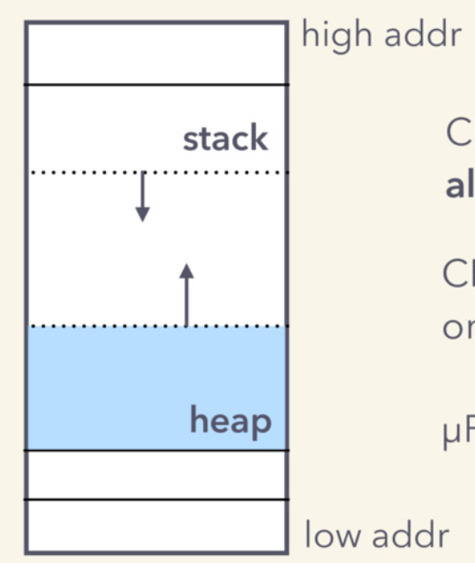
Heap and Stack
00000:
00400:
00800:
00c00:
01000:
01400:
Low address space
initialization
heap
stack
2ec000:
High address space

Slide 4
15 (1,0)
16 (2,7)
31 (2,7)
IN
0 (0,0)
Address i to (x, y) Map Function
Even rows: i = x*ROWS + y
Odd rows i = (x+1)*ROWS - y - 1
7 (0,7)
8 (1,7)
23 (2,7)
24 (3,7)
order

Slide 5
Fun and Cost
Fun
High Value
Low Value
Cost
$10
$100
$1,000

