Slide 1



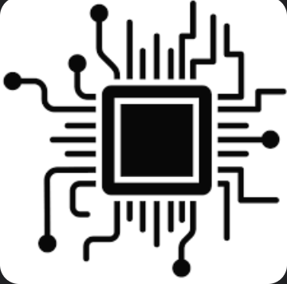

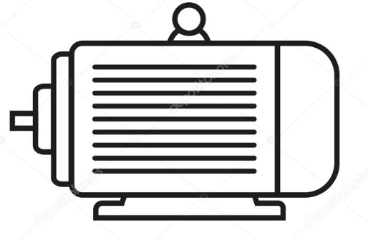


We
Robots!
Microcontroller
LEDs
Sensors
Displays
Motors
https://www.codesavvy.org/

