Slide 1
CoderDojo Robot Figures

Slide 2
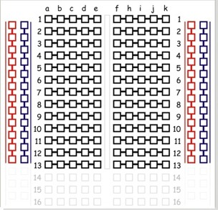
Breadboard Regions
Power Rail
Columns
(Bus Strips)
Red for +5 V
Blue (Black) for GND
numbered rows run across
(horizontal center connections)
Red column for 3.3 V
side columns share ground
and power
(vertical edge connections)
Iinternal row connectors
component slot (center trough)

Slide 3
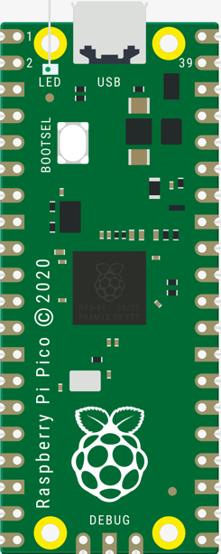
Base Bot Circuit Diagram

Slide 4
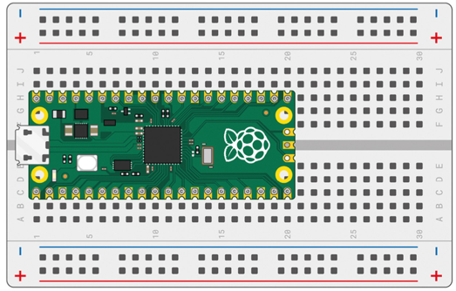
Pico on Breadboard

Slide 5
Pico on Breadboard with GND Markers

Slide 6
Wiring Harness
Back of OLED Display
CS
DC
RES
SDA
SCL
VCC
GND

Slide 7
Pico with GND and Power
VBUS
VSYS
GND
GND
3.3 OUT
GND
GND
5V Rail
3.3V Rail
GND
GND
GND
GND
Incoming 5V

Slide 8
Button Connections
3.3 OUT

Slide 9
Noisy Transition
Stable
State
Transition
State
HIGH
Stable
State
LOW
Time
20 msec

Slide 10
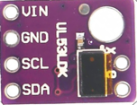
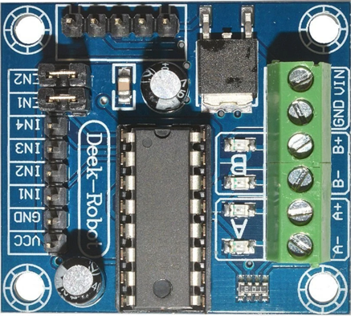
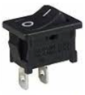
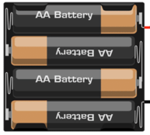
Base Bot Breadboard Connections
VL53L0X Time-of-Flight Sensor
3.3V
VBUS
VSYS
3.3 OUT
6V
Power
Switch
Motor
Motor
I2C0 SCL
L293 Mini 4 Channel
Motor Driver
I2C0 SDA
5V Power Rail

Slide 11
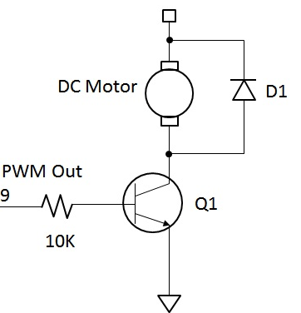
Motor Driver Circuit
Flyback diode to prevent motor from generating current that will destroy the Pico GPIO circuits.
5 Volts
200 milliamps current
NPN Transistor used to
switch the the power to the motor
GND

Slide 12

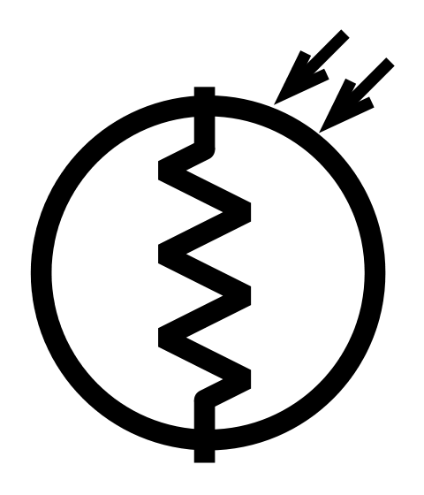
Motor Driver Circuit
ADC_VREF - 3.3 Volts
AGND
10K Resistor
GP26
Photoresistor

Slide 13
H-Bridge
SW 1
SW 2
Motor
SW 3
SW 4

Slide 14
Motor Driver Circuit
3.3 Volts Out
GP22 (pulldown)
Encoder
GP17
(pulldown)
GP16 (pulldown)

