Slide 1
MicroPython Figures

Slide 2
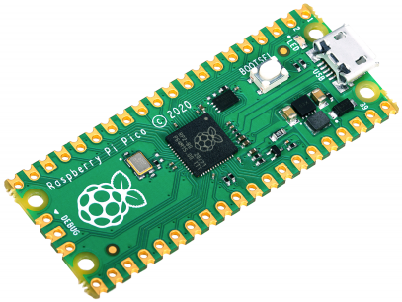
$4 list price
264K RAM
26 3.3V GPIO Ports
2MByte Flash
BOOTSEL mounts as a file system
Micro USB B (built in USB controller)
3 12-bit analog to digital pins
2 × UART, 2 × I2C, 2 × SPI, 16 × PWM channels
1 × Timer with 4 alarms, 1 × Real Time Counter
2 × Programmable IO (PIO) blocks, 8 state machines total

Slide 3
Sensors
Microcontroller
Output Controls

Slide 4
Distance Sensor
Motor
Light Sensor
Raspberry Pi
Pico
Servo
Motion Sensor
LED
Sound Sensor
Display

Slide 5
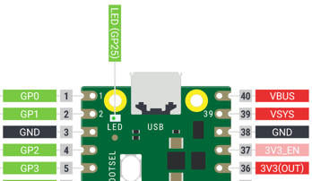
SDA
VCC
SCL
GND

Slide 6
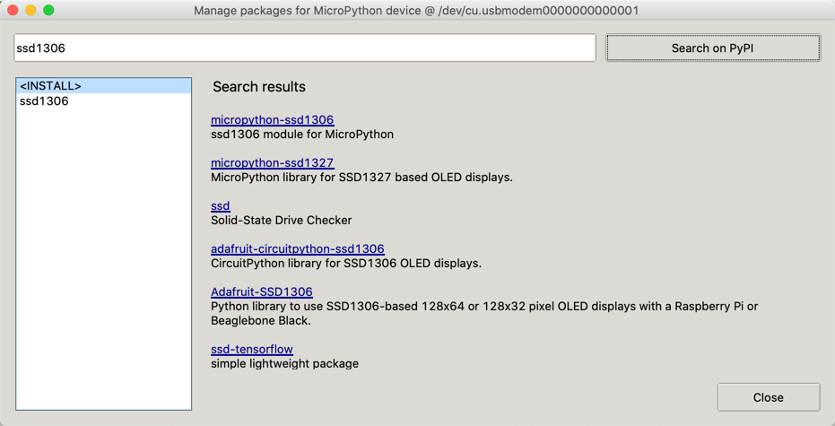
Search for ssd1306
Click this line

Slide 7


Slide 8
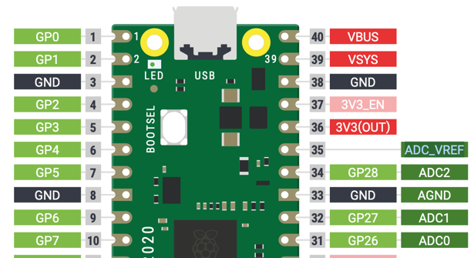
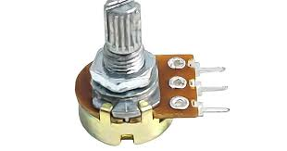
Potentiometer Connections
10K Ohm Linear Potentiometer

Slide 9
SSH1306 SPI Connections
Breadboard row number
CS
GND
SCK
VCC
SDA
DC
RES
spi_sck=machine.Pin(2)
spi_tx=machine.Pin(3)
spi=machine.SPI(0,baudrate=100000,sck=spi_sck, mosi=spi_tx)
CS = machine.Pin(1)
DC = machine.Pin(4)
RES = machine.Pin(5)
oled = ssd1306.SSD1306_SPI(128, 64, spi, DC, RES, CS)

