Slide 1

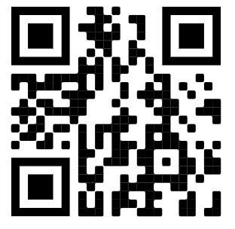

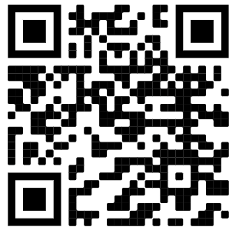
CoderDojo Twin Cities

Slide 2

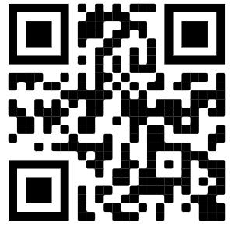



https://www.codesavvy.org/
CoderDojo Twin Cities
Coding Clubs

Slide 3
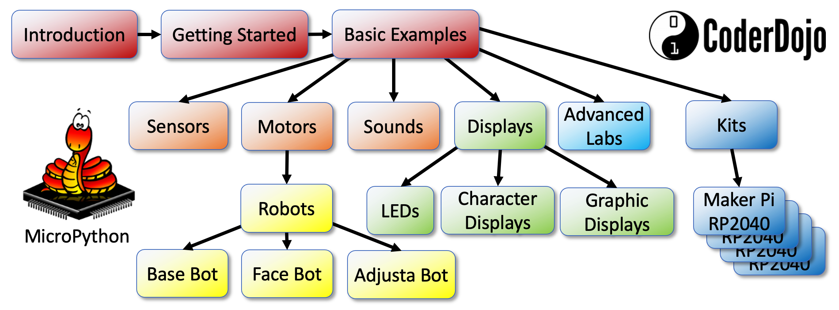
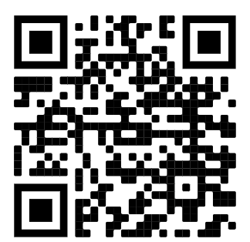
MicroPython STEM Lessons
Over 120 lessons on using MicroPython to build fun projects
Lessons licensed with creative commons for free use in your classrooms (CC BY-NC-SA 3.0)
Based on the low cost $4 Raspberry Pi Pico
Hundreds of Lessons for $20 robots
Written by engineers, tested by teachers in the classroom
Over 10 new wireless labs based on the Pico “W”
https://www.coderdojotc.org/micropython/

Slide 4
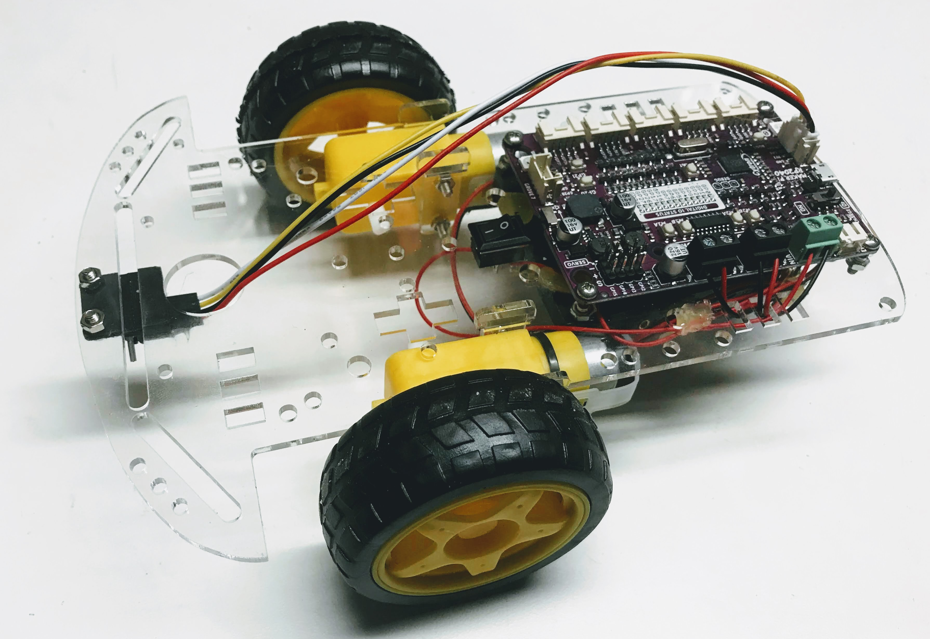
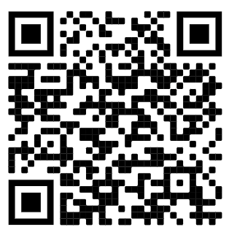
$20 MicroPython Robot Kit
Based on low-cost but powerful Raspberry Pi RP2040 microcontroller
Cytron Maker Pi RP2040 controller board
264K of RAM! – plenty of room for complex programs
100s of sample lessons created by professional software engineers
The lessons are to customize to your curriculum
Lessons licensed with creative commons for free use in your classrooms (CC BY-NC-SA 3.0)
No soldering required
Easy to add additional sensors and displays
Works with both ultrasonic and time-of-flight distance sensors

Slide 5
Optum Robot Kit
Optum Robot Kit
Kit Contents:
Kit Contents:
Cytron Maker Pi RP2040 board (includes Grove connectors, screwdriver and feet)
2 Wheel Drive Smart Car Kit: Chassis Main board (acrylic), 2x DC Motors with wires soldered, 2x wheels, and 4x AA battery case.
Ultrasonic distance sensor (HC-SP04P ping sensor)
Ping sensor mount
2x M3 6 mm screws and nuts
4x M3 10 mm screes and nuts
Micro USB cable
Cytron Maker Pi RP2040 board (includes Grove connectors, screwdriver and feet)
2 Wheel Drive Smart Car Kit: Chassis Main board (acrylic), 2x DC Motors with wires soldered, 2x wheels, and 4x AA battery case.
Ultrasonic distance sensor (HC-SP04P ping sensor)
Ping sensor mount
2x M3 6 mm screws and nuts
4x M3 10 mm screes and nuts
Micro USB cable
https://www.coderdojotc.org/micropython/ kits/maker-pi-rp2040-robot/01-intro/
https://www.coderdojotc.org/micropython/ kits/maker-pi-rp2040-robot/01-intro/
Scan QR code
for assembly and
programming
directions:
Scan QR code
for assembly and
programming
directions:
Optum Robot Kit
Optum Robot Kit
Kit Contents:
Kit Contents:
Cytron Maker Pi RP2040 board (includes Grove connectors, screwdriver and feet)
2 Wheel Drive Smart Car Kit: Chassis Main board (acrylic), 2x DC Motors with wires soldered, 2x wheels, and 4x AA battery case.
Ultrasonic distance sensor (HC-SP04P ping sensor)
Ping sensor mount
2x M3 6 mm screws and nuts
4x M3 10 mm screes and nuts
Micro USB cable
Cytron Maker Pi RP2040 board (includes Grove connectors, screwdriver and feet)
2 Wheel Drive Smart Car Kit: Chassis Main board (acrylic), 2x DC Motors with wires soldered, 2x wheels, and 4x AA battery case.
Ultrasonic distance sensor (HC-SP04P ping sensor)
Ping sensor mount
2x M3 6 mm screws and nuts
4x M3 10 mm screes and nuts
Micro USB cable
https://www.coderdojotc.org/micropython/ kits/maker-pi-rp2040-robot/01-intro/
https://www.coderdojotc.org/micropython/ kits/maker-pi-rp2040-robot/01-intro/
Scan QR code
for assembly and
programming
directions:
Scan QR code
for assembly and
programming
directions:

