Slide 1
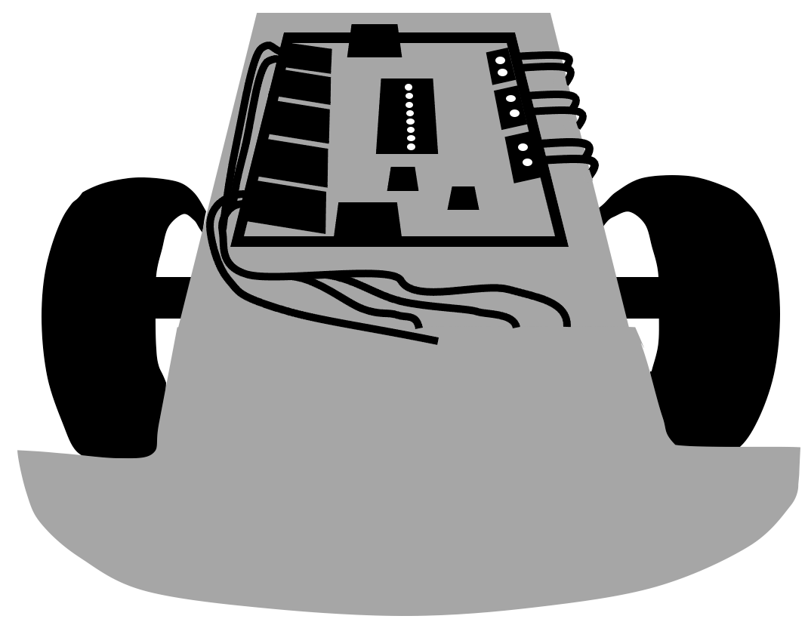
Dodge Nature Preschool
Dodge Nature Preschool
Dodge Nature Preschool
Dodge Nature Preschool
Robot Expert
Robot Expert
Robot Expert
Robot Expert
Dodge Nature Preschool
Dodge Nature Preschool
Dodge Nature Preschool
Dodge Nature Preschool
Robot Expert
Robot Expert
Robot Expert
Robot Expert
Dodge Nature Preschool
Dodge Nature Preschool
Dodge Nature Preschool
Dodge Nature Preschool
Robot Expert
Robot Expert
Robot Expert
Robot Expert
Dodge Nature Preschool
Dodge Nature Preschool
Dodge Nature Preschool
Dodge Nature Preschool
Robot Expert
Robot Expert
Robot Expert
Robot Expert
Dodge Nature Preschool
Dodge Nature Preschool
Dodge Nature Preschool
Dodge Nature Preschool
Robot Expert
Robot Expert
Robot Expert
Robot Expert

