Slide 1

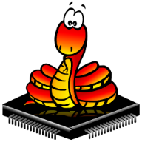
Micropython For Kids Journey Map
Introduction
Getting Started
Basic Examples
Sensors
Motors
Sounds
Displays
Advanced
Labs
Kits
Robots
LEDs
Character
Displays
Graphic
Displays
Maker Pi
RP2040
Maker
RP2040
MicroPython
Maker
RP2040
Maker
RP2040
Base Bot
Face Bot
Adjusta Bot

