Slide 1
Physical Computing

Slide 2

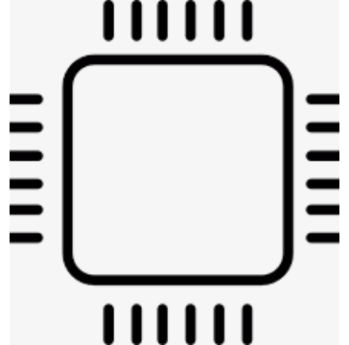
The Real World
Sensor Data (light, sound)
Interactive
Computer
System
Actuators: (displays, motors)

Slide 3
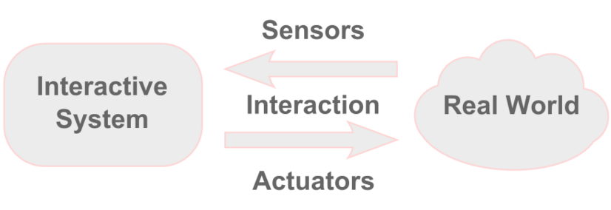
What is Physical Computing?
Physical computing involves interactive systems that can sense and respond to the world around them.

