Slide 1

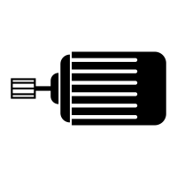
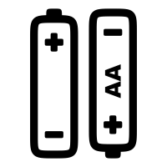
Motor Circuit
Motor
Switch
Positive
Ground
Battery
Pack

Slide 2
H-Bridge
Switch 1
Switch 2
Switch 3
Switch 4
GND
GND

Slide 3
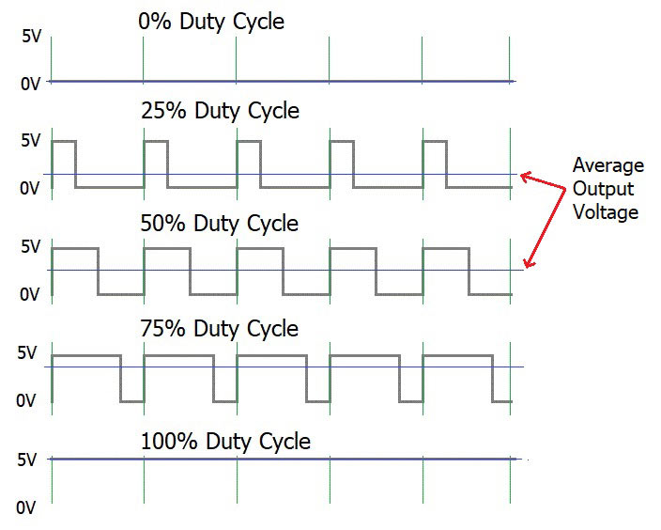
Pulse Width Modulation
Off
Slow
Medium
Fast
Fastest

Slide 4
Motor Controller
Inputs
Outputs
High Power
Motor
Controller
Motor 1
Motor 2
Microcontroller
PWM
High
Power
100 milliamps
Low Power
PWM Signals
1 milliamp

Slide 5
Microcontroller
Inputs (sensors)
Digital Outputs
Microcontroller
LEDs
Digital
Motor
Controller
Program
Speaker
Analog
Data
(RAM)
Display

Slide 6
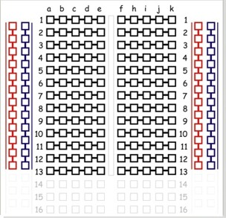
Breadboard
Power Rail
Columns
(Bus Strips)
Red for +5 V
Blue (Black) for GND
numbered rows run across
(horizontal center connections)
Red column for 3.3 V
side columns share ground
and power
(vertical edge connections)
Iinternal row connectors
component slot (center trough)

Slide 7
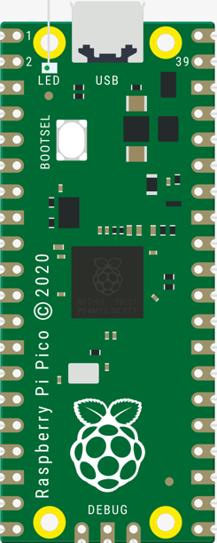
Raspberry Pi Pico
Micro USB Connector
$4.00 at Microcenter in St. Louis Park
264K SRAM (100x Arduino Uno)
2MB flash memory
26 × multi-function digital input or output pins
3 12-bit analogue inputs
16 controllable PWM channels
2 SPI, 2 I2C, and 2 UART channels
Accurate clock and timer on-chip
8 Raspberry Pi Programmable I/O (PIO) state machines
Temperature sensor
Dual core ARM Cortex-M0+ RISC processors
8 × Programmable I/O (PIO) state machines

Slide 8
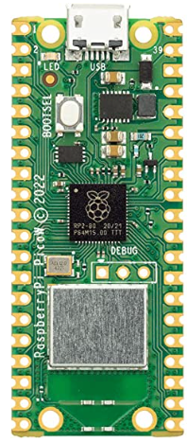
Raspberry Pi Pico W (wireless)
Micro USB Connector
$6.00 at Microcenter in St. Louis Park
All the same features as the Pico plus:
2.4GHz 802.11n wireless LA
Bluetooth will eventually also be supported (libraries missing)
Wireless Chip

Slide 9
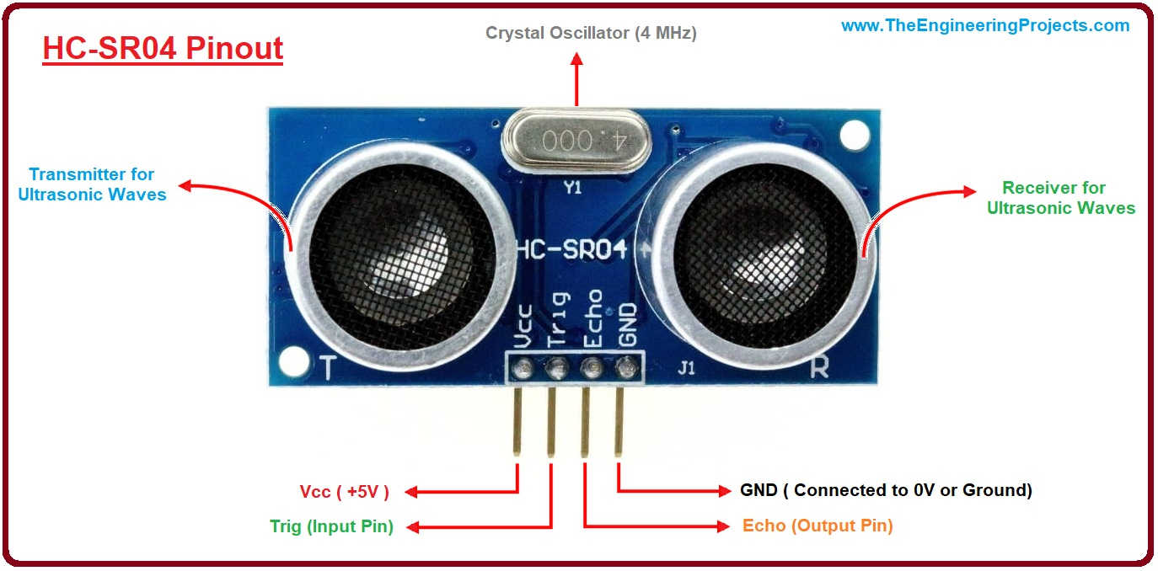
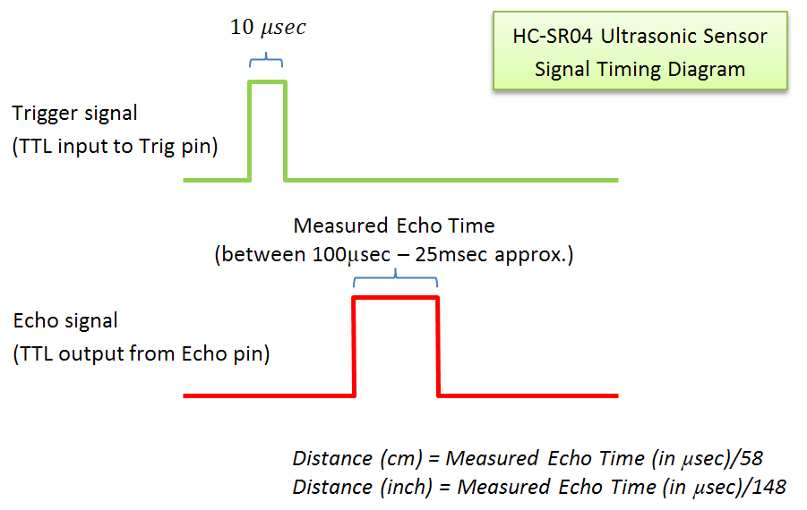
Ultrasonic “Ping” Distance Sensor
HC-SR04 is a low-cost ultrasonic distance sensor that you can find for about $3.00
Uses “echolocation” to measure the time that a sound pulse takes to bounce off an object

Slide 10
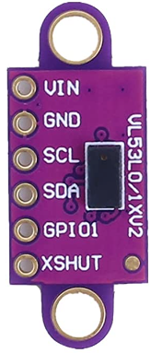
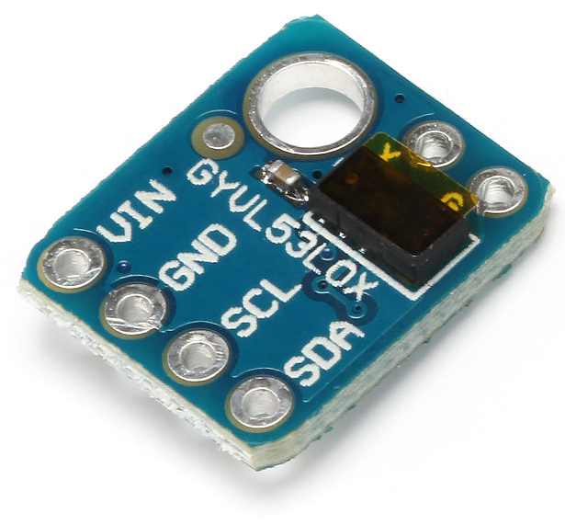
Time-of-Flight Distance Sensor
The VL53L0X is a low-cost ($3.00) time-of-flight sensor sends out a light pulse and measures the time it takes to bounce back
The sensor uses a IIC interface to send distance data to the microcontroller
Light travels about 1 foot every nanosecond so the stopwatch in the sensor must be accurate to the 1/100th of a nanosecond!
Sensor
Emitter
Stopwatch
Receiver
Target
Distance = C * Time
C = 186,000 miles per second
2

Slide 11


Light Sensor Circuit
ADC_VREF - 3.3 Volts
AGND
10K Resistor
GP26
Photoresistor

Slide 12
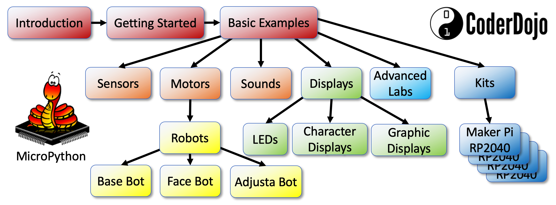

MicroPython
Many robot teaching labs are moving away from C/Arduino to MicroPython
Python is the most popular language in schools and the preferred language for most robotics projects
MicroPython has thousands of drivers and sample code for many devices
https://www.coderdojotc.org/micropython/

Slide 13





https://www.codesavvy.org/
Code Savvy Explorer Clubs (Coder Dojo Twin Cities and Rebecca Coder Dojo)
Coding Clubs

