Slide 1
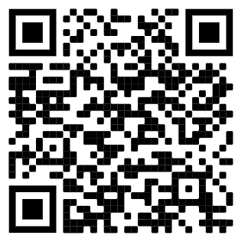
CoderDojo TC Robots Cytron Maker Pi RP2040 Ultrasonic Ping Sensor Version
Kit Contents Checklist
Cytron Maker Pi RP2040
Chassis main board (acrylic)
Ultrasonic ping distance sensor
Ping sensor mount
2x M3 6 mm screws and nuts
4x M3 10 mm screes and nuts
Micro USB cable
4x AA batteries
Getting Started Guide
https://www.coderdojotc.org/micropython/kits/maker-pi-rp2040-robot/01-intro/
Please return to Dan McCreary when done!

