Slide 1
Badge Ideas
Code Savvy Robot Certification Badge

Slide 2
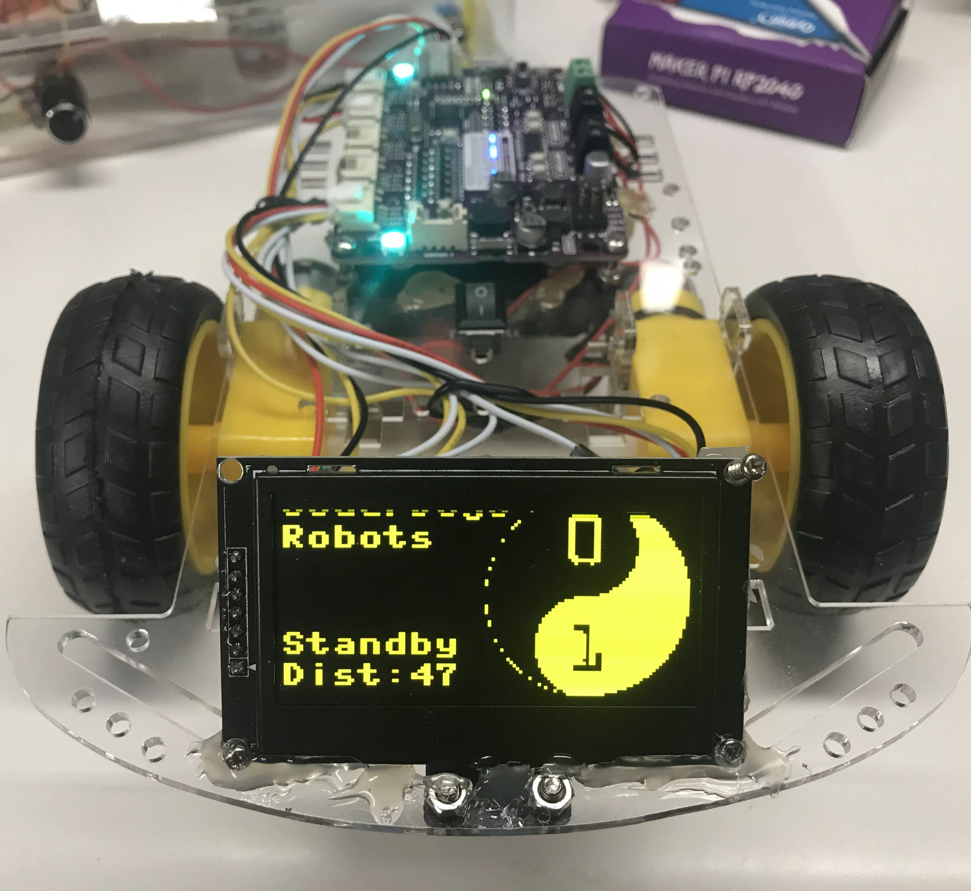
Front View

