Slide 1
Scratch Annotated Figures
These are screen captures off the Scratch site with annotations added in PowerPoint. After we add the annotations, we then do another screen capture and save the images to the $HOME/docs/img folder. We then reference the images using the following relative image Markdown format:
![Image Label](../img/filename.png)

Slide 2
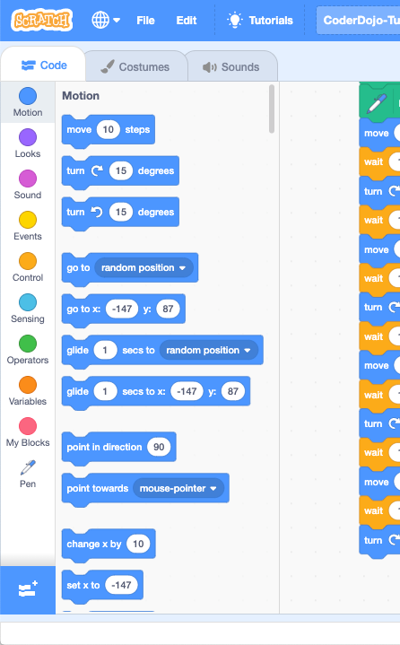
Click
Here For
Extensions

Slide 3
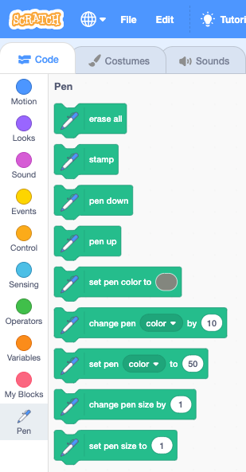
Click
Here For
Pen Blocks

Slide 4
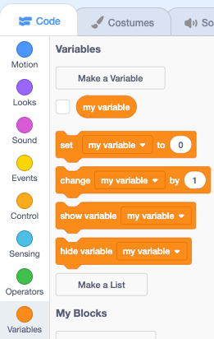
Click Here To
Make A New Variable
Click
Here For
Variables

Slide 5
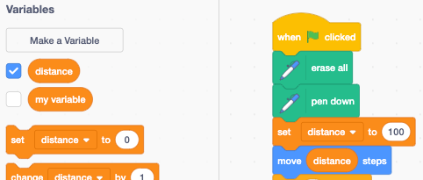

Slide 6
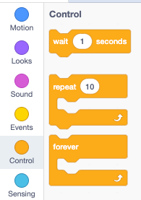
Use the
“repeat” control
and change index
counter to 4
Click
Here For
Controls

