Slide 1
Scratch Figures

Slide 2
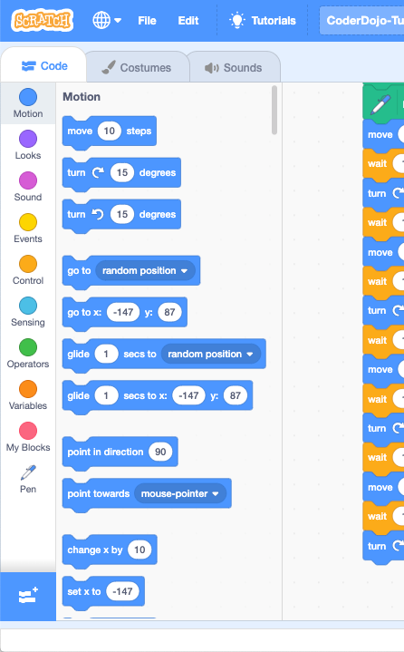
Click
Here For
Extensions

Slide 3
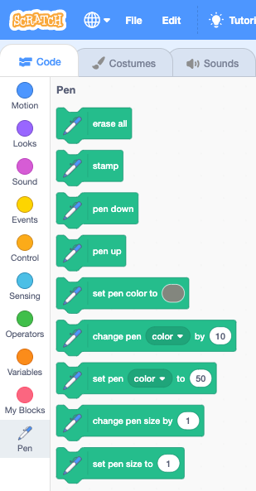
Click
Here For
Pen Blocks

Slide 4
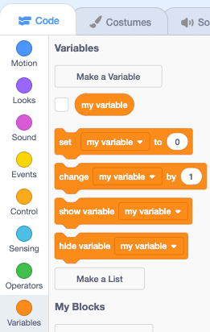
Click
Here For
Variables

