Slide 1

Bitmaker Labs
Program Volunteer Training
Autism Ontario
August 2014

Slide 2
Evening Agenda…
Who I am & why I’m here
Intro to ASD
Understanding and Supporting ASD
Development of Student Profile
Q&A’s
Home Time

Slide 3
Autism Spectrum Disorder
Characteristics appear before age 3
Language delay (most often)
More interested in objects than people
Unusual play with toys and objects, specialized interests / talents
Oversensitive to sounds, sights, textures
Wide range of IQ levels, often higher-functioning than they appear

Slide 4
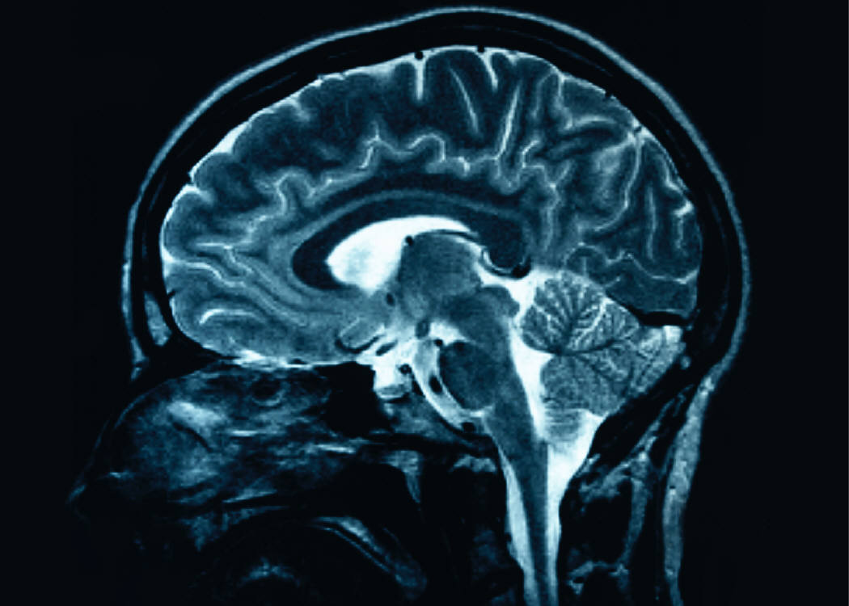
Causes?
The exact cause of autism is not known, however, it is likely influenced by genetics. However, genetics alone do not account for all instances of autism. For good reason, the increasing prevalence of autism has generated great interest in the potential involvement of toxins in our environment.
A Neuro-Developmental disorder
Notes:
Autism risk factors, for example, appear to include such influences as parental age at conception, maternal nutrition, infection during pregnancy and prematurity.
Autism Speaks Environmental Factors in Autism Initiative targets research that can advance our understanding of the environmental influences that increase – or decrease – autism risk. None of these influences appears to “cause” or “prevent” autism by themselves. Rather they appear to influence risk in those genetically predisposed to the disorder.

Slide 5
What is Autism?
No two people experience autism in the same way
Life-long, neurological disorder
ALL individuals with autism have some degree of difficulty in these 3 areas:
    Verbal & non-verbal communication
    Social Interaction
    Behaviour (repetitive or restricted interests / activities)

Slide 6
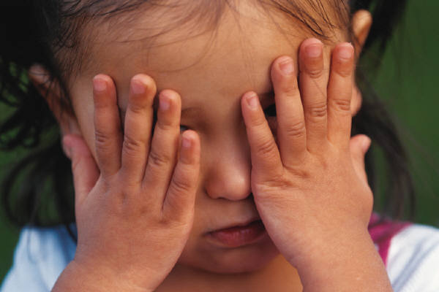
Communication
Notes:
Communication is commonly the first recognized challenge in young children.
Children with Autism or PDD-NOS
Some children do not develop typical language at all and will have to develop an alternative way to communicate such as sign language or pictures exchange.
Some children may develop a few words, but may then stop using them. Some of those children will develop
Some will develop language at a later age than typical children
As their speech develops, they may have a slight difference in the sound of their words, struggle with intonation differentiation, and have difficulty with social communication (see next slide)
Children with PDD-NOS and Asperger’s
Some children will develop speech exactly as typical children would.
Some children will develop speech early or seem to be overly gifted as they will speak in full sentences at a young age.

Slide 7
Communication
Expressive Communication: A means of communicating your wants, needs, thoughts, ideas, beliefs
Receptive Communication: the ability to understand others communication of their wants, needs, thoughts, ideas, beliefs etc.
  An individual with ASD often has difficulty in both areas
  Some individuals may show more significant delays in receptive oral language
  However, difficulties in one area DO NOT necessarily denote deficits in the other

Slide 8
Communication Strategies
Use clear, concise phrases
Use positive instructions/re-direction instead of “no” or “stop”
Break instructions down into smaller steps (i.e. chunking)
Allow extra time for individuals to process the information provided
Get to know the individual, his/her family and anyone else in the support circle
Use a variety of communication methods, especially visual ones
Be consistent in terms of the language and phrasing used
Attend to non-verbal and paraverbal cues (for ALL parties involved)

Slide 9
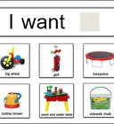
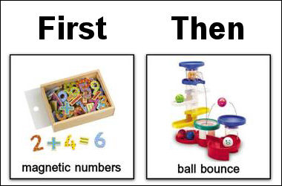
Make it Visual
Most persons with ASD are much better visual than auditory learners, it is strongly recommended that facilitating transitions should be accomplished using visual materials which are paired with clear, concrete, concise verbal instructions.

Slide 10
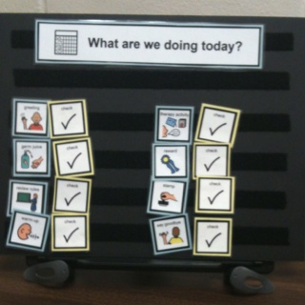
Make it Visual
Social Story about the day? Some participants use social stories to help understand what to expect when coming to new programs.
Day Schedule: Will help with routine, transition and lesson child’s anxiety.

Slide 11
What Can We Do To Help?
LANGUAGE:
Reduce language (words)
Use visual aids
Give the individual time to respond
Use concrete language
Avoid the following;
    Idioms
    Metaphors
    Sarcasm
    Double meanings

Slide 12
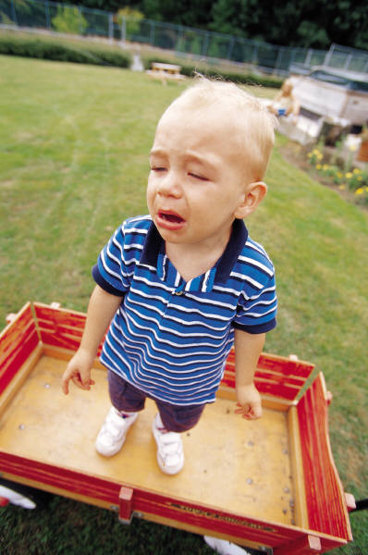
Social Development
Notes:
Social development meaning understanding how to play, interact appropriately with peers, have a polite conversation or know how to respond when in a challenging social situation can all be areas of concern for children with ASD.
Children with Autism or PDD
Some children may use toys in a peculiar manner or not in the way they were designed (ex. spin car wheels instead of rolling on ground)
Some children will struggle with basic interaction skills such as sharing and turn taking
Some children may use an inappropriate behaviour such as hitting to get someone’s attention, as that is what they have learned to be the fastest way to have someone interact with them.
Children with Asperger’s or PDD
Some children will have limited ability to read social cues and non-verbal language (eye rolling, watching the clock, scowling face, etc.)
Some children will struggle with basic skills such as sharing and turn taking, even when their language skills are high enough to make you believe they should know how to.
Some children may use an inappropriate behaviour such as hitting to get someone’s attention, as that is what they have learned to be the fastest way to have someone interact with them.
Some children may struggle to understand socially accepted practices in the community and may appear rude or disrepectful.

Slide 13
What are Social Skills?
Social skills are any skill facilitating interaction and communication with others. Social rules and relations are created, communicated, and changed in verbal and nonverbal ways. The process of learning such skills is called socialization. (wikipedia.org/wiki/Social_skills)
Social skills training (SST) is a form of behavior therapy used by teachers, therapists, and trainers to help persons who have difficulties relating to other people.

Slide 14
What do we mean by Social Skills?
conversational skills (greetings, joining a conversation, verbal turn-taking, listening skills, talking about a particular topic, awareness of personal space, ending a conversation, etc)
play skills (observational skills, joining play, turn-taking, sharing, compromising, conflict resolution, coping with 'no', coping with losing, reciprocal play, ending play, etc)
understanding emotions (reading facial expressions, reading body language, voice quality - intonation, pitch, speed, awareness of own body language, having a large emotional vocabulary eg. not just happy/sad, anger management and self-regulation skills)

Slide 15
…Social Skills cont…
dealing with conflict (as above - anger management and self-regulation skills, theory of mind see section on pg. 7, communication skills such as the ability to ask for help, ability to walk away from a stressful situation, being assertive but not aggressive, dealing with bullying, etc)
friendship skills (many of the above but also things like knowing what a friend is, and being able to choose appropriate friends, recognize true friends from false friends, develop the ability to share a friend, deal with peer pressure, etc).

Slide 16
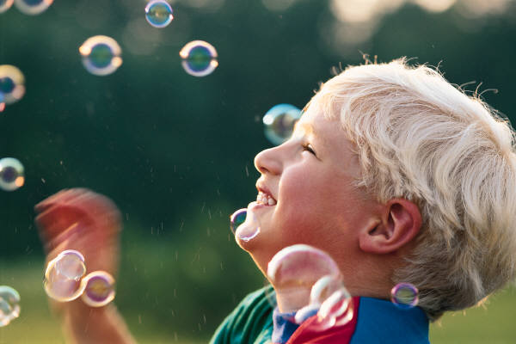
Repetitive Behaviours and/or Restrictive Interest

Slide 17
Repetitive Behaviours and/or Restrictive Interest
For the majority of children on the spectrum, we see an inappropriate repetitiveness of a behaviour or interest.
You may often hear this referred to as “stimming”
Some children with have consistent physical movements (rocking, finger flicking, etc.) or vocalizations (humming, clicking, etc.)
Children may have exaggerated stimming during high emotion times, both postivie and negative.
Sometimes these appear similar and can make it hard to determine if the child is upset or in a great mood.
Some children may have a strong interest in a game, toy, tv show, etc. that they can use/play with for long periods of time without interruption if allowed.
Again the child may turn to the activity during positive and/or negative times of the day.

Slide 18
What Can We Do To Help?
Modify OUR Behaviour…
Focus on what TO DO
Teach appropriate alternatives
Identify motivators
Be consistent
You stay calm and remain objective; don’t take behaviors personally!!!

Slide 19
Other Challenges Commonly Found…
Sensory sensitivities
  Typical: visual, auditory, tactile, etc.
  Also: vestibular and proprioceptive
Motor planning challenges
Anxiety and emotional regulation
Learning needs

Slide 20
Sensory Processing
Have you ever been in a crowded place and suddenly you feel like you can’t take it anymore?
Have you had to wear clothing that was uncomfortable? Too tight? Too itchy? Scratchy tags?
Have you had to turn off your car radio because that song that is playing feels like noise in your brain?
What if you couldn’t get relief from these things? How long do you think you would be able to hold it together?
It is common to mistake sensory challenges for bad behaviour. But how do you know the difference?

Slide 21
I need a volunteer!
Are you brave enough to come on up and show what a clear communicator you are??

Slide 22
Potential Strengths
Memorizing – great long term memory
Understand and use concrete information and great with rules
Using visual information
Learning routines quickly and being motivated by them
Very dedicated to certain subject areas
Take in “chunks” of information and retain it well

Slide 23
Developing a Student Profile
Based on what you have learned, what information do you think is most valuable to understanding and knowing the individuals who you will be working with?
What do you need to know before they arrive to be sure their day is as smooth and successful as possible?

Slide 24

Questions?

Slide 25
Need more information?
Thank you for your interest and passion towards individuals with ASD! Your contribution matters!
www.autismontario.com
416-246-9592
shona@autismontario.com
905-713-6191 / 416-246-9592 x236

