Slide 1
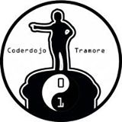

Beginning

Slide 2
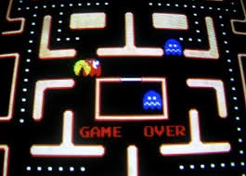
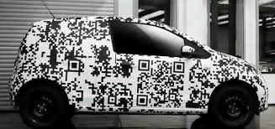
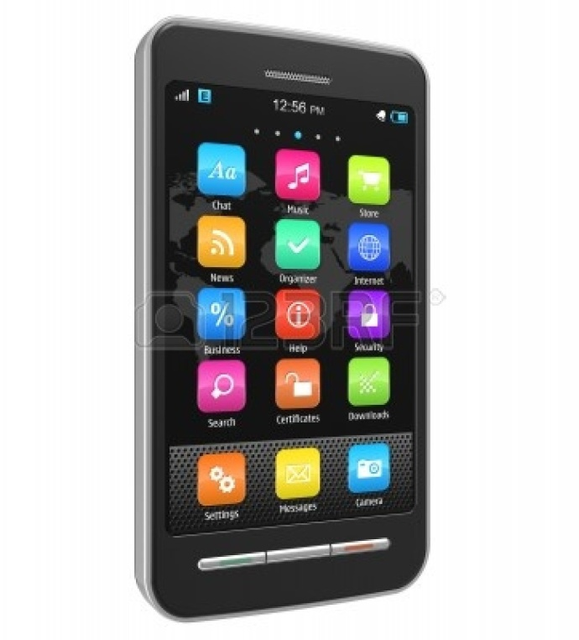

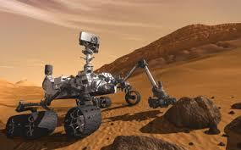
Why code...
Code is fun! Code is everywhere...
Notes:
Why are we here at Coderdojo. 1. To learn how to code. To have fun.
Coding is fun. You get to make machines do cool things.
Mobile Apps –
Computer games – any of ye have Xbox or Wii? We’ll make one today
Nasa Mars Explorer – needs software and coders to make it work – (a bit like Robot game from last week).
Cars – all cars, from my car to F1 fararri, need code to work.
web sites and applications like facebook...
<number>

Slide 3

Plan for Today
Use a new programming language...
Use an IDE (Integrated Development Environment)
Remembering things in Python (Memory and naming)
Computer arithmetic (Maths)
Using python libraries
Be Cool.
Notes:
There’s lots of them. They let you give the computer instructions/tell it what to do. Remember the robot game we played in the last few weeks
Computers have their own language called binary. Programming languages, like scratch, make it easier for us to create cool programmes.
<number>

Slide 4

“Above all, be cool...”
Coders need to stay in the “coding zone”
We’ll take a break at 5ish.
Don’t leave without telling a mentor
Help each other.
Ask lots of questions.
Concentrate…
Share your code!!!
Notes:
<number>

Slide 5
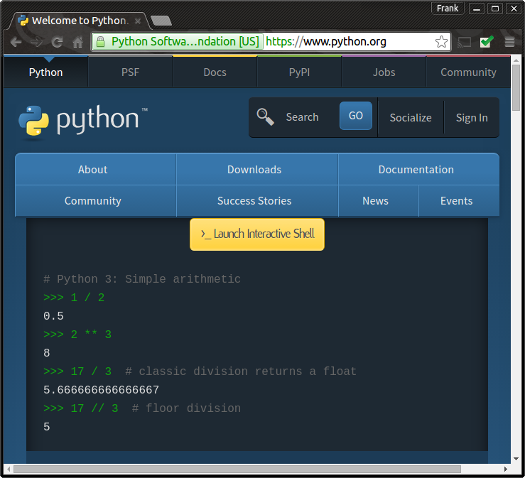
Step 1: Install Python
You need to download Python to you laptop.
Open an Internet Browser and type this address into the Address Field:
https://www.python.org/
The mentors can help you with this…

Slide 6
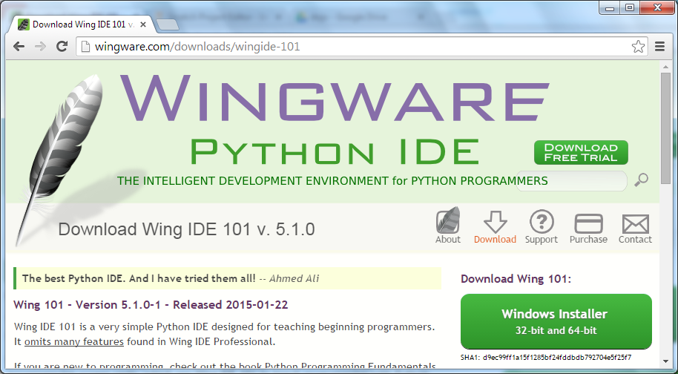
Step 2: Get Wings
In your Internet Browser, type this address into the Address Field:
http://wingware.com/downloads/wingide-101
Click on “Installer” button
You may need help from a mentor for this…

Slide 7
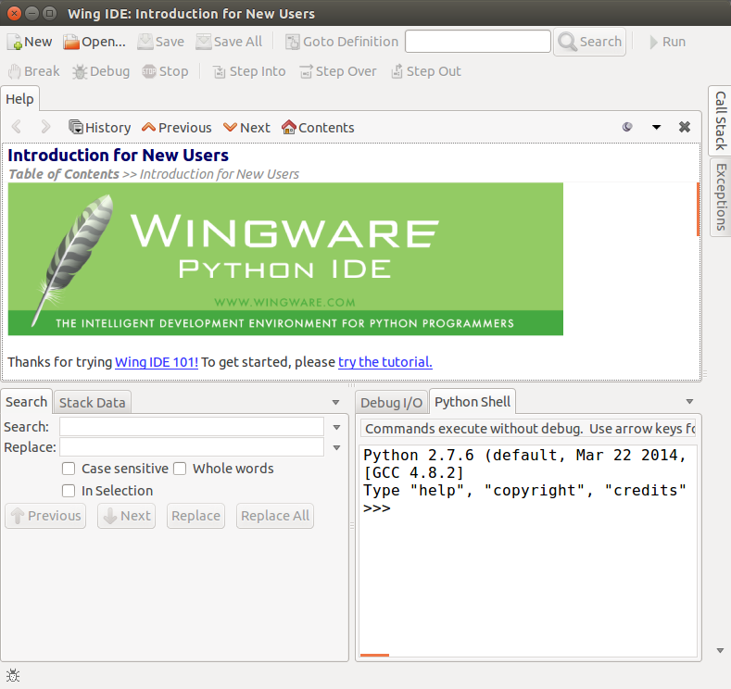
Step 3: Find the Python Shell
Find the “Python Shell” in Wings. The Python Shell allows us to start coding with python straight away...

Slide 8

Step 4: Remembering things
Python can remember things, so let's tell it to remember our secret word.
Type the following into the Python Shell
>>> secret = 'crocodile‘
>>>
Now tell Python to print something by using the “print” command:
>>> print(secret)
crocodile
>>>
Python will remember the secret until you quit Wings. So you can always go back and print your secret again by saying "print secret.”
Now try to print something Python doesn't know:
>>> print(number)
Traceback (most recent call last):
File "", line 1, in
NameError: name 'number' is not defined
>>>
Python didn't know what number was. Try the following code to “tell” Python what number is.
>>> number = 43
>>> print(number)
43
>>>
In Scratch, this is the same as :

Slide 9

Step 5: Python Calculator
Your computer is better than any calculator at doing maths. Try the following in the Python Shell
>>> print(2+33)
35
>>> print(33333333 * 44444444)
1481481451851852
>>> n=123456789
>>> print(n*n*n)
1881676371789154860897069
>>>
Multiplication and division are done using the * and / symbol.
Now use the shell to find the answer to 254 * 341?…
In Scratch…

Slide 10
Step 6: Python Functions - random
Python has lots of functions help you write programs
Let's tell Python to pick a random number. Get the "random" library by typing this:
>>> import random
Now we can say "random.randint(1,100)" to pick a random number from 1 to 100.
>>> random.randint(1,100)
45
>>>
Which random number did you get???

Slide 11
Step 7: Python Functions – len and str
Coders often call words “strings”.
The “len” function will count how many letters are in a word. Try the following:
>>> len(secret)
9
This means that there is 9 letters in the word “crocodile”. Remember we used secret to remember the word crocodile

Slide 12
Step 8: Words and Numbers
What happens when you try to use words in maths? Try the this:
>>> print('red' + 'yellow')
redyellow
>>> print('red' * 3)
redredred
>>> print('red' + 3)
Traceback (most recent call last):
File "", line 1, in
TypeError: cannot concatenate 'str' and 'int' objects
>>>
A word that you put in quotes is just a string of letters called a "str" in python.
Numbers that don't have a decimal point are integers and are called "int" in python.
You can't add a str and an int. But you can turn a number into a string if you use the str() function. Try this:
>>>print 'red' + str(3)
red3
If you add two words, it sticks them together
If you multiply a word by 3, it makes three copies
Python doesn't know how to add a word and a number!!
Notes:
<number>

Slide 13

Step 9: Repeating Things
Remember this in Scratch:
In Python, we can repeat things using a “for” command.
If you say "for something in something:" with a colon (:) at the end, python will look for any indented lines afterwards and repeat them. Try this:
>>> for letter in secret:
... print(letter)
...
c
r
o
c
o
d
i
l
e
It is saying "for every letter in the secret, do this next thing." The computer repeats "print letter" nine times, once for each letter in ‘crocodile’.
This can be tricky. If it doesn’t work try again or ask a mentor for help.

Slide 14
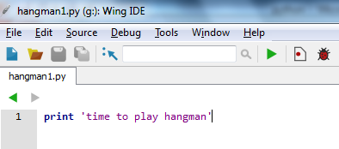
Step 10: Create a Program
Now we will start to use python to make a game of hangman.
A python program is just a file with code in it. Let's make one.
In Wings, go to File -> New
Now type in the following into the Editor and Save the file with the name “hangman1.py" on your desktop.
To run your program, click on the Run button. You should see ‘time to play hangman’ appear in you shell. Put some other lines of code in and run it. Next week we’ll continue to code Hangman…

