Slide 1

MatterMind
MVP selection
Read-only active-matter
status reconstruction
Product decision based on five discovery interviews
Notes:
Source: MatterMind discovery interviews 001–005 and docs/mvp/mvp-selection.md. Illustration generated for this fictional portfolio project.

Slide 2
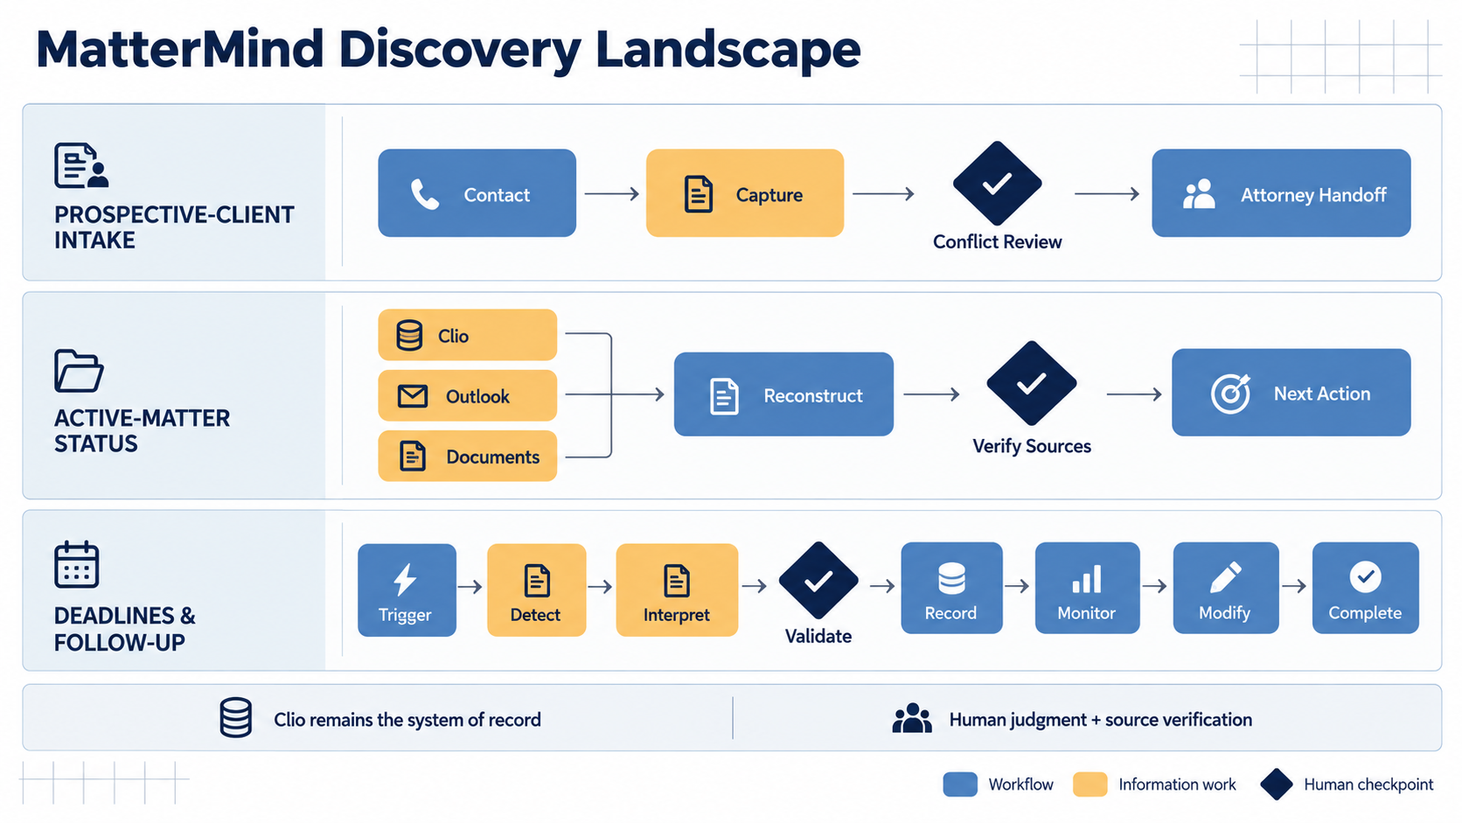
Notes:
Source: MatterMind discovery interviews 001–005. The three workflows remain visually neutral; the next slide explains the selection decision.

Slide 3
Selected V1 scope
One matter, a defined source set, a fixed brief, and no autonomous writes
DEFINED MATTER SOURCES
Clio records
Matter email
Attachments
Defined time window
CURRENT-STATE BRIEF
MATTERMIND
Reconstruct current state
Ground material claims
Surface uncertainty
Last significant event
Current waiting state
Next action and owner
Known deadline
Significant new information
Evidence and freshness
Read-only output keeps early failures observable and reversible
Notes:
Source: docs/mvp/mvp-selection.md. The exact source boundary remains subject to feasibility investigation.

Slide 4
Trust and operating boundaries
Source evidence and explicit uncertainty define acceptable V1 behavior
V1 DOES
V1 DOES NOT
Links material claims to inspectable evidence
Reports unknown or contradictory states
Shows the reviewed time boundary
Keeps the user in control of interpretation
Remains read-only
Write to Clio, email, calendars, or tasks
Make legal judgments or deadline decisions
Resolve conflicting sources silently
Present unsupported claims as facts
Expand into intake or obligation detection
Unknown or insufficient evidence is valid product behavior
Notes:
Source: docs/mvp/mvp-selection.md. Read-only operation lowers action risk but does not make inaccurate claims harmless.

Slide 5
Validation gates before implementation
The product decision stands only if the bounded workflow proves useful and reviewable
1
Pain
Reconstruction occurs often enough to justify intervention.
2
Source sufficiency
A bounded source set supports a useful current-state brief.
3
Association and permissions
Evidence maps to the correct matter and respects access boundaries.
4
Evaluation and trust
Qualified reviewers can judge accuracy, support, freshness, and usefulness.
5
Business value
Faster orientation improves response time, avoids duplicate work, or increases capacity.
Next: define explicit scope, success criteria, and validation evidence
Notes:
Source: docs/mvp/mvp-selection.md. Technical feasibility, architecture, and implementation planning follow these product validation gates.

