Slide 1

MatterMind
From discovery to MVP
Product decision and V1 scope
Fictional legal-operations portfolio project
Notes:
Sources: MatterMind discovery interviews 001–005 and docs/mvp/mvp-selection.md. All people, matters, and organizations are fictional and synthetic.

Slide 2
Discovery findings
Five stakeholder interviews established the workflow landscape, but several business and technical assumptions remain open
ESTABLISHED
REQUIRES VALIDATION
Clio remains the matter-management system of record
Daily work and context span Outlook, documents, Teams, and SharePoint
Staff manually bridge gaps between systems and communication channels
Source verification matters when information is summarized or reconstructed
Human judgment remains essential for conflicts and legal deadlines
Workflow frequency and time burden have not been measured
The minimum useful evidence set remains unknown
Matter-to-evidence association may be difficult across systems
Permission and access constraints need feasibility research
User trust depends on accuracy, grounding, and useful abstention
Discovery supports a product bet, not an implementation design
Notes:
Sources: discovery interviews 001–005. Established findings are separated from assumptions that still require validation.

Slide 3
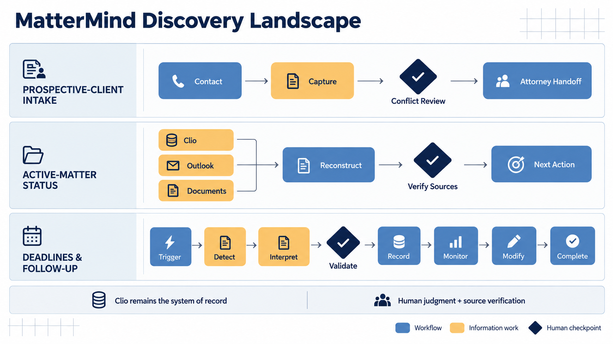
Notes:
Source: MatterMind discovery interviews 001–005. This visual distinguishes workflow activities, information work, and human checkpoints.

Slide 4
Prospective-client intake
Technically narrow, but discovery did not establish enough pain or return on investment for the first MVP
WHAT DISCOVERY SHOWED
WHY IT WAS DEFERRED
The workflow is clunky but generally works
Ownership, routing, and handoff contain deterministic opportunities
AI may help structure narratives and identify possible parties
Conflict determination must remain a human judgment
Pain per intake appears relatively low
Observed failures appear occasional
Volume, handling time, error rate, and cost remain unmeasured
The strongest opportunities may be conventional workflow automation
Disposition: reserve until discovery demonstrates material user pain or capacity value
Notes:
Sources: discovery interviews 001–003 and MVP selection handoff. No quantitative intake volume, time, error rate, or ROI has been established.

Slide 5
Deadlines, obligations, and follow-up
Meaningful cognitive work exists, but reliability demands and uncertain pain make this a poor first proving ground
WHAT DISCOVERY SHOWED
WHY IT WAS DEFERRED
Potential obligations arise from documents, email, and internal commitments
Staff detect candidates before attorneys validate legal meaning
The current process includes meaningful human safeguards
Confirmed obligations may need updates across Clio and Outlook
Discovery did not show routine missed court deadlines
Pain and workload magnitude remain uncertain
False negatives may carry significant consequences
Detection alone covers only part of the obligation lifecycle
Disposition: defer until value, evaluation tolerance, and review controls are better understood
Notes:
Sources: discovery interviews 001 and 005. The firm is not known to routinely miss serious court deadlines; the current process appears effective.

Slide 6
Active-matter status
The strongest balance of demonstrated pain, bounded product risk, and learning value
DESIRABILITY
Recurring reconstruction pain appeared across legal operations, attorney, and paralegal roles.
VIABILITY
Professional time goes toward reconstructing information that already exists.
FEASIBILITY
One selected matter and limited authorized sources create a natural product boundary.
RISK
Read-only behavior, source grounding, and abstention keep early failures observable and reversible.
LEARNING VALUE
The MVP tests retrieval correctness, matter association, provenance, permissions, and user trust.
MVP decision: read-only active-matter status reconstruction
Notes:
Sources: discovery interviews 001, 003, and 004; docs/mvp/mvp-selection.md.

Slide 7
MatterMind V1 product definition
The user requests a brief for one matter; MatterMind reconstructs state from authorized evidence and takes no action
DEFINED INPUT
Matter identity
Authorized evidence
Constrained source set
Defined time boundary
RECONSTRUCTION
Determine current operational state
Ground claims
Expose uncertainty
EXPLICIT TRIGGER
Authorized user selects one matter and requests current status
FIXED OUTPUT
Structured matter status brief with inspectable evidence
Working source hypothesis: Clio plus matter-associated email and attachments
Notes:
Source: MVP selection handoff. The source boundary remains a hypothesis, not a technical decision or integration commitment.

Slide 8
Matter Status Brief
Illustrative synthetic experience showing structured state, evidence, and uncertainty
HENDERSON MATTER
SUPPORTING EVIDENCE
Current operational status
Email from Jane Smith
Settlement discussions remain open. The firm appears to be waiting for revised settlement documents from opposing counsel.
September 21, 2026
Opposing counsel expects to provide revised documents after internal review.
SUPPORTED
Waiting on
View source
Revised settlement documents from opposing counsel
Review the revised documents when received
Owner
Unknown
INFERRED
Next action
Notes:
Illustrative synthetic example based on the V1 output definition and the evidence example supplied in the MVP handoff. It does not represent a real client or matter.

Slide 9
Trust model
MatterMind communicates the strength of evidence and remains read-only regardless of confidence
SUPPORTED
INFERRED
CONFLICTING
UNKNOWN
Retrieved evidence directly supports the statement.
Multiple sources imply the state, but none states it directly.
Available evidence supports different conclusions.
The available evidence cannot support a useful answer.
READ-ONLY ACTION BOUNDARY
MatterMind reports and explains reconstructed state. It does not modify records, tasks, calendars, deadlines, documents, assignments, or email.
Reliability takes priority over always producing an answer
Notes:
Source: MVP selection handoff. Unknown is valid product behavior and should not be presented as system failure.

Slide 10
Explicit V1 boundaries
The narrow scope protects the product decision from adjacent workflows and uncontrolled operational actions
IN V1
OUT OF SCOPE
One explicitly selected matter
A constrained set of authorized evidence
A structured current-state brief
Inspectable support for material claims
Explicit uncertainty and abstention
Read-only user-requested operation
Intake automation or conflict determination
Authoritative deadline calculation
Task, calendar, email, or document changes
General firm-wide chat or unrestricted search
Background agents or proactive monitoring
Replacing Clio or creating another source of truth
Clio remains the system of record
Notes:
Source: MVP selection handoff. The exclusions prevent scope expansion into intake, deadline automation, generalized search, or operational write-back.

Slide 11
Assumptions and invalidation
Retrieval correctness may matter more than model sophistication
PRODUCT VALUE
EVIDENCE AND ACCESS
A1 Reconstruction occurs often enough
A2 It consumes meaningful professional time
A8 The brief improves the workflow
A9 Users treat it as an orientation aid
A3 A limited source set contains enough evidence
A4 Evidence maps to the correct matter
A5 Current state is usually recoverable
A6 Stale information can be distinguished
A7 Claims can link to useful evidence
A10 Permissions can be respected
HIGHEST-RISK ASSUMPTIONS
RECONSIDER THE MVP IF
A3 and A4: retrieve the right evidence for the right matter and user
Reconstruction is rare or trivial, evidence is inaccessible, matter association is unreliable, integration cost outweighs value, or the brief fails to improve the existing workflow.
Notes:
Source: MVP selection handoff assumptions A1–A10 and invalidation conditions. A3 and A4 were explicitly identified as potentially higher risk than LLM quality.

Slide 12
What we validate next
Product evidence comes before architecture and implementation planning
1
Measure the problem
How often does reconstruction occur, and how much time does it consume?
2
Test the source boundary
What minimum evidence set produces a useful brief?
3
Verify retrieval correctness
Can evidence map reliably to the correct matter and authorized user?
4
Measure ambiguity
How often is current state stale, conflicting, or genuinely unknown?
5
Evaluate value and trust
Does the brief reduce reconstruction time, and what grounding or abstention earns trust?
Next artifact: explicit MVP scope, success criteria, and validation plan
Notes:
Source: MVP selection handoff. Architecture, provider selection, evaluation design, and implementation planning follow product validation.

