Slide 1
Demo presentation
By student

Slide 2
Introduction
In this presentation we investigated the how ….. Data can be predicted.
We used x y z

Slide 3
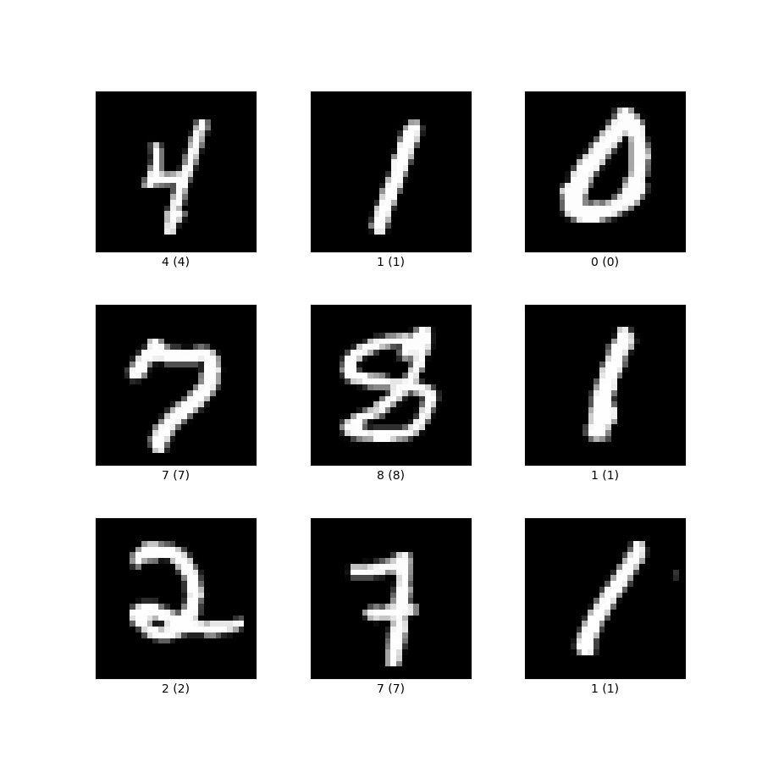
Data sets used
The data set used was taken from Kaggle
OR
The data set used was gathered using x y and z sensors

Slide 4
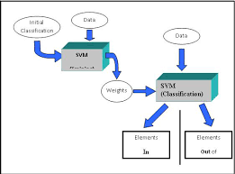
Model selection
We made use of a SVM because our data was …., after investigating with a neural network and regression classifier we found the best accuracy was achieved by the svm.
This could be because…
Use software like https://draw.io/ to make models.

Slide 5
Augmentation results
We applied 4 augmentation techniques:
Technique 1
Technique 2
….
…
Techniques 1 and 2 lead to poorer performance and techniques 3 and 4 lead to a better performance. Combining 3 and 4 improved the model further…

Slide 6
Conclusions
We found that model x and data preprocessing techniques y z lead to the highest performing model
Future work would include….

Slide 7
What we learned
What did you learn throughout this course?

