Slide 1
Data visualising
Paula Seidler

Slide 2
Recap
Looked at uses of microcontrollers in research
How to read from sensors and write to an SD card

Slide 3
Contents
Looking through the format of data and how best to plot it
Publishing your datasets

Slide 4
Inspecting Your Measured Data - Types
What types of data did you measure? What formats?
Were sensors analog (continuous signal) or digital (discrete steps)?
Are you investigating categorical or continuous data?
How many different variables were measured?
Is the data collected over time or at a single point?

Slide 5

Inspecting Your Measured Data - Values & Quality
1. Analyze Data Statistics - Pandas DataFrame
Basic Information: df.info(), df.shape(), df.head()
Check for Missing or Incorrect Data: df.isnull(), df.isna(), df.duplicated()
Handle Missing Data: df.fillna(), df.dropna(), df.replace()
Descriptive Statistics: df.describe(), df.value_counts()

Slide 6
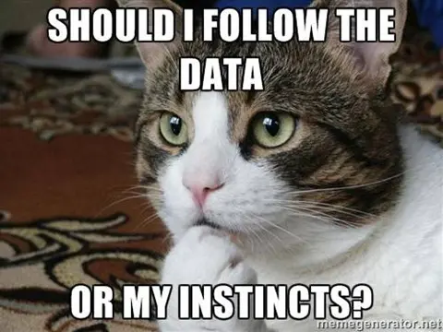
Choosing the Right Visualization for Your Data/Research Question
Trends over time → Line plot
Distribution of values → Histogram
Comparison between categories → Bar plot, Box plot
Relationships between two variables → Scatter plot
Patterns & correlations → Heatmap

Slide 7


Python Libraries for visualizing Data
Matplotlib: Basic plotting -> good for most basic data visualisation
Seaborn: Statistical visualizations -> builds upon matplotlib, operates on DataFrames, make nice-looking figures easy!
-> look documentation/tutorials/inspiration!

Slide 8
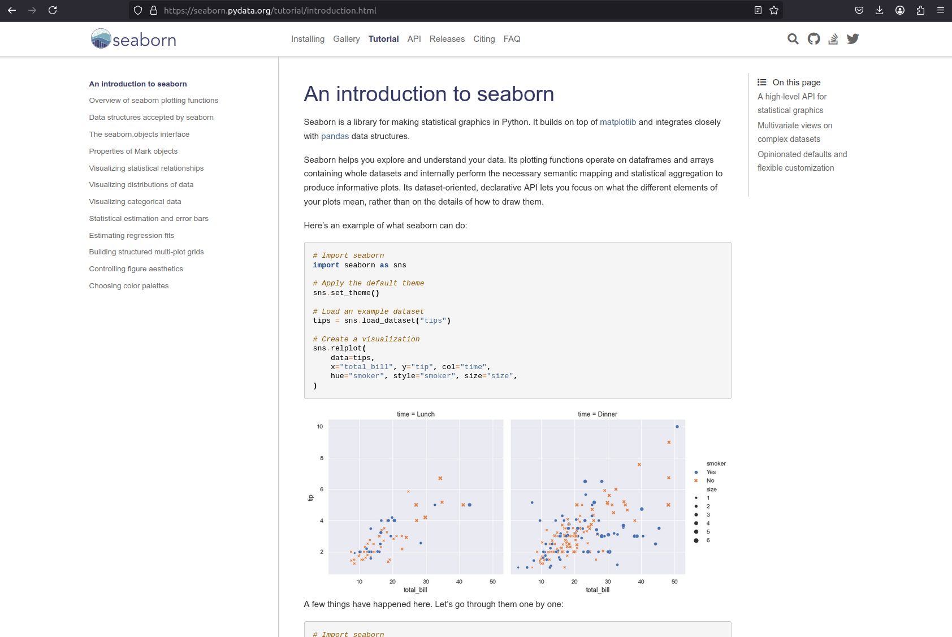
Screenshot seaborn

Slide 9
Categories

Slide 10
Categories -> Comparison Plots
Bar Plot → Simple comparison of categories.
Example: Average crop yield across different regions.
Stacked Bar Plot → Breaks categories into subgroups.
Example: Proportion of different irrigation methods used per region.
Box Plot → Shows data distribution for categories.
Example: Spread of soil nitrogen levels in different farms.
Violin Plot → Like a box plot, but also shows density.
Example: Distribution of rainfall across different seasons.

Slide 11
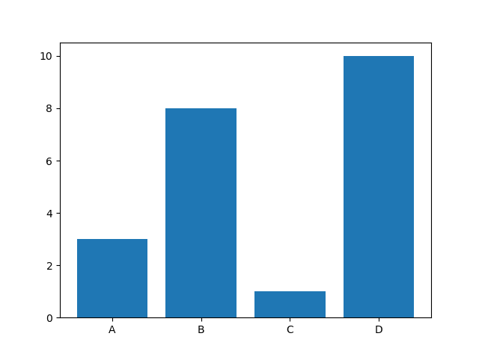

Bar Plots:
Simple comparison of categories
Use if you want to compare one variable across several categories
Example: Comparing average rainfall in different regions

Slide 12
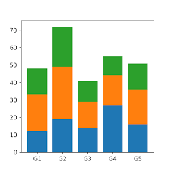

Stacked Bar Plot:
Breaks categories into subgroups
Use if categories are divided into several groups
Example: Daily rainfall split by light, moderate, and heavy rain

Slide 13
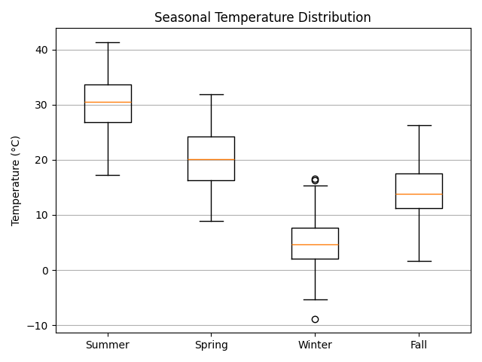
Box Plots:
Compare Categories + Statistics
Use if you want to show spread, median, and outliers per category
Example: Comparing temperature variations across seasons

Slide 14
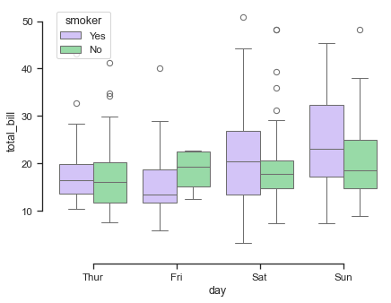
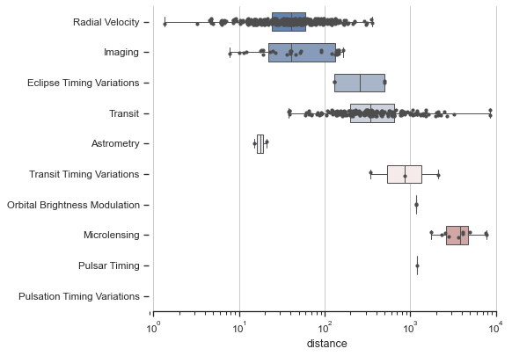
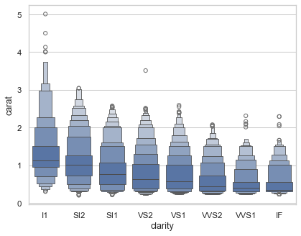
More Boxplots
-> using seaborn -> try around in the lab later!

Slide 15
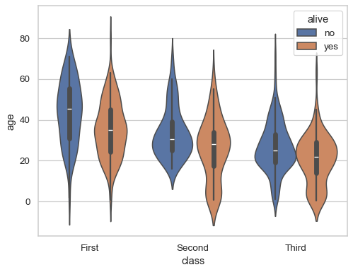
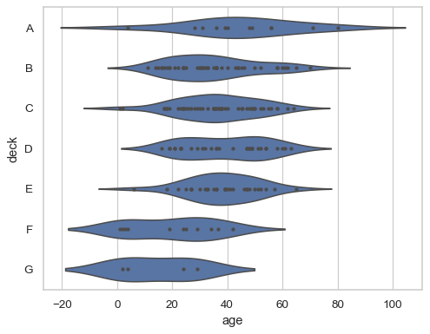
Violinplots:
A box plot with density.
Use if you want to show the full distribution of your categories, including density, spread, and outliers
Example: Distribution of rainfall across different regions

Slide 16
Categorical Plots
Good for:
Comparing discrete values or averaged data across categories
Distribution and spread within categories (e.g., box, violin plots)
Proportions across categories (e.g., stacked bar plots)
Limitations:
Not ideal for trends or continuous variable relationships

Slide 17
Time Trends

Slide 18
Trend Plots (For Time-Series Data)
Line Plot → Tracks changes over time.
Example: Monthly temperature variations affecting crop growth.
Area Plot → Line plot with shaded area under the curve.
Example: Cumulative rainfall received over a season.

Slide 19
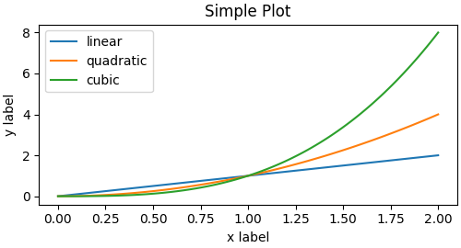

Line Plots
Tracks changes over time
Use if you want to show trends and variations over time.
Example: Tracking temperature and moisture changes over a week.

Slide 20
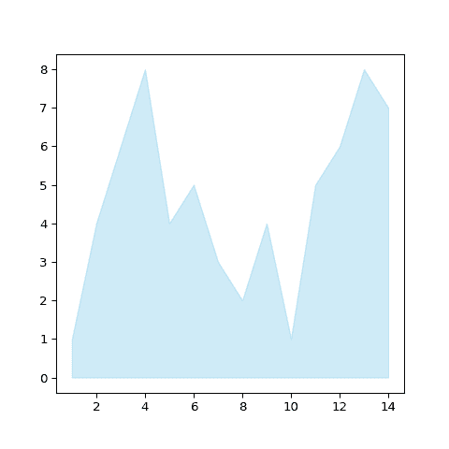

Area Plots
Line plot + shaded area under the curve
Use if you want to show trends and variations, where the total value matters over time
Example: Total rainfall accumulation throughout the year

Slide 21
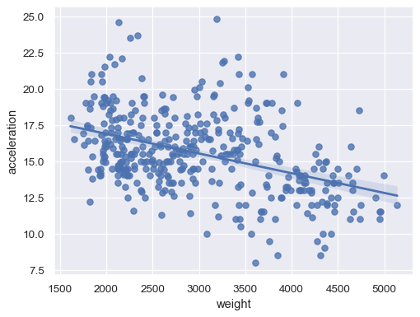
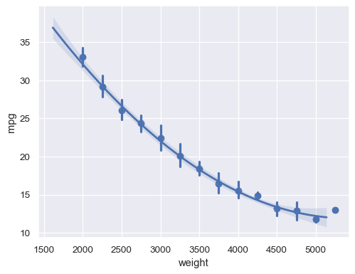
More Line Plots

Slide 22
Time-Trend Plots
Good for:
Tracking trends over time and comparing the impact of different factors on the same variable
Limitations:
Not ideal for categorical comparisons
Requires consistent measurement conditions (same unit, scale, etc.)
Issues with different time spans or intervals across measure

Slide 23
Relationships between variables

Slide 24
Relationship Plots -> Two or More Variables
Scatter Plot → Relationship between two numerical variables.
Example: Effect of fertilizer use on crop yield.
Heatmap → Color-coded grid for correlation or spatial data.
Example: Soil moisture levels across a farm plot.

Slide 25
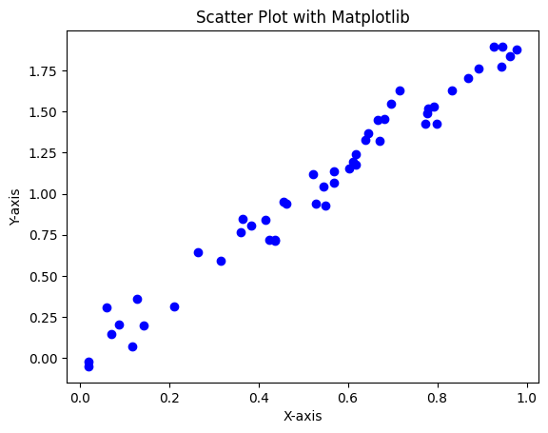
Scatter Plots
Relationship between two numerical variables
Use if you want to show how two continuous variables correlate
Example: Relationship between temperature and fruit ripening speed

Slide 26
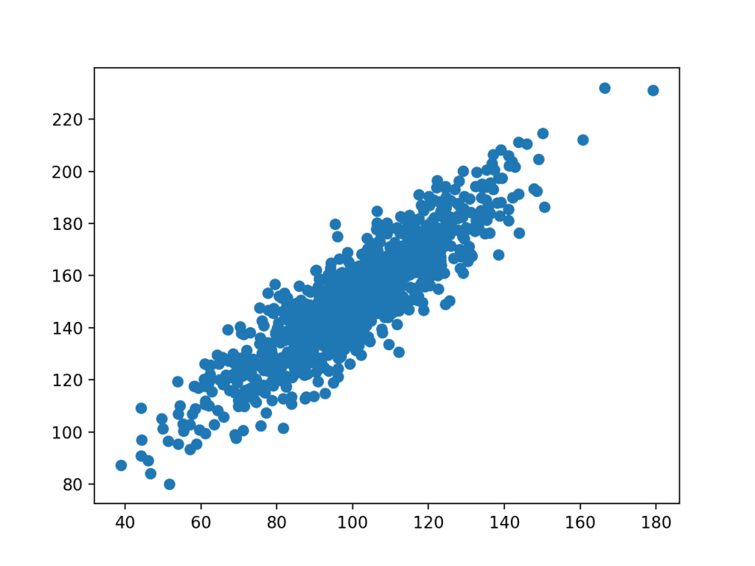
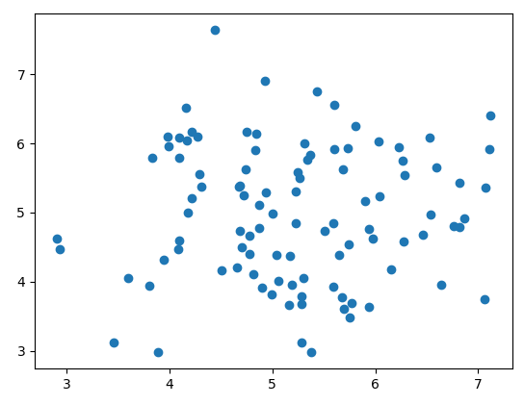
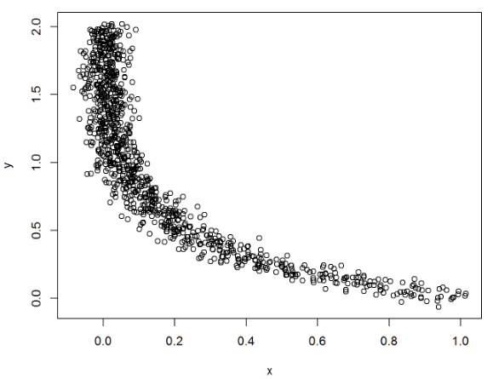
Scatter Plots - What does it tell you?

Slide 27
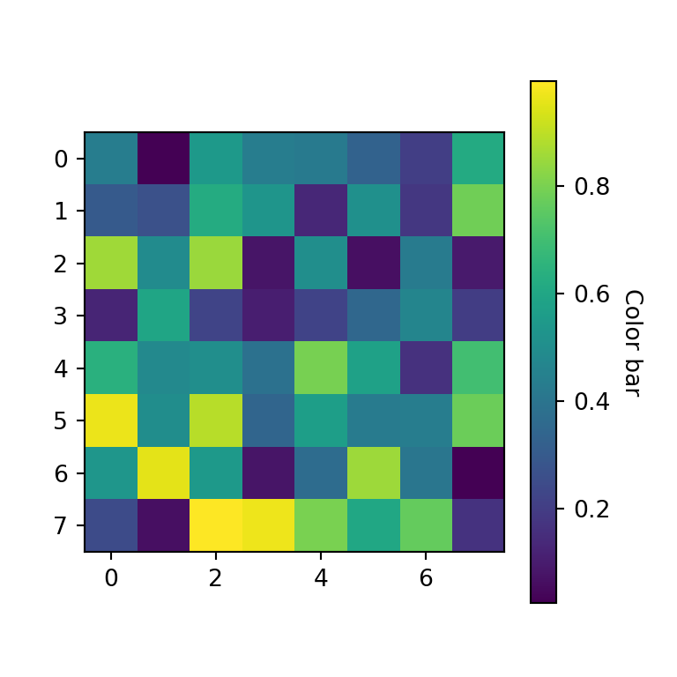
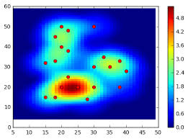
Heat Maps
Color-coded grid for correlation or spatial data
Use if you want to show correlations or patterns between multiple variables in a matrix form
Example: Correlation between various soil nutrients and crop yield

Slide 28
Correlation Plots
Good for:
Scatter Plots: Relationships between continuous variables
Heatmaps: Visualizing correlations/patterns in multiple variables
Limitations:
Not ideal for trends over time
Can become cluttered with too many points or variables

Slide 29
Distributions

Slide 30
Distributions -> Single Variables
Histogram → Frequency distribution of a variable.
Example: Distribution of soil pH across different fields.
Density Plot (KDE) → Smooth version of a histogram.
Example: Probability density of crop yield values.

Slide 31
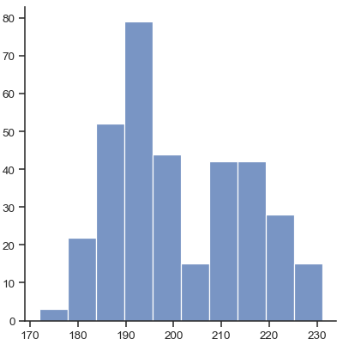
Histogram
Distribution of a variable
Use if you want to show the distribution of a single variable.
Example: Distribution of noise levels (dB) in a specific region throughout the day

Slide 32
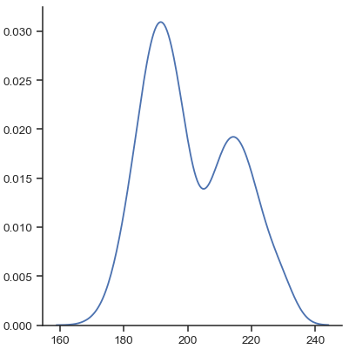
Density Plot
Smooth Histogram
Use if you want to show the smooth distribution and density of a single variable.
Example: Density of humidity levels in a specific region throughout the day.

Slide 33
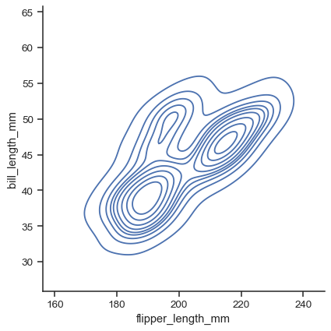
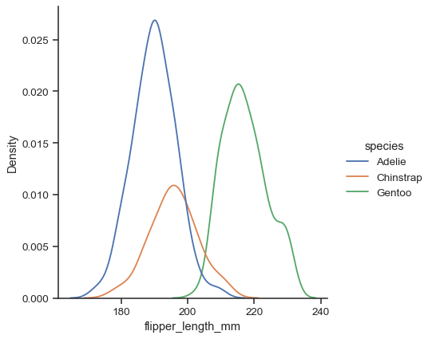
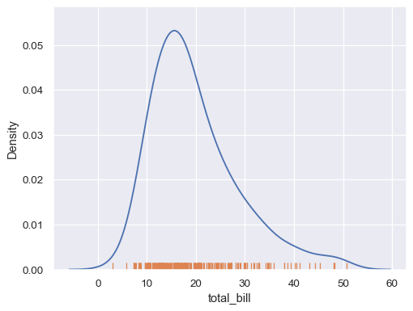
More Distribution Plots

Slide 34
Distribution Plots
Good for:
Visualizing the distribution of a single variable
Sensechecking data spread, outliers, noise
Identifying patterns and variations in data
Limitations:
Not ideal for showing relationships between multiple variables

Slide 35
Examples - which visualisation to choose?
Is there a correlation between light intensity and temperature during the day?
How does soil moisture change throughout the day in different land types (grass vs. bare soil)?
How much does humidity fluctuate in a greenhouse every hour during the day?

Slide 36
Examples - which visualisation to choose?
Is there a correlation between light intensity and temperature during the day? Scatter Plot
How does soil moisture change throughout the day in different land types (grass vs. bare soil)? Line Graph
How much does humidity fluctuate in a greenhouse every hour during the day? Box Plot/Violin Plot

Slide 37
Making good Figures

Slide 38
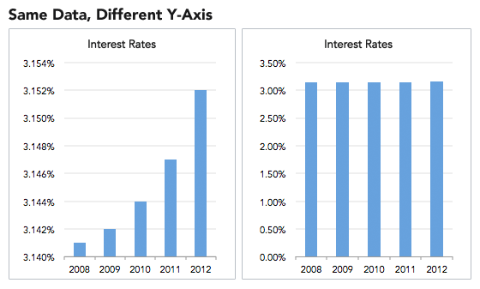
Make your Plots understandable!
Label Axes: Include meaningful labels and units.
Use Fair Scales: Avoid exaggerating differences with misleading scales.
Consistent Intervals: Be cautious with log scales and starting points.
Add Legends: Clearly distinguish data series.

Slide 39
Publish your datasets

Slide 40
Publishing your datasets
Make your data accessible to research -> upload to Kaggle!
“Datasets”
“New Dataset”
Add data: What format? (CSV, JSON, etc.)
Add metadata and a description

Slide 41
The labs

Slide 42
Labs
Make Kaggle Account
Labsheets -> try around with different data visualization techniques
Find Kaggle datasets - come up with descriptive plots for what you want to analyse
What is the research question you want to answer? What do you want to highlight?
Why did you choose the specific plot for this dataset/question? What can you see in the plot?
Notes:
How they gathered data, what type of data, do you understand the complexity…

Slide 43
Example Kaggle datasets you could use
https://www.kaggle.com/datasets/rishidamarla/global-rise-in-temperatures-in-each-country
https://www.kaggle.com/datasets/atharvaingle/crop-recommendation-dataset
https://www.kaggle.com/datasets/anandshaw2001/imdb-movies-and-tv-shows

Slide 44
If you are looking for a slightly easier task
Download this dataset: https://www.kaggle.com/datasets/makuwilad/malawi-tourism-dataset
The ultimate goal is to visualise the amount of hotels in every location (use the lodges.csv)
Make sure to avoid plotting null data (aka exclude nan)
Make sure to combine the similar names, for example 'Mzuzu' appears 65 times, 'Mzuzu.' appears 1 time, and 'Mzuzu City' appears 1 time.
Choose the best plot to visualise it

