Slide 1
DevOps_ext_KHAI_Winter
Scherbakov Denis

Slide 2
Objectives
To automate code deployment from a developer to web-server
Provide continuous deployment to:
Increase productivity
Increase the quality of turnkey solutions

Slide 3







Tools & technologies

Slide 4








WebHook
Commit

Slide 5



Slide 6
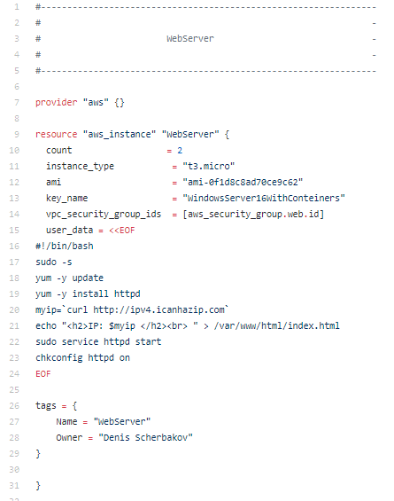
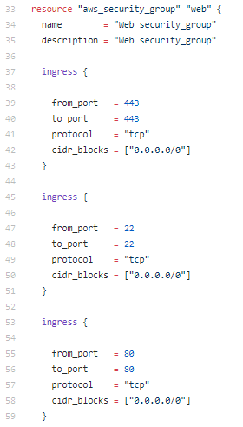
Infrastructure as a code approach

Slide 7






Slide 8


Test

Slide 9
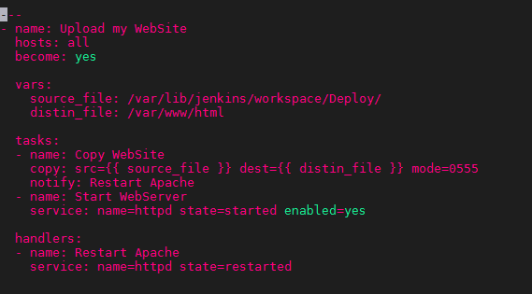
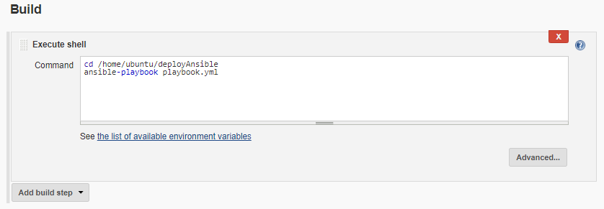
Ansible

Slide 10
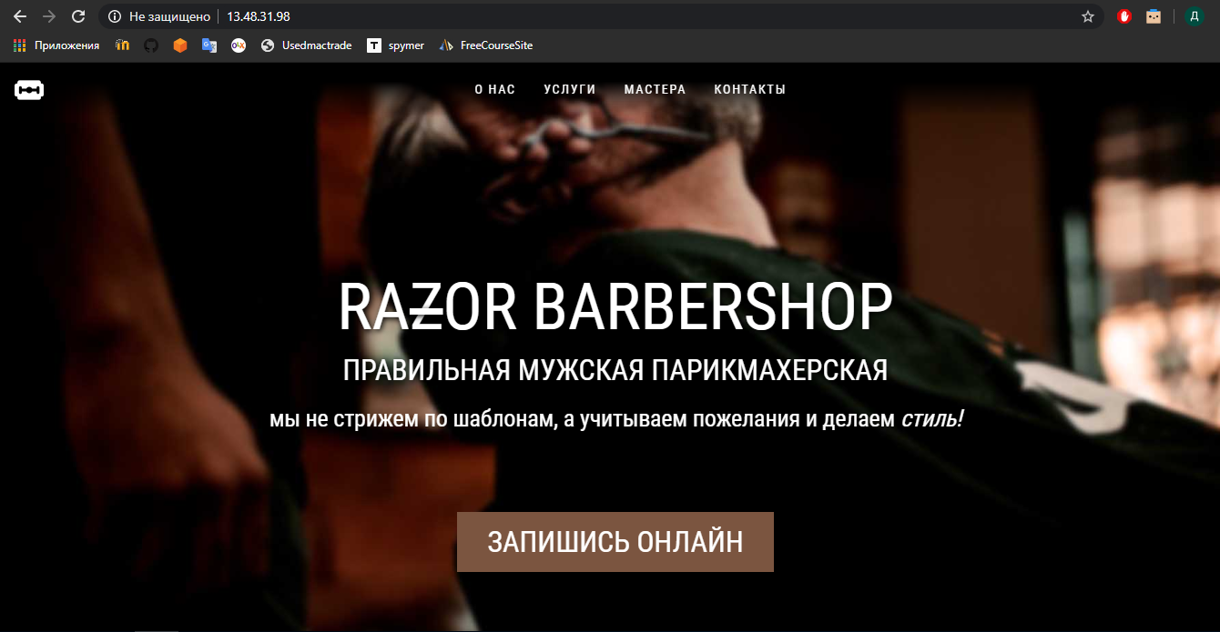

Slide 11

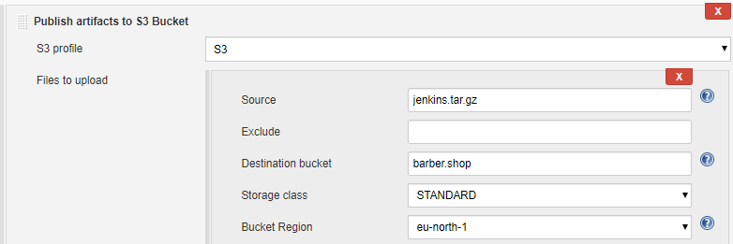
Amazon S3

Slide 12
Thanks for your attention!

