Slide 1

PHASE 1 · ML DETECTION ENGINE
Observion
AI-Driven Network Threat Detection & Observability
IBM PBEL 3.0 Internship Project · Practical AI & Cyber Security prototype

Slide 2

Implemented Features
CSV Flow Upload
Upload network flow CSVs (max 500 MB). Preprocessing pipeline aligns data to the CICIDS2017 78-feature schema.
Random Forest Classifier
Multi-class attack classification with per-prediction confidence scoring and interpretable feature importance.
Rich Output Set
Attack distribution, benign/malicious split, risk score, model confidence, top attack types, and full prediction table.
Modular Codebase
Designed to plug in additional models — XGBoost, LSTM, Autoencoders — without rearchitecting the pipeline.

Slide 3

Architecture & Tech Stack
No live traffic capture or network simulation yet — current pipeline is batch/offline, CSV-driven.
CSV Upload
Preprocessing
Batch CSV input for offline pipeline ingestion.
Cleaning, schema checks, and feature alignment.
Random Forest
Prediction Engine
Trained model used for classification inference.
Generate labels with confidence scores.
End-to-end batch pipeline: raw CSV input flows through preprocessing and model inference to a structured results dashboard.
Python
Scikit-Learn
Pandas / NumPy
Matplotlib / Plotly
Docker
Git
Currently file/CSV-based — no database integrated yet.

Slide 4

Why Random Forest?
Serves as an interpretable baseline before experimenting with XGBoost, LightGBM, Isolation Forest, Autoencoders, LSTM, and Transformers in later phases.
Strong Tabular Baseline
Proven performance on structured, flow-based data like CICIDS2017 without heavy feature engineering.
Handles Mixed Scales
Naturally processes mixed-scale numerical features without aggressive normalization.
Built-in Explainability
Feature importance scores make predictions interpretable — critical for SOC analyst trust.
Fast & Lightweight
Low resource requirements enable rapid iteration during research and development cycles.
Robust to Noise
Ensemble approach reduces overfitting compared to single decision trees, handling outliers gracefully.

Slide 5
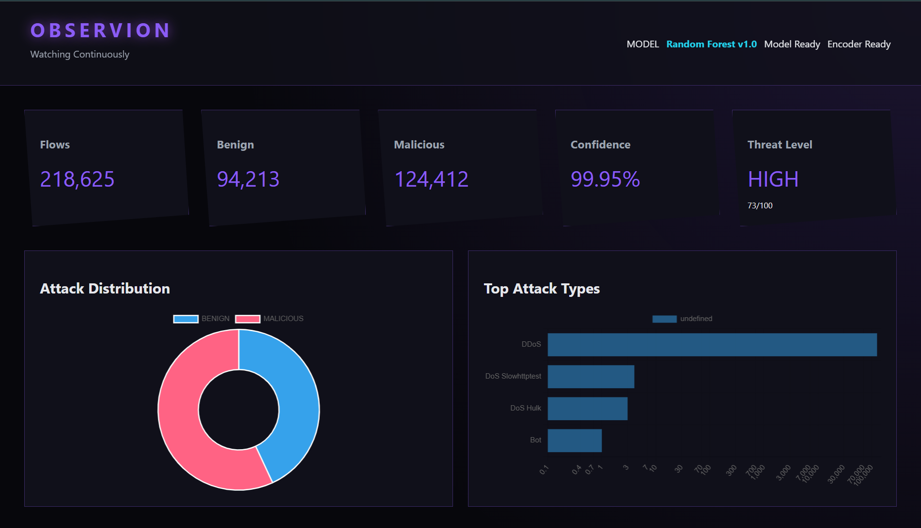
Frontend Dashboard — Wireframe
Current implemented UI — intentionally minimal at this stage. Single-page design covers the full analyst workflow.

Slide 6
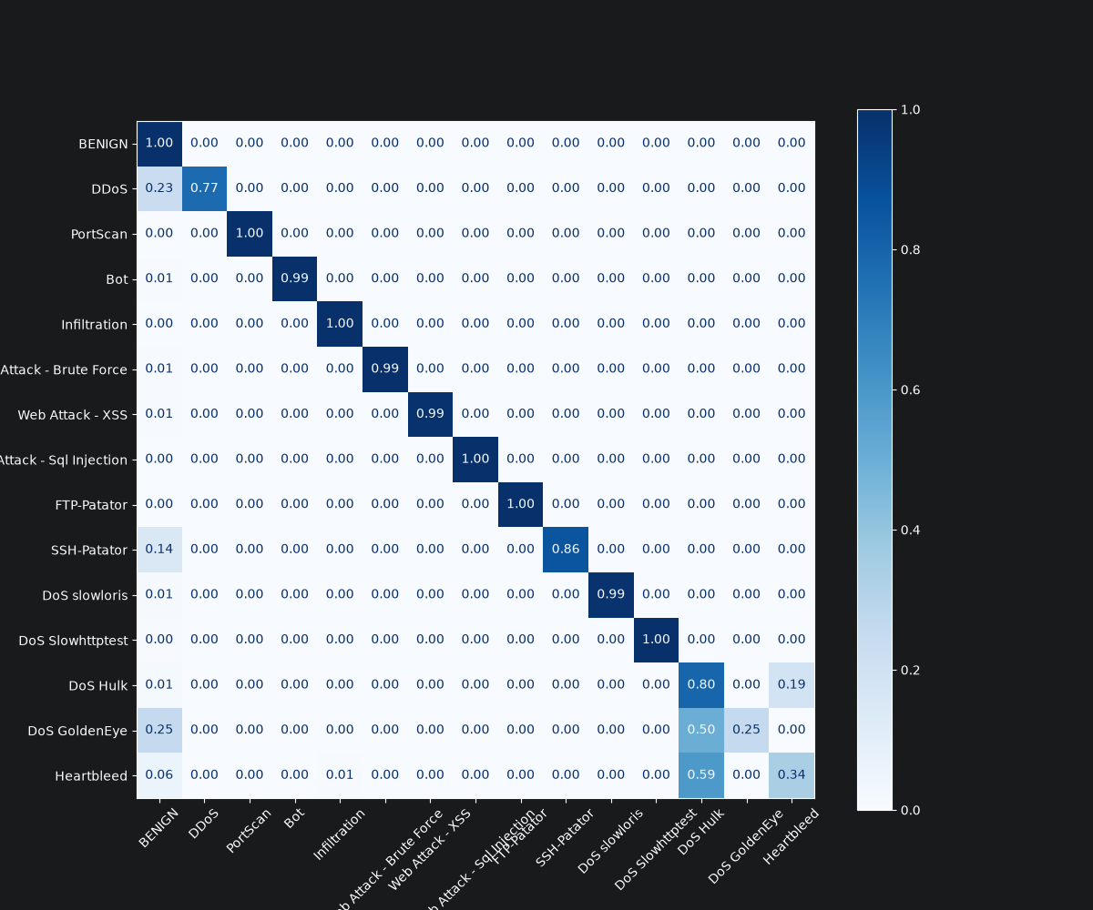
Model Performance & Current Limitations
Performance Summary
Near-perfect accuracy on 10 of 15 attack classes. Remaining confusion stems from feature similarity and class imbalance in CICIDS2017.
Known Limitations
⚠ Offline Only
⚠ Class Imbalance
No live or real-time traffic analysis — CSV-only, batch mode currently.
Underrepresented attack types in CICIDS2017 yield weaker per-class performance.
⚠ Dataset Constraints
⚠ Feature Similarity
Public dataset limits diversity and realism of certain attack scenarios.
Some attack classes share nearly identical flow-level signatures, causing cross-class confusion.

Slide 7

Value & Usefulness
🔍 SOC Triage Speed
Gives analysts a fast, ML-assisted way to triage flow data and flag malicious traffic at scale.
📊 Interpretable Output
Risk scoring and confidence metrics — not just a binary verdict — support analyst decision-making.
🔬 Research Artifact
Demonstrates practical ensemble ML applied to network intrusion detection on a recognized benchmark dataset.
🏗 Foundation Layer
Serves as the detection engine for a future full network observability and live simulation platform.

Slide 8
Future Roadmap
Phase 1 — Complete ✓
1
ML Detection Engine: Random Forest classifier, CSV pipeline, frontend dashboard, CICIDS2017 evaluation.
2
Phase 2 — Planned
Custom dataset via CICFlowMeter to address class imbalance. Add XGBoost, LightGBM, Isolation Forest, Autoencoder, LSTM, Transformer models.
Phase 3 — Planned
3
Live network simulation: Containerlab, Docker, FRRouting (server, benign user, attacker, router/telemetry node). Real-time SNMP, Syslog, NetFlow ingestion.
4
Phase 4 — Planned
Local LLM assistant via Ollama + RAG (ChromaDB) for natural-language alert explanation. Migrate to SQLite/PostgreSQL.

Slide 9
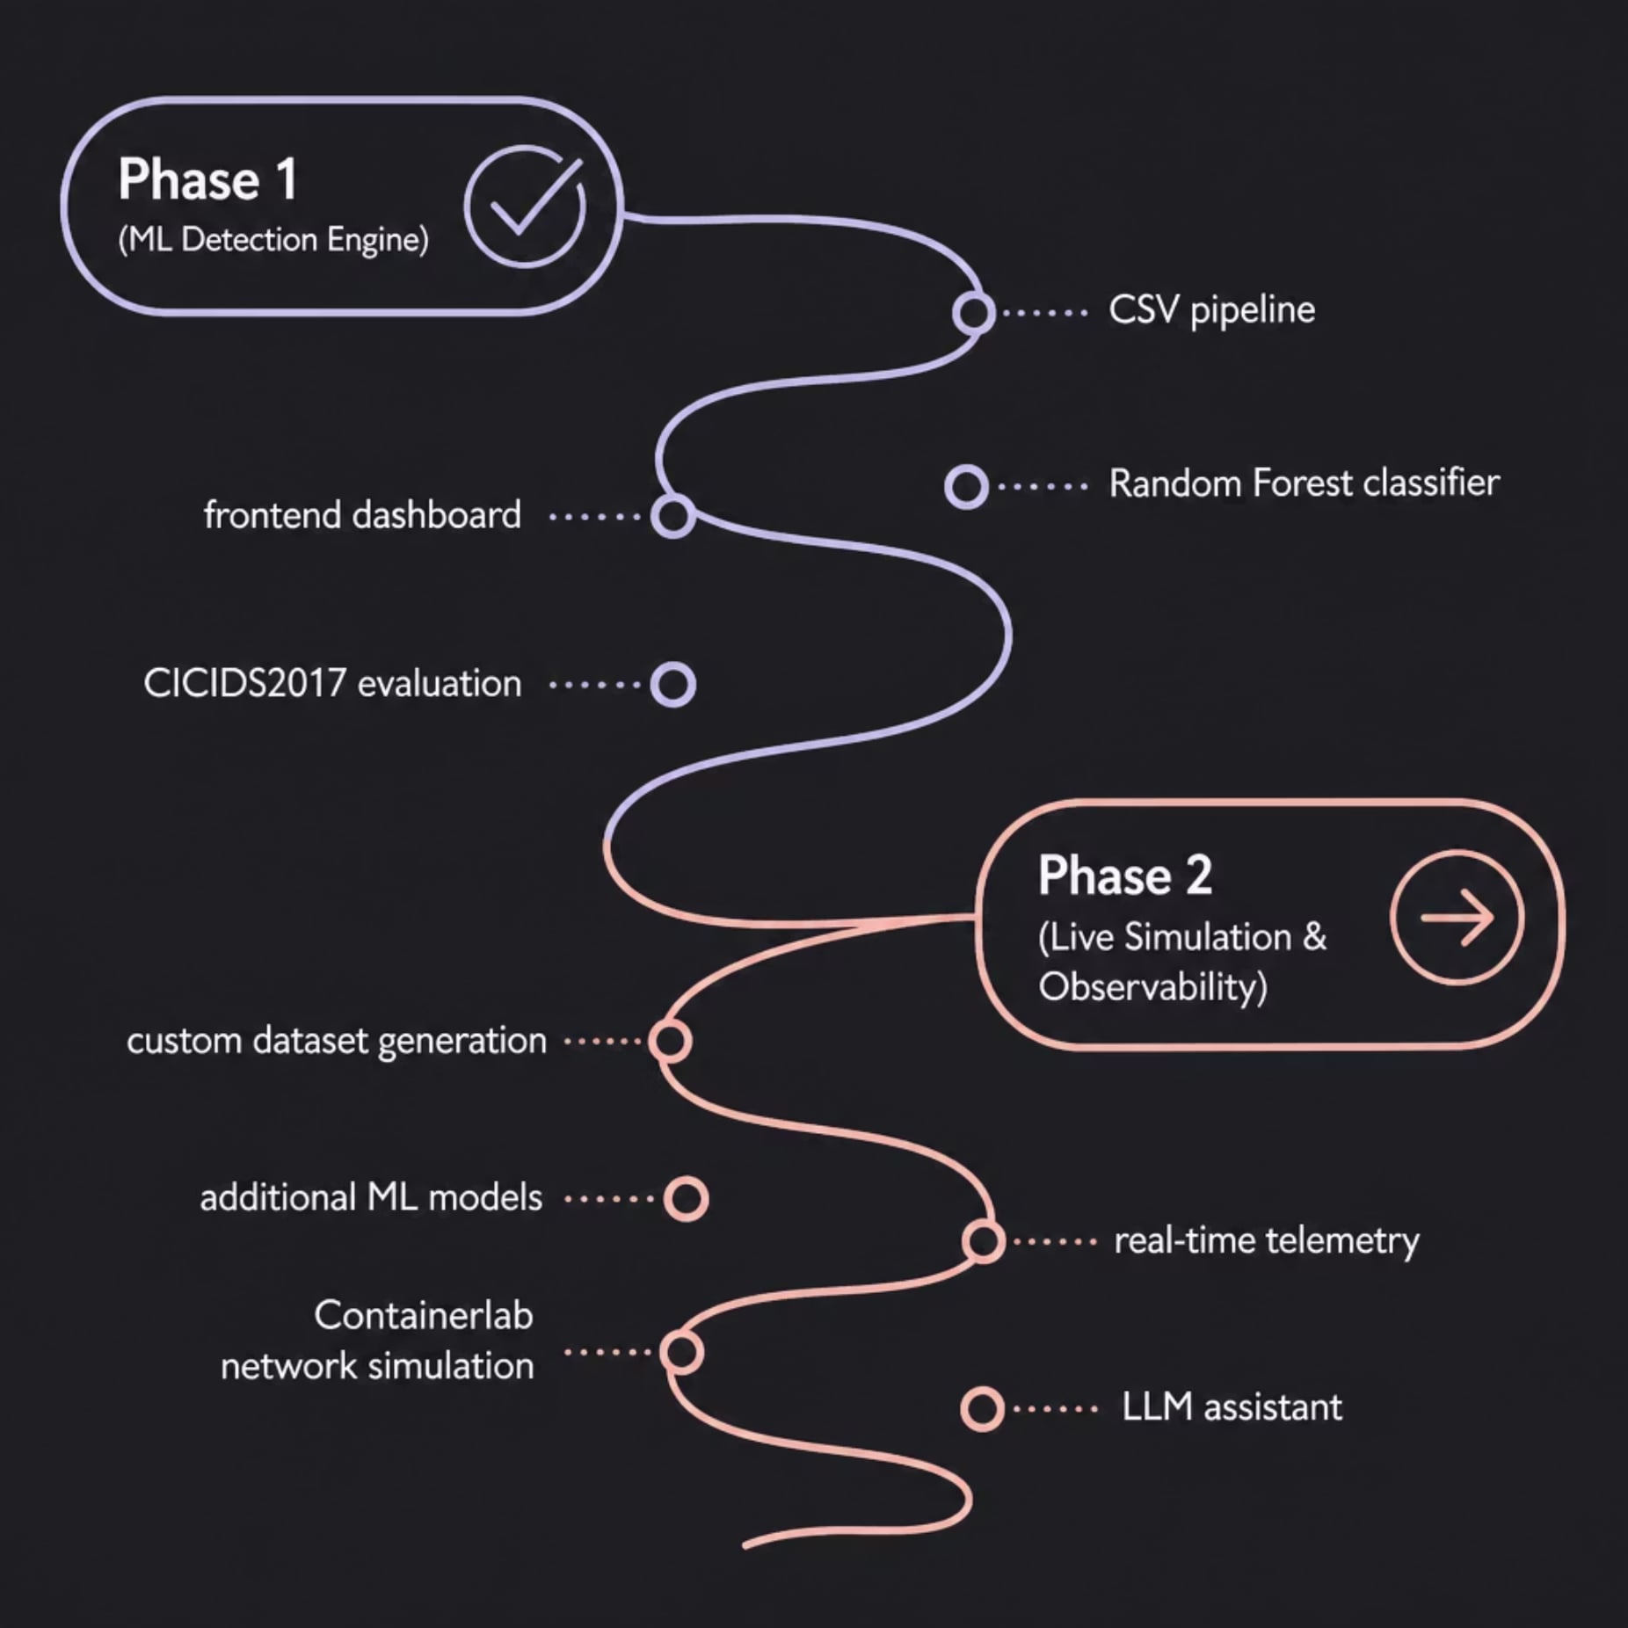
Project Status Summary
Where We Stand
Phase 1 — ML Detection Engine is complete and fully functional. The Random Forest classifier, preprocessing pipeline, and single-page frontend are operational and validated against CICIDS2017.
Phase 2 — Live Simulation & Observability is the planned next milestone, introducing live network simulation, expanded model support, and real-time telemetry ingestion.
Phase 1 is a working research prototype
not yet a production deployment.

Slide 10

Thank You
Observion
AI-Driven Network Threat Detection & Observability Platform
Author
Current Phase
Harsh
Phase 1 — ML Detection Engine ✓
Next Phase
Phase 2 — Live Simulation & Observability

