Slide 1
Fire & Smoke Detection
on industrial cameras, built on DINOv3
Input · parameters · output · how it runs · the pipeline
1
Camera frame
2
DINOv3 backbone
3
Detection + scene heads
4
Temporal confirmation
5
Alarm
Model 1: DINOv3 ViT-S + Faster R-CNN Model 2: DINOv3 ViT-Ti + FCOS (light)
Notes:
Two models share one pipeline. Model 1 is the accurate reference; Model 2 is the light, batch-exportable variant.

Slide 2
The pipeline, end to end
One frame in, boxes and an alarm decision out
1 Camera frame
webcam, video file or CCTV
any resolution
2 Pre-process
letterbox to 640 x 640
RGB, ImageNet mean/std
3 DINOv3 backbone
ViT-S (M1) or ViT-Ti (M2)
frozen, self-supervised
4 Feature pyramid
blocks 5/8/9/11 ->
strides 8, 16, 32, 64
Glow prior
classical CV, no learning
7 warm-light statistics
Scene classifier
whole image -> P(smoke), P(fire)
sees hidden-fire glow
5 Detection head
Faster R-CNN (M1) / FCOS (M2)
boxes: smoke, fire + score
7 ALARM + event log
on-screen alarm, CSV of every alarm on/off, annotated video
6 Temporal confirmation
alarm only if the SAME tracked object is seen in 6 of the last 15 sampled frames
Blue = frozen DINOv3 Green = trained Amber = rule-based Red = output
Notes:
DINO is never removed: both models run DINOv3 first. The two heads share one backbone pass. The temporal step is rules, not learning.

Slide 3
The two detection heads
Both turn DINOv3 features into boxes, in different ways
Faster R-CNN (Model 1)
two-stage: propose, then check
FCOS (Model 2)
one-stage: every location predicts directly
1
Region proposal network
looks over the feature maps and proposes ~300 candidate regions: "something might be here"
1
Every location votes
all 8,500 points across the 4 pyramid levels predict at once, no proposals
2
RoIAlign
crops a fixed 7 x 7 feature patch for each proposed region
2
Class score
how likely this point is on smoke or on fire
3
Box head
classifies each patch as smoke, fire or background, and refines its box
3
Box + centerness
distances to the 4 box edges, and how central the point is in its object
4
Non-max suppression
keeps the best box where several overlap
4
Score + NMS
score = sqrt(class x centerness), then keep the best boxes
+ Precise at high confidence; the stronger model here
- The number of regions varies per image, so it cannot be exported as a batched graph
+ Fixed-shape output: batches across cameras, exports to TensorRT
- Scores are compressed (max ~0.75), so it needs its own threshold; less accurate in our run
Notes:
Faster R-CNN asks 'where might something be?' then checks each candidate. FCOS asks every location at once. That fixed-shape output is what makes FCOS batchable for many cameras.

Slide 4
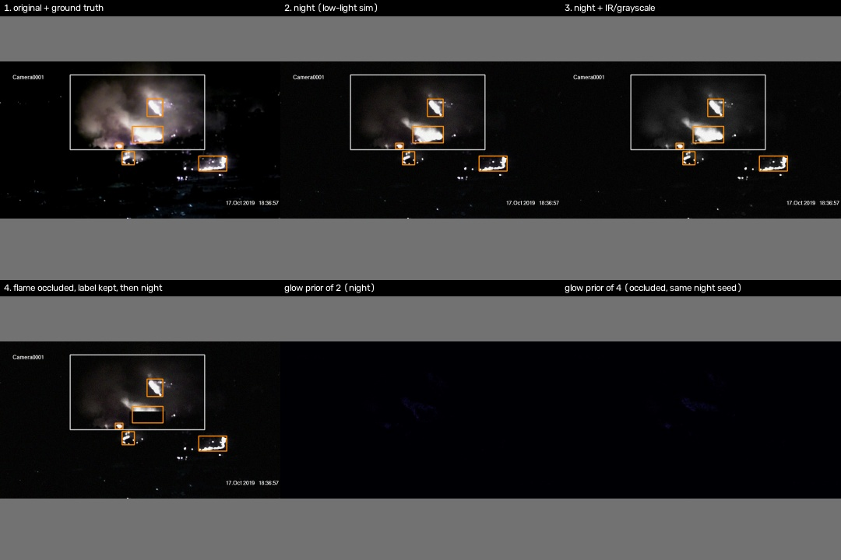
Input
What the model receives, and in what shape
1
Video frame
Any resolution (site cameras: 1280 x 720). Webcam, video file or CCTV stream.
2
Letterbox to 640 x 640
Aspect ratio kept, grey padding. Resolution is fixed: 448 px was measured to cost 24 points of recall.
3
Normalise
RGB scaled to 0-1, then ImageNet mean/std, as DINOv3 expects.
4
Glow statistics
7 numbers from the frame (warm cast, highlights, glow blobs) for the scene classifier.
5
Sampling
Deployment samples 1-5 frames per second per camera, not every frame.
Training inputs are augmented to match the site: original, night, IR, and a flame hidden behind an obstacle.
Tensors: images (B, 3, 640, 640) · glow (B, 7)
Notes:
B is the batch: several cameras' frames at once. Only Model 2 can run batched after export.

Slide 5
Model parameters
Same pipeline, two sizes
 | Model 1 | Model 2 (light)
Backbone | DINOv3 ViT-S/16 | DINOv3 ViT-Ti/16
Embedding dim / blocks | 384 / 12 | 192 / 12
Backbone parameters | 21.6M | 5.5M
Feature pyramid | 256 channels | 128 channels
Detection head | Faster R-CNN (two-stage) | FCOS (one-stage), 2 convs
Total parameters | 39.3M | 6.9M
Checkpoint file | 157 MB | 28 MB
Input size | 640 x 640 | 640 x 640
Batched ONNX export | No - measured to fail | Yes - verified
5.7x
fewer parameters
2.8x
faster per frame
0.726
Model 1 test mAP@0.5
Notes:
Model 2 changes the backbone size and the head. Input size stays 640 because smaller inputs lost too much recall.

Slide 6
Training parameters
D-Fire dataset, trained on a Kaggle P100
Setting | Value
Dataset split | train 13,776 / val 3,445 / test 4,306
Verified negatives | 9,838 images (45.7%)
Optimiser | AdamW, weight decay 1e-4
Learning rate | 1e-4, warmup 500 iters, cosine
Stage 2 (Model 1) | last 2 blocks unfrozen, lr 5e-5
Batch / precision | 8, fp16 mixed precision
Epochs | M1: 40 + 15 M2: 45
Model selection | best validation mAP@0.5
Night, IR and occlusion exist to match the deployment site, not the web images in D-Fire.
Notes:
Same data, optimiser and augmentation for both models, so the comparison isolates the architecture.

Slide 7
Runtime and alarm parameters
How a detection becomes an alarm
Alarm threshold
Release threshold
Window
M1 0.90 · M2 0.55
M1 0.75 · M2 0.40
15 sampled frames
Each model at its own operating point: M2 never scores above ~0.75.
Below this, a detection no longer counts as evidence.
The sliding window the confirmation looks back over.
Enter hits
Exit hits
Tracking
6 of 15
2 of 15
IoU 0.20 · min box 4 px
Detections of the same tracked object needed to raise the alarm.
Hysteresis: a briefly hidden flame does not switch the alarm off.
Links boxes frame to frame; drops tiny junk boxes.
Notes:
Random flicker never lands on the same track, so it never reaches 6 hits. Stationary look-alikes can, which is why hard negatives matter.

Slide 8
Output
What comes out for every processed frame
1
Boxes
[x1, y1, x2, y2] in the original camera's pixels
Event log from the live lighter test
time | event | class | score | evidence
19.5 s | ALARM_ON | fire | 0.315 | 3/8 hits
28.3 s | ALARM_OFF | - | - | track 1
81.8 s | ALARM_ON | fire | 0.375 | 3/8 hits
2
Class + score
smoke or fire, confidence 0-1
3
Scene probabilities
P(smoke), P(fire) for the whole image
Raw export outputs (Model 2, for TensorRT)
4
Alarm state
confirmed track, class, hits in window
cls_logits (B, 8500, 3)
bbox_regression (B, 8500, 4)
bbox_ctrness (B, 8500, 1)
scene_logits (B, 2)
5
Recordings
annotated video + CSV event log + alarm snapshots
Notes:
8500 = candidate locations over the 4 pyramid levels at 640 px. Decoding and NMS run after the network.

Slide 9
How it runs
Per frame, in order
1
Read the newest frame (stale frames are dropped, so it never lags behind)
Run it
Double-click run_both_models.bat
1-2 one model, webcam
3-4 one model, site video
5-7 both side by side
press q to stop
2
Letterbox to 640 x 640, normalise, compute the 7 glow statistics
3
DINOv3 backbone -> feature pyramid (one pass, shared by both heads)
4
Detection head -> boxes; scene classifier -> P(smoke), P(fire)
849 ms
305 ms
5
Map boxes back to camera pixels; drop tiny boxes and masked regions
Model 1 per frame
Model 2 per frame
6
Update tracks; raise or release the alarm by the 6-of-15 rule
Laptop CPU, same frames. On a GPU with batching, only Model 2 can use TensorRT.
7
Draw the on-screen display, write the video and the event log
Notes:
Step 1 matters for live cameras: without dropping stale frames the system would alarm on old video.

Slide 10
Results
Held-out test split of 4,306 images, plus real site footage
0
false alarms on 54 min of site footage
both models, at their own thresholds
2.8x
faster: Model 2
305 vs 849 ms per frame
-11 pts
recall cost of Model 2
at the same false-alarm rate
Notes:
Model 2 is faster, smaller and deployable, but not yet as accurate. Model 1 remains the accuracy reference.

Slide 11
Next steps
1
Model 2, stage 2
Unfreeze its last 2 blocks. It trains only 1.5M parameters today, so it should gain more than Model 1 did.
2
ViT-S + FCOS
Model 1's backbone with Model 2's head: batched export without the accuracy loss, if it holds.
3
Hard negatives from the site
Hard hats, hi-vis and dusty haze as training negatives.
4
Benchmark on the target GPU
TensorRT fp16 with batching, before any camera count is stated.
Notes:
The system is designed for multi-camera scaling; the final model and camera capacity come from these experiments and GPU benchmarking.

