Slide 1
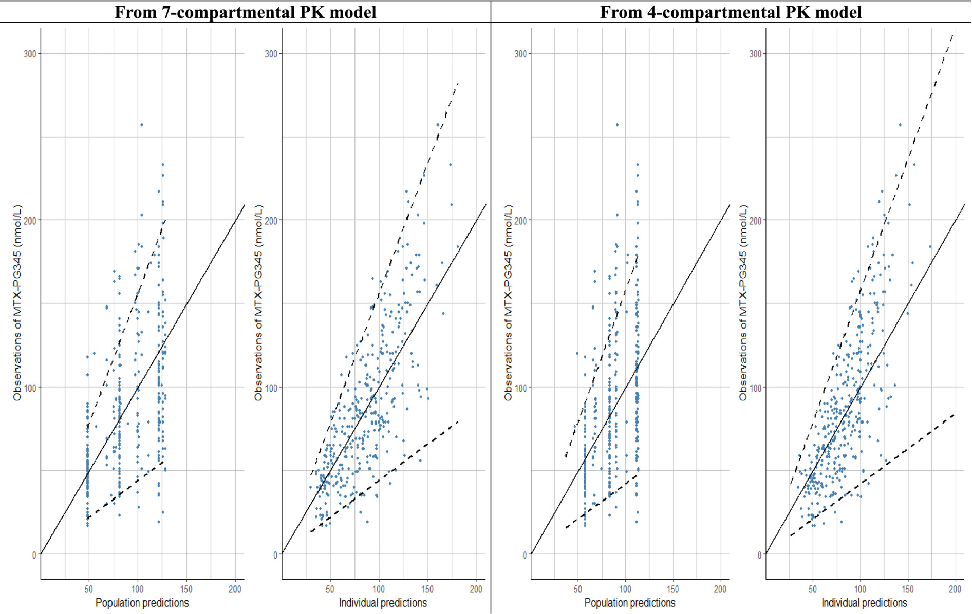
Pharmacokinetic‐pharmacodynamic modelling and simulation of methotrexate dosing in patients with rheumatoid arthritis
Brit J Clinical Pharma, First published: 05 July 2024, DOI: (10.1111/bcp.16158)
Notes:
Observation vs. prediction plot of methotrexate polyglutamate3–5 inside erythrocytes (ery‐MTX‐PG3–5) derived from seven‐compartmental pharmacokinetic (PK) model and four‐compartmental PK model. Solid blue dots are the sum of observed ery‐MTX‐PG3–5 concentrations. Black solid lines represent the identity line. Black dashed lines represent the 90% prediction interval.
IF THIS IMAGE HAS BEEN PROVIDED BY OR IS OWNED BY A THIRD PARTY, AS INDICATED IN THE CAPTION LINE, THEN FURTHER PERMISSION MAY BE NEEDED BEFORE ANY FURTHER USE. PLEASE CONTACT WILEY'S PERMISSIONS DEPARTMENT ON PERMISSIONS@WILEY.COM OR USE THE RIGHTSLINK SERVICE BY CLICKING ON THE 'REQUEST PERMISSIONS' LINK ACCOMPANYING THIS ARTICLE. WILEY OR AUTHOR OWNED IMAGES MAY BE USED FOR NON-COMMERCIAL PURPOSES, SUBJECT TO PROPER CITATION OF THE ARTICLE, AUTHOR, AND PUBLISHER.

