Slide 1
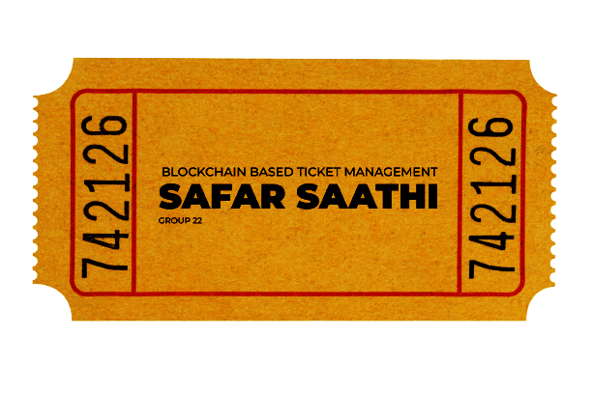
CS731
COURSE PROJECT
Aakarsh Mittal (200002)
Kuldeep Singh Chouhan (200530)
Sandeep Kumar Bijarnia (200856)
Yash Raj Mittal (201148)

Slide 2

Introduction
Safar Saathi is an online ticket management system powered by Ethereum smart contracts.
Its user-friendly web platform allows publishers to add transportation of various modes and publish tickets effortlessly and consumers to purchase them and also provides cancellation feature.

Slide 3




Tech Stack & Installation
CS731_workspace GitHub Repository

Slide 4
Client Roles
Publisher | Buyer
Can publish transportation events | Buy and download a ticket from available options
Recover money, collected from the closed events | Ticket cancellation
Buyer’s privileges | Profile update and deletion
Anonymous account
Verification through physical tickets

Slide 5
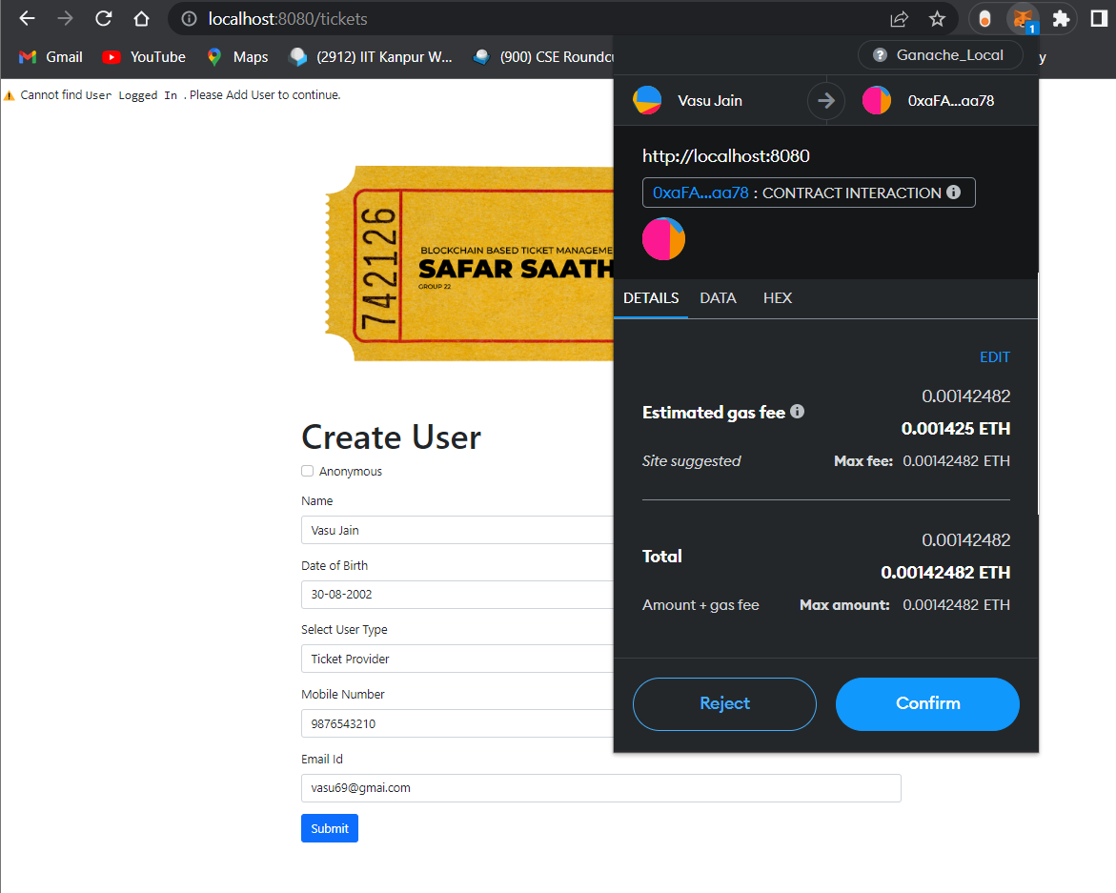
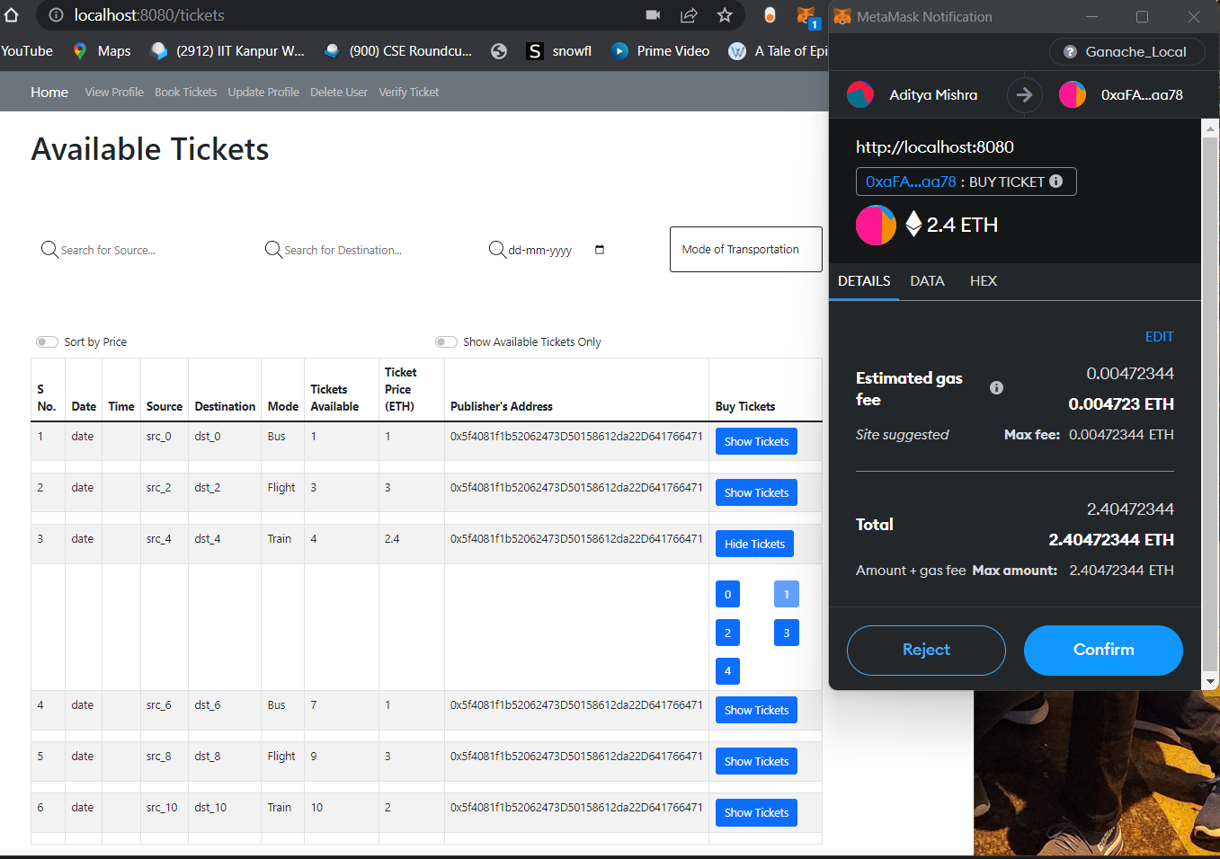
Role: Publisher & Buyer
Logging in Viewing and booking available tickets

Slide 6
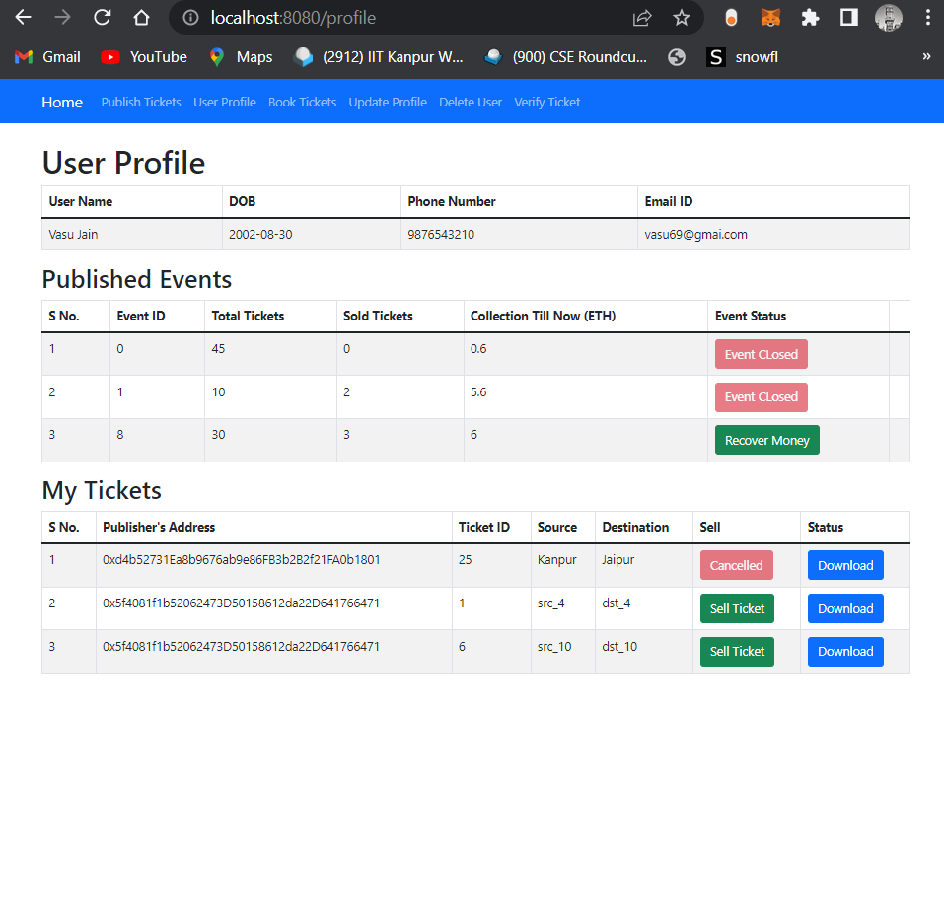
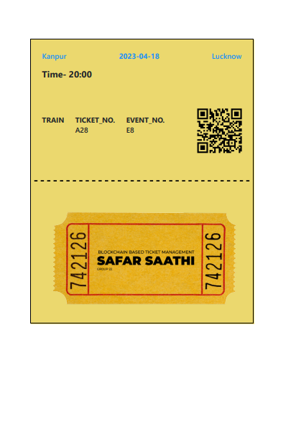
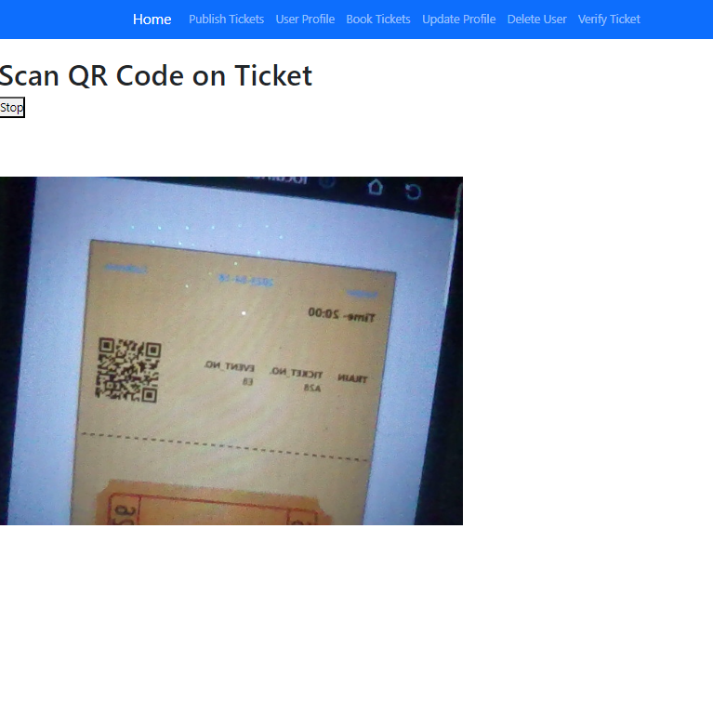
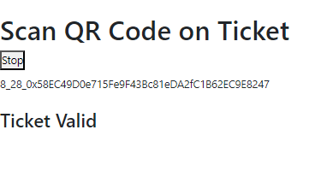
Role: Publisher & Buyer
Profile Page Printable Tickets Ticket Verification

Slide 7
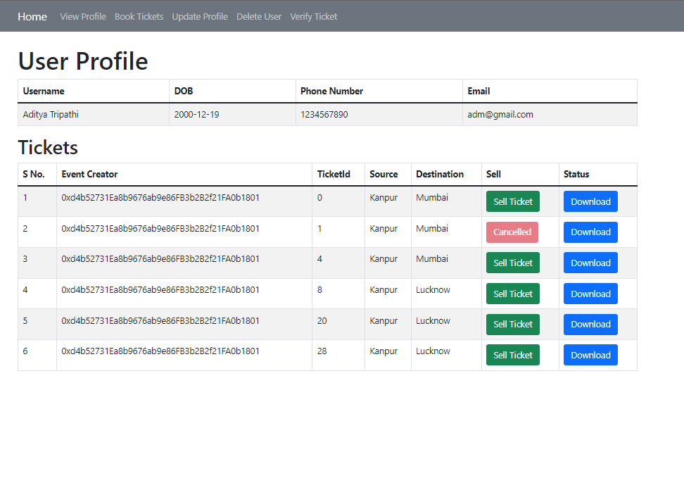
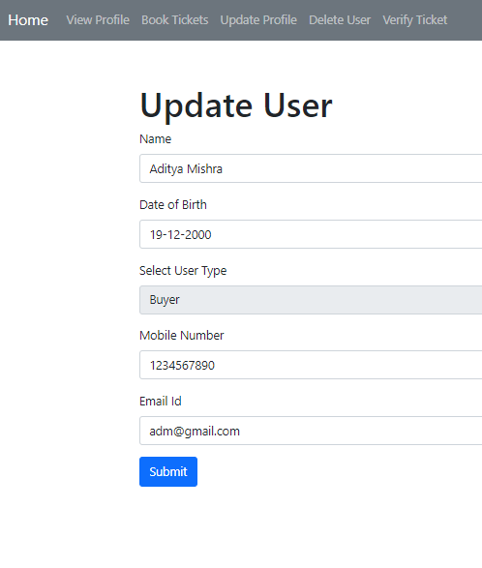
Role: Publisher & Buyer
Tickets cancellation Update Profile

Slide 8
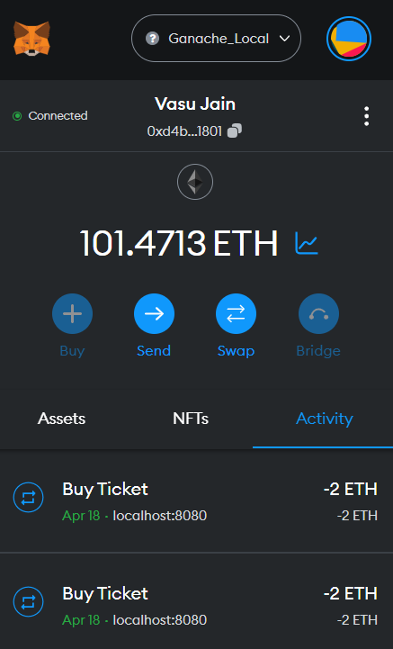
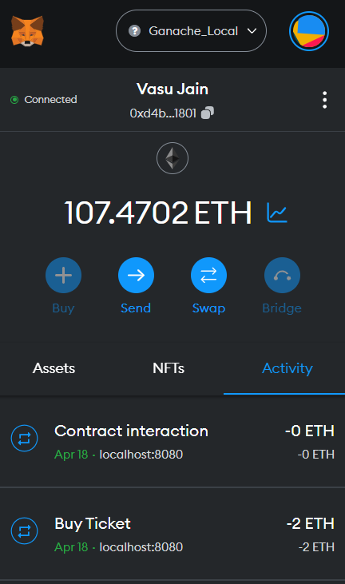
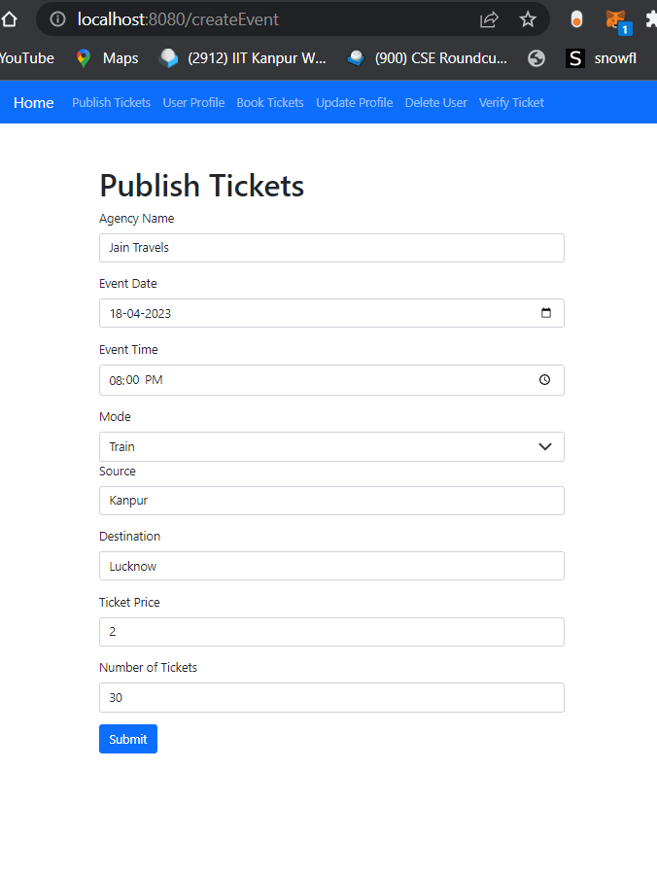
Role: Publisher Only
Closure of events Transfer the collected funds Publish tickets

Slide 9

Features
As tested, each publisher can easily make 50 events with 50 tickets
100 users creation were tested, were 50 were publishers and 50 were buyers
Integrated with MetaMask for easy payment in ETH
Auto login with MetaMask wallet
A user friendly interface showcasing all the available tickets, with sorting by price and filtering by source, destination, mode and date of travel

Slide 10

Features
Printable and verifiable tickets for offline purchase
Ticket verification through QR code and scanner
Dynamic prices, with max price being 1.5x(initial price)
User friendly creation, updating and deletion of user profile
Anonymous profile for fast and secure buying and selling
Ticket cancellation with 60% refund
Off-chain storage of user details

Slide 11

What for 2.0?
Test-net deployment
Better on-chain & off-chain data storage
Automated user creation with each having a unique address
Dealing with ‘price gouging’ from sellers end

Slide 12
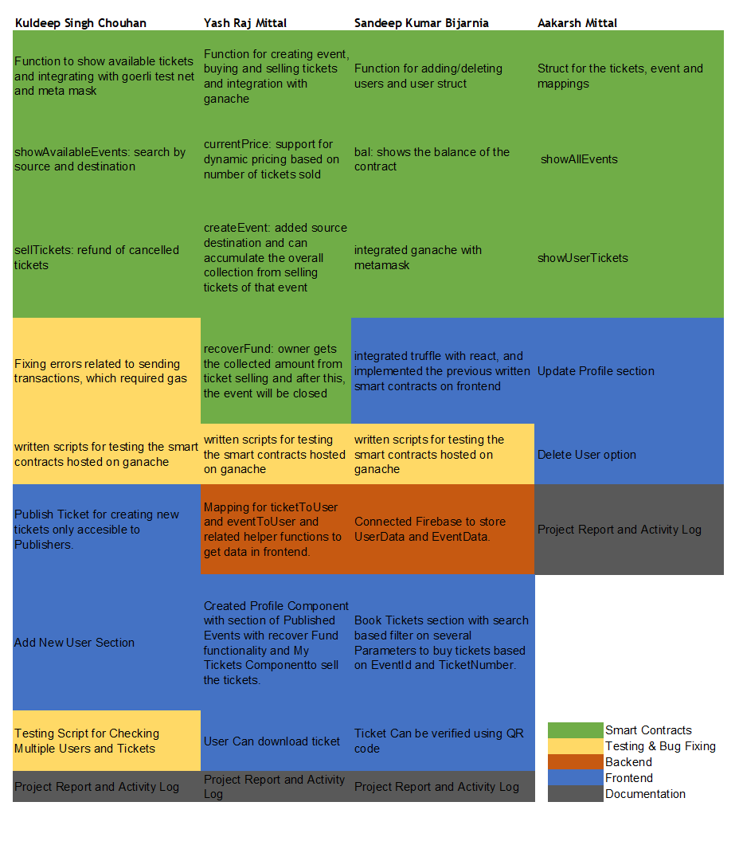

Work
Distribution
Complete Activity Log

Slide 13

Thank You!

