Slide 1

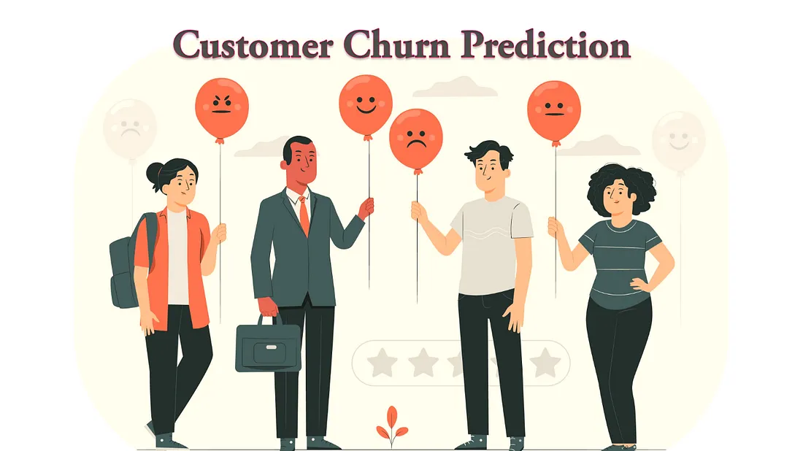

Slide 2
Problem Overview
🎯 Problem statement
Customer retention is a key metric in the telecom industry that measures how well they keep the subscribers from switching to other competitor providers. The purpose of this analysis is to identify the factors that contribute to customer churn and make a predictive model that can forecast if the customers are likely to leave.
🔍 Why is it important to solve?
Customer churn data is imperative for businesses to identify customers likely to leave and take proactive steps to reduce their churn rate. Churn analysis will help to find friction points and improve customer retention.

Slide 3
Model Outcomes
Customer churn prediction is typically a Supervised Learning (Classification) problem because we have historical customer data with labeled outcomes (churned or not churned).
Classification Models
Dummy Classifier (Baseline Model)
Logistic Regression
Decision Tree
Random Forest
Gradient Boosting (XGBoost)
Support Vector Machine (SVM)
Neural Networks (Deep Learning)

Slide 4
Data Overview
Dataset
The dataset used is a Telecom churn dataset (customer_churn_dataset-training-master.csv and customer_churn_dataset-testing-master.csv) from Kaggle.
Features
Customer ID: Unique identifier for a customer
Age: Age of the customer
Gender: Gender of the customer
Tenure: Duration for which a customer has been using the company's products/services
Usage Frequency: No of times the customer has used the services in the last month
Support Calls: No of calls the customer has made to support in the last month
Payment Delay: No of days the customer has delayed their payment in the last month
Subscription Type: Type of subscription chosen by the customer
Contract Length: Contract duration that the customer has signed with the company
Total Spend: Total amount the customer has spent on the company's products or services
Last Interaction: No of days since the customer had the last interaction with the company
Churn: Binary label indicating whether a customer has churned (1) or not (0)

Slide 5
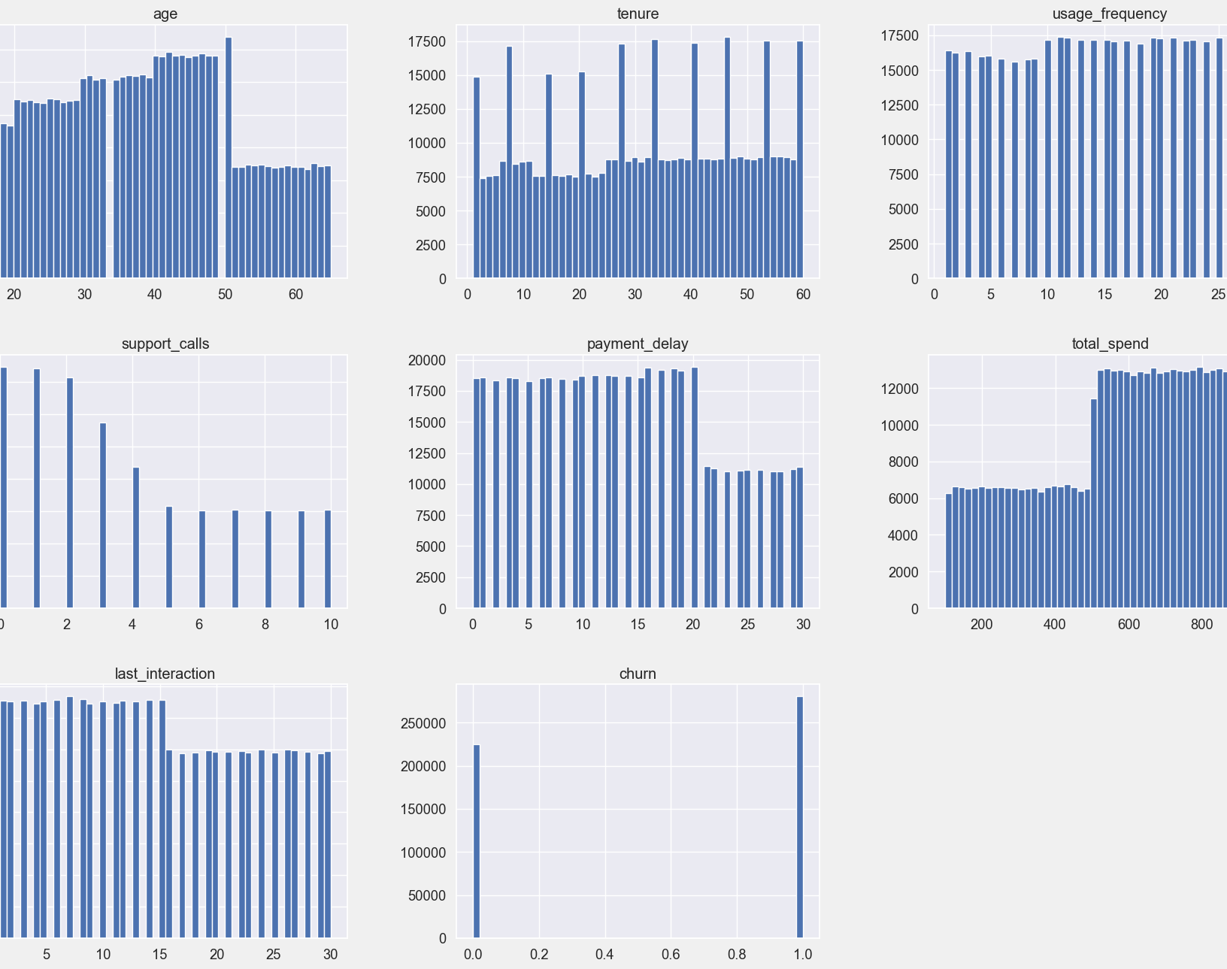
Visualizations
age: Fair to say that the data is evenly distributed, with some peaks in the age group of 30-50 and a sharp decline over 60.
tenure: The service usage duration is evenly spread from 0 to 60 months. A significant number of customers have used the service for more than 30 months.
usage_frequency: Most customers maintain a stable usage pattern.
support_calls: The number of support calls gradually decreases between 0 to 10 times. Most customers make few support calls (with the majority calling fewer than 3 times). There are a few cases where customers call very frequently.
payment_delay: Most customers have payment delays (between 0 to 20 days), but the delay is significant (more than 20 days) for certain number of customers.
total_spend: Total spending lies between 0 to 1000. Most customers spend more than 500.
last_interaction: Most customers have interacted between 0 to 14 days, but there are notable number of customers who interacted between 16-30 days.

Slide 6
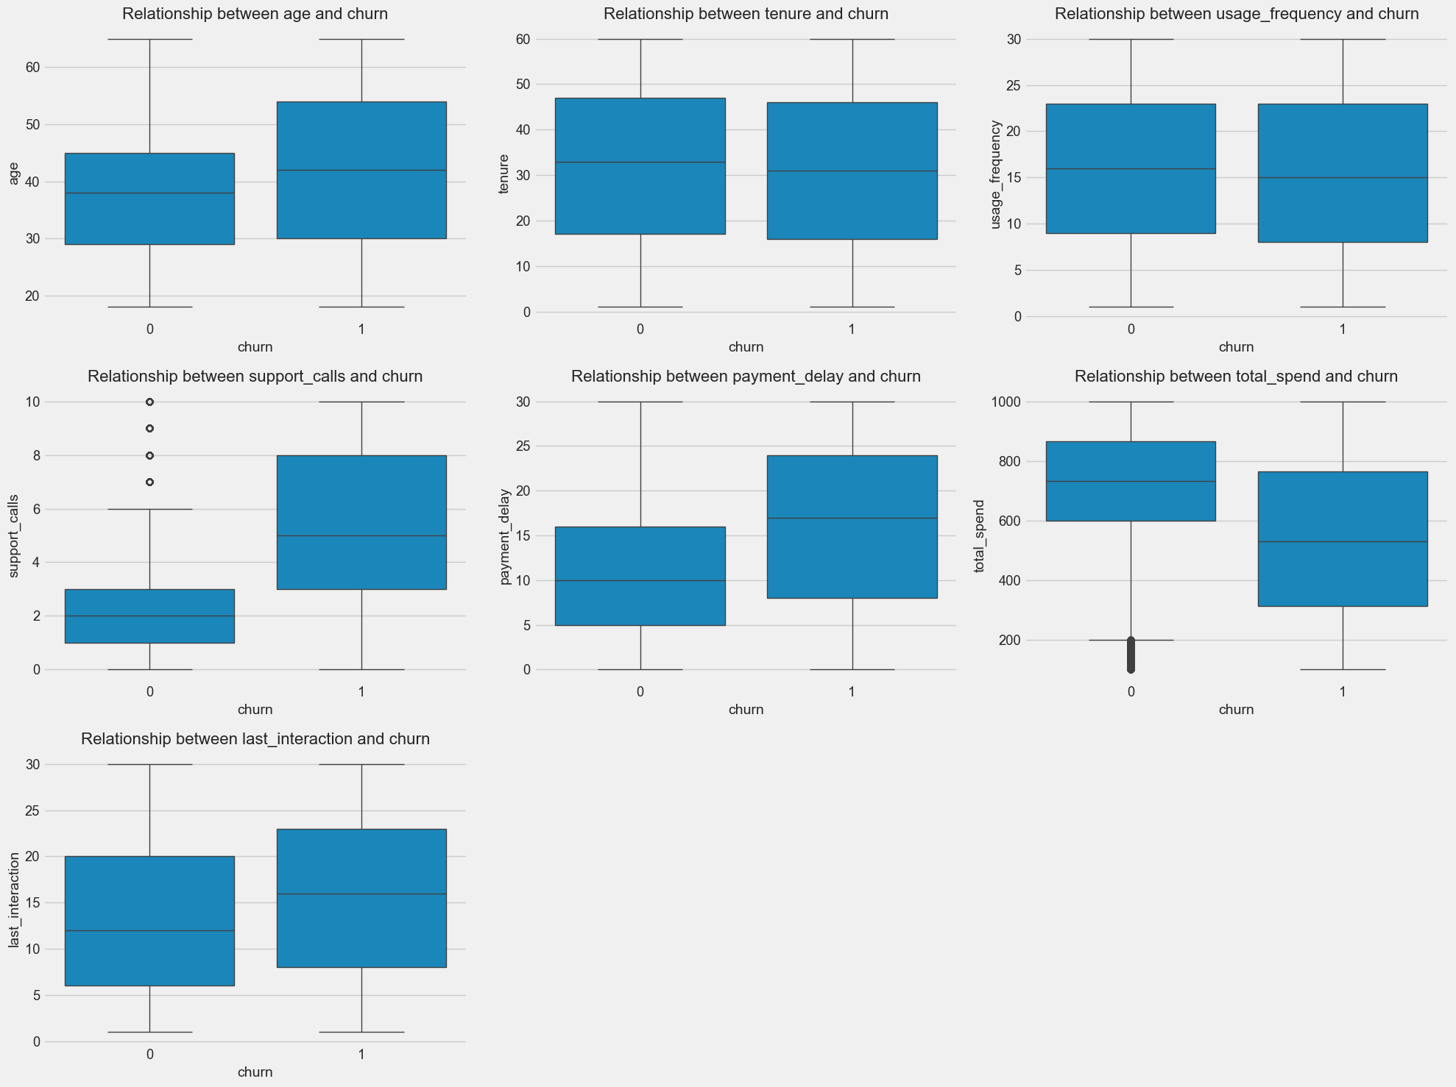
Visualizations (contd.)
The Churn group has a wider age distribution. The median age is around 45 years old for churn group whereas it is around 40 for non-churn group. Though older customers (45+ years old) tend to churn, it may not be the deciding factor. Age should be considered with other factors.
Customers who use the service less or have less recent interaction are more likely to churn as they may be dissatisfied with the service/support.
Customers who have higher payment delay or low spending are likely to churn.
Customers who make higher support calls are most likely to churn. Churning customers make more than 5 support calls.
Tenure does not seem to have any direct relationship with churn

Slide 7
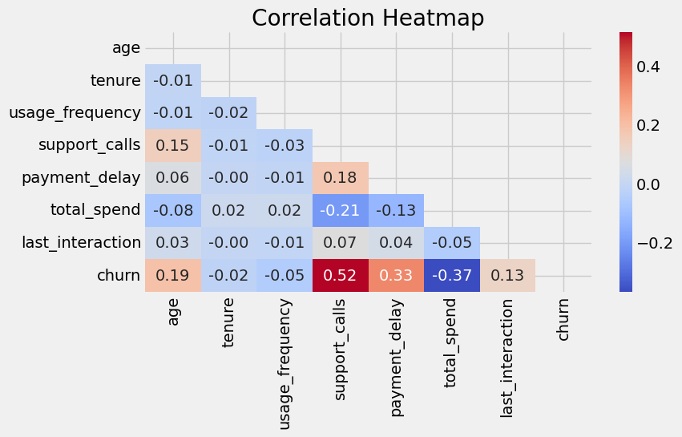
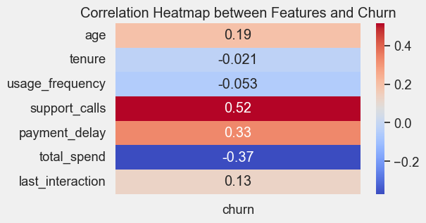
Visualizations (contd.)
Support calls and payment delay have strong correlation with churn

Slide 8
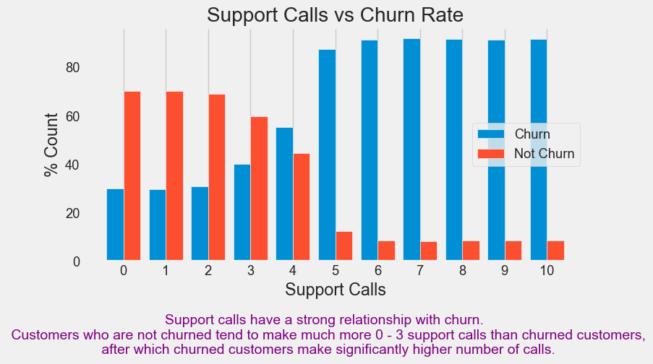
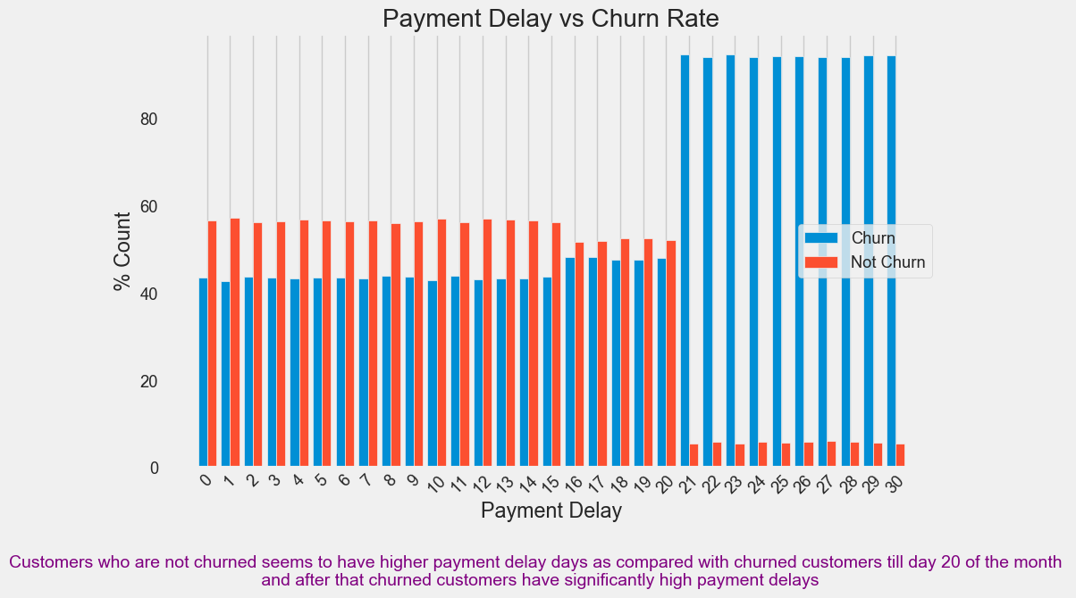
Visualizations (contd.)

Slide 9
Data cleaning, preprocessing & preparing
Data Cleaning
Clean the column names if required
Duplicate Check
Missing Value Check
Drop unwanted column(s)
Data split
Used train_test_split() from sklearn.model_selection to split your dataset into training and testing sets with 80-20 split and random_state=42
Data Preprocessing
Created preprocessor pipeline using column transformer
SimpleImputer() using mean
StandardScaler() for numeric columns
OneHotEncoder() for categorical columns
🎯 Outcome is clean and scaled data ready for Modeling

Slide 10
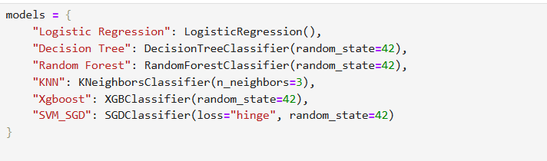
Classification Models
List of models used for training

Slide 11
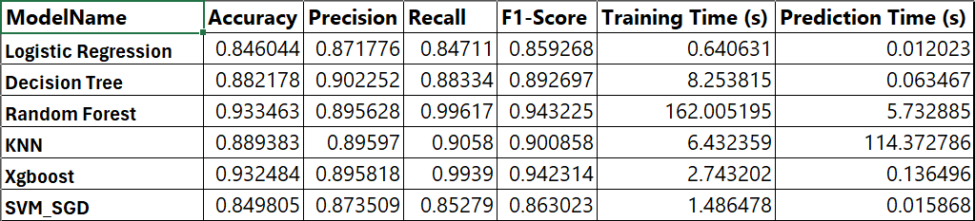
Evaluations
Random forest and XGBoost have higher and comparable recall and F1-score
The score for Decision Tree and KNN comes next

Slide 12
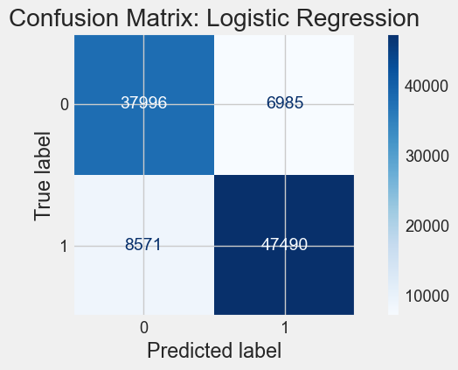
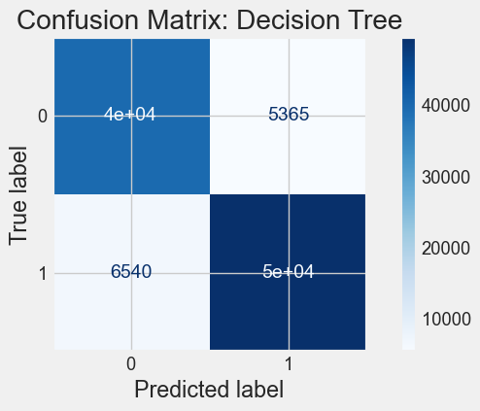
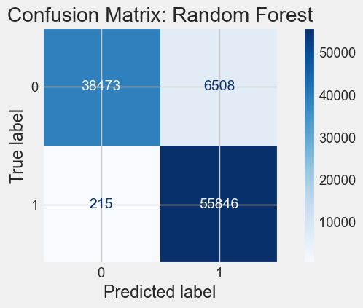
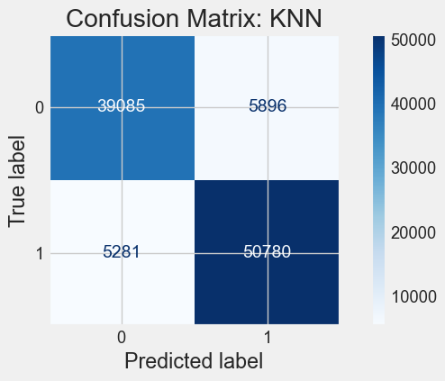


Confusion Matrices

Slide 13
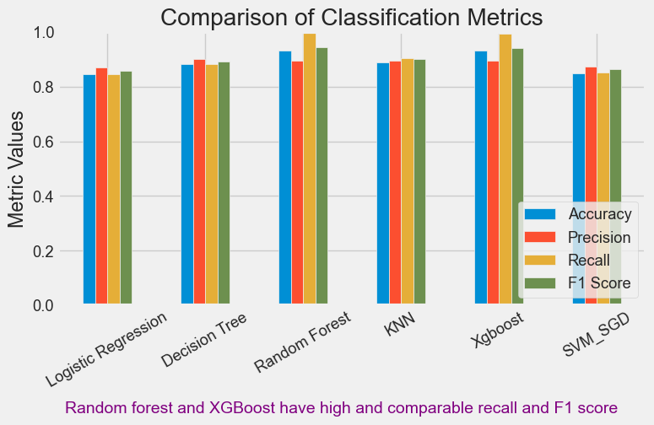
Comparison of Classification Metrics

Slide 14
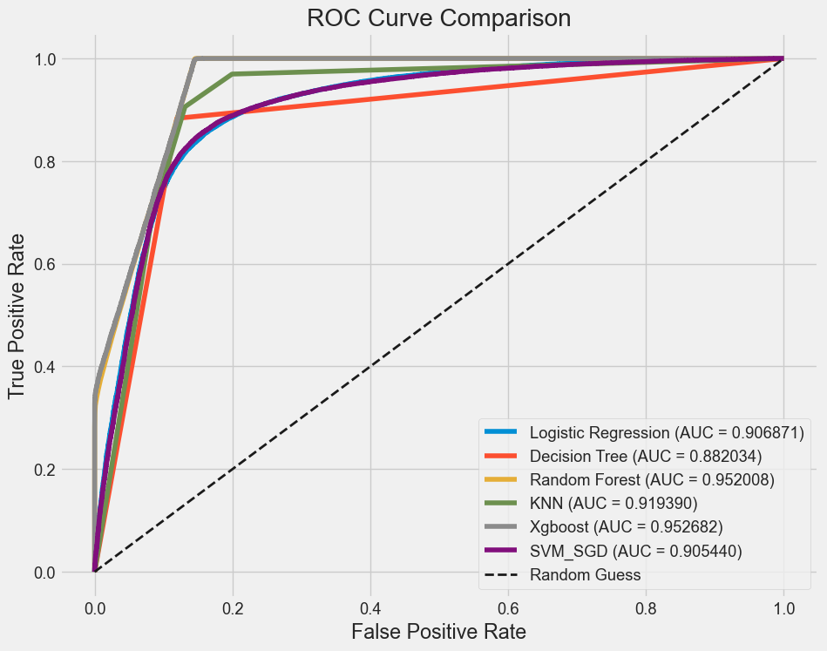
ROC Curve Analysis
Random Forest and XGBoost ROC curves are closer to top left corner showing better model performance.
Higher AUC value (closer to 1) for Random forest and XGBoost indicates they are better classifier in this case.

Slide 15

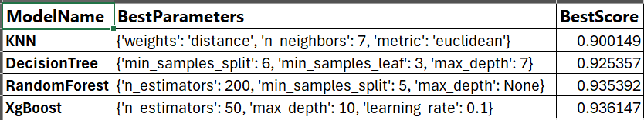
Hyperparameter tuning
Hyperparameter tuning optimizes model performance by finding the best values for parameters like learning rate, depth, and number of estimators etc.
Grid Search: Try all possible combinations of a predefined set of hyperparameters.
Random Search: Randomly sample hyperparameters within a defined range. It is faster than grid search for large search spaces.

Slide 16
Recommendation & Conclusion
The Random Forest model has demonstrated the best overall metrics in this analysis, making it a reliable tool for predicting the churn of customer.
XGBoost also have great metrices and is comparable to Random forest.
The model performs good and makes correct predictions in most cases.
While the model is performing good, there is still a significant rate of false negatives, which means it is not correctly identifying some churns.
Using hyperparameter tuning improved the scores.

Slide 17
Challenges and overcome
SVM was not completing processing. Tried with changing the kernel to linear with other options and still didn't help. Then tried using SGD classifier and it worked.
Used RandomizedSearch for performance in hyperparameter tuning as GridSearch was taking way longer time.

Slide 18

Next Steps…
Use Neural network to see if we can get better results.
Do SHAP analysis to do more interpretation on the models.

