Slide 1


GIRIJANANDA CHOWDHURY INSTITUTE OF MANAGEMENT AND TECHNOLOGY, AZARA
DEPARTMENT OF COMPUTER SCIENCE AND ENGINEERING
GROUP MEMBERS:
NITU ALAM – 190310007031 (LEAD)
MANAS PRATIM DUTTA - 19031000702
PROJECT GUIDE:
RITUSHREE DUTTA
ASSISTANT PROFESSOR,CSE,GIMT
TITLE:-PARKINSON’S DISEASE DETECTION USING MACHINE LEARNING

Slide 2
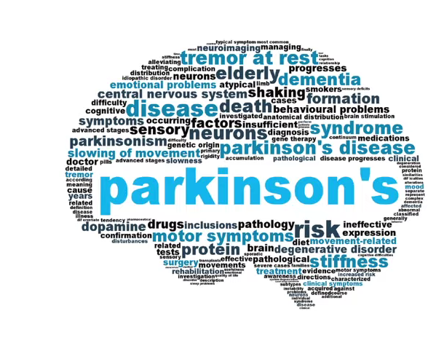
INTRODUCTION
What is Parkinson’s Disease?
Parkinson’s Disease is a progressive nervous system disorder that affects movement leading to shaking, stiffness, and difficulty with walking, balance, and coordination. Parkinson’s symptoms usually begin gradually and get worse over time.
It happens mostly to people over 50 years , but nowadays it can happen to people in their middle age i.e 30-50 years

Slide 3
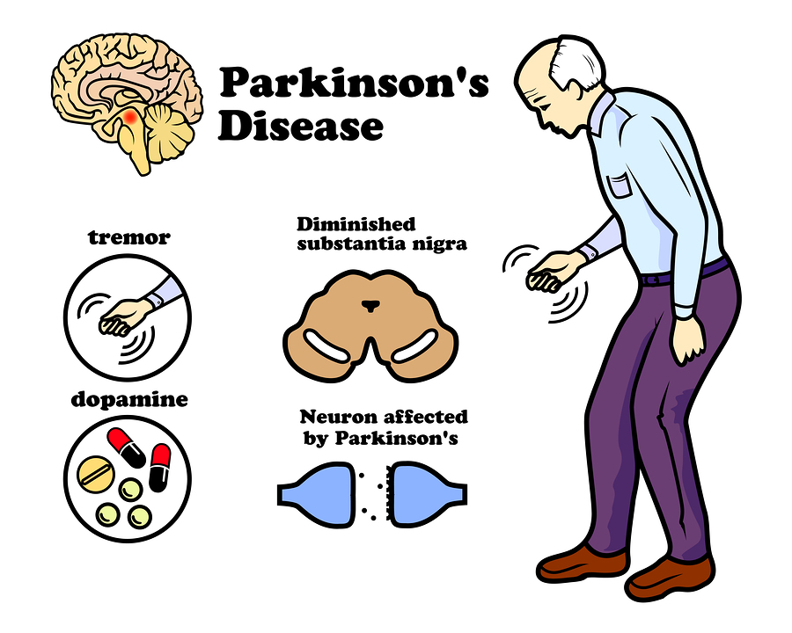
PROBLEM STATEMENT
Early Detection of Parkinson’s Disease.

Slide 4

AIM
The main aim is to discriminate healthy people from those with Parkinson’s Disease by classification using Support Vector Model (SVM) Algorithm.

Slide 5


OBJECTIVE
To build a model to accurately detect the presence of Parkinson’s disease in an individual and then deploy our Machine Learning model as a web app using Streamlit library of Python.

Slide 6
LITERATURE SURVEY
S.NO | TITLE | AUTHORS | TECHNIQUES
1 | Diagnosis of Parkinson’s disease using Artificial Neural network | Anila M and Dr G Pradeepini | ANN, Random Forest, KNN, SVM, XGBoost
2 | Machine Learning-based Approaches for Prediction of Parkinson’s Disease | Arvind Kumar Tiwari | Minimum Redundancy Maximum Relevance Feature Selection Algorithms
3 | A deep learning approach for prediction of Parkinson’s disease progression | Afzal Hussain Shahid and Maheshwari Prasad Singh | PCA based DNN model
4 | Prediction of Parkinson’s Disease at Early Stage using Big Data Analytics | Siva Sankara Reddy Donthi Reddy and Udaya Kumar Ramanadham | Hadoop, Hive, R Programming, MapReduce, PIG, Zookeeper, HBase, Cassandra, Mahout
5 | Performance Analysis of Classification algorithms on Parkinson’s Dataset with Voice Attributes | T. Swapna, Y. Sravani Devi | Naïve Bayes, Random Forest, Neural Networks, Decision Trees, AdaBoost, SVM, KNN
6 | Impact of Patients | M. Abdar and M. Zomorodi-Moghadam | SVM and Bayesian Network

Slide 7
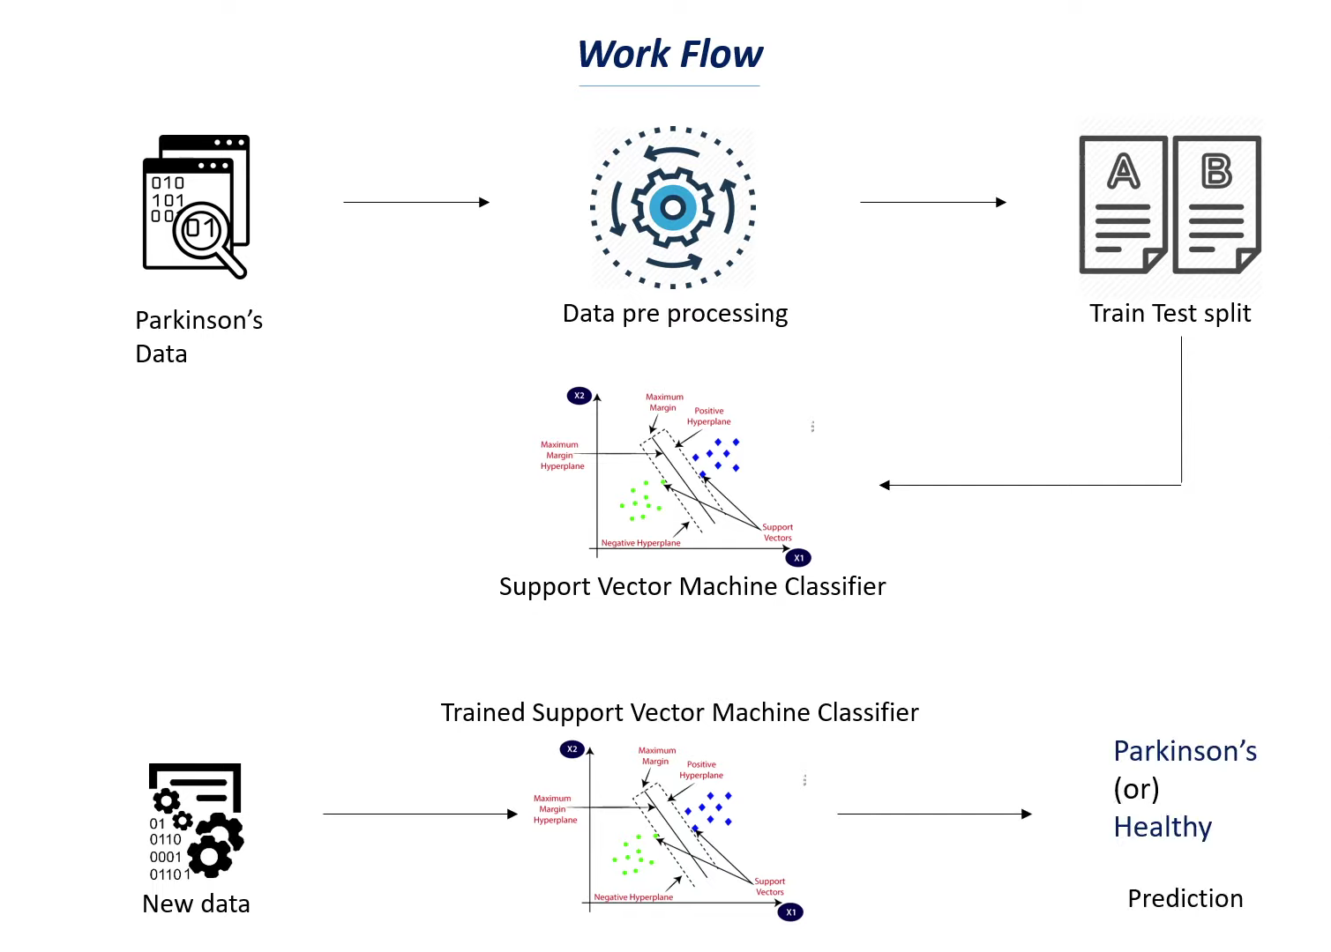
METHODOLOGY

Slide 8
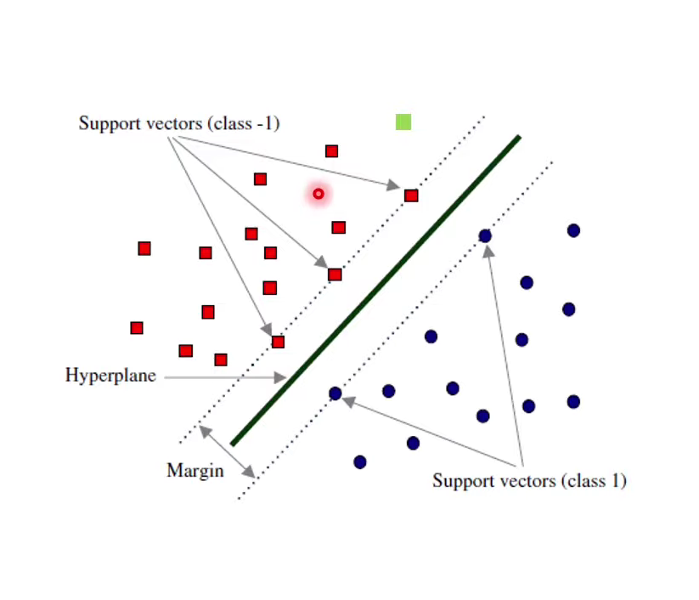
MACHINE LEARNING MODEL USED AND ITS INTUITIONS:
SUPPORT VECTOR MACHINE (SVM) CLASSIFIER
Supervised learning model
Uses for both Classification and Regression
Hyperplane
Support Vectors

Slide 9
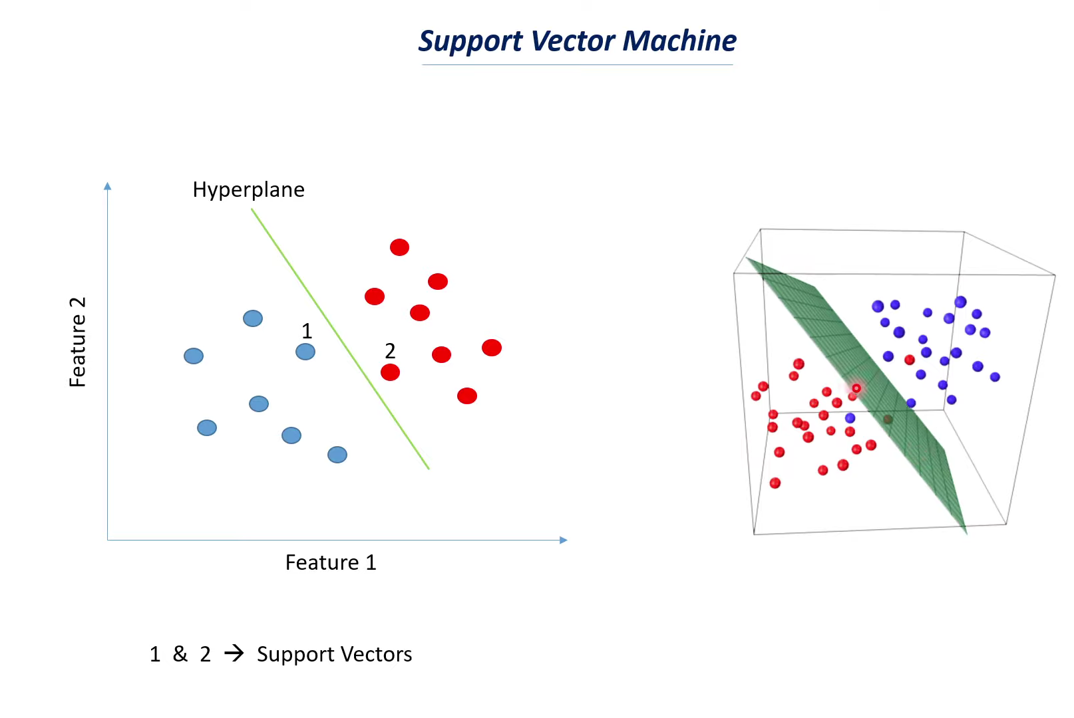

Slide 10
DATASET USED:
Title: Parkinson’s Disease Data Set
Abstract: Oxford Parkinson's Disease Detection Dataset
Data Set Characteristics: Multivariate
Number of Instances: 197
Area: Life
Attribute Characteristics: Real
Number of Attributes: 23
Associated Tasks: Classification
Missing Values? N/A

Slide 11
DATA SET INFORMATION
This dataset is composed of a range of biomedical voice measurements from
31 people, 23 with Parkinson's disease (PD). Each column in the table is a
particular voice measure, and each row corresponds one of 195 voice
recording from these individuals ("name" column). The main aim of the data
is to discriminate healthy people from those with PD, according to "status"
column which is set to 0 for healthy and 1 for PD.

Slide 12
ATTRIBUTE INFORMATION
name - ASCII subject name and recording number
MDVP:Fo(Hz) - Average vocal fundamental frequency
MDVP:Fhi(Hz) - Maximum vocal fundamental frequency
MDVP:Flo(Hz) - Minimum vocal fundamental frequency
MDVP:Jitter(%),MDVP:Jitter(Abs),MDVP:RAP,MDVP:PPQ,Jitter:DDP - Several
measures of variation in fundamental frequency
MDVP:Shimmer,MDVP:Shimmer(dB),Shimmer:APQ3,Shimmer:APQ5,MDPV:APQ,Shimmer:DDA - Several measures of variation in amplitude
NHR,HNR - Two measures of ratio of noise to tonal components in the voice
status - Health status of the subject (one) - Parkinson's, (zero) - healthy
RPDE,D2 - Two nonlinear dynamical complexity measures
DFA - Signal fractal scaling exponent
Spread 1, Spread 2 ,PPE - Three nonlinear measures of fundamental frequency variation

Slide 13
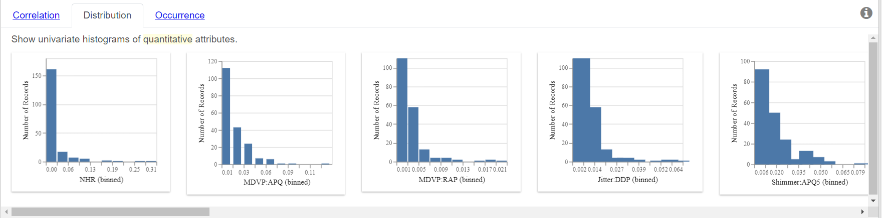
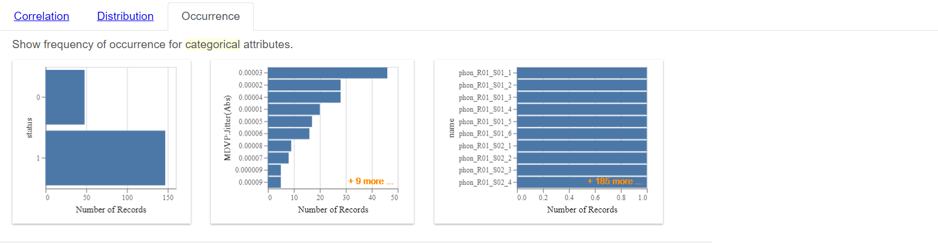

Slide 14
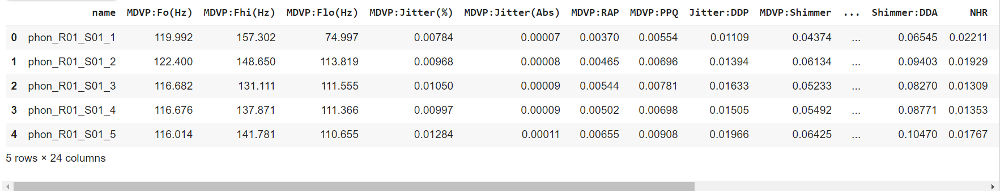
STANDARDIZATION
As we can see that the data points in our dataset have different ranges. If we fit this data in our model we will not a perfect prediction that we desired, so we will standardised our data by using StandardScaler function to get value of data in the same ranges without changing the actual meaning.

Slide 15
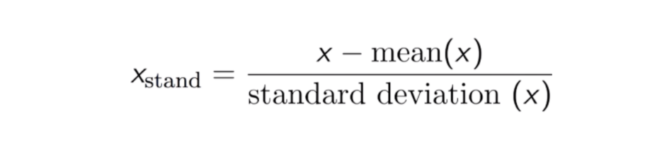
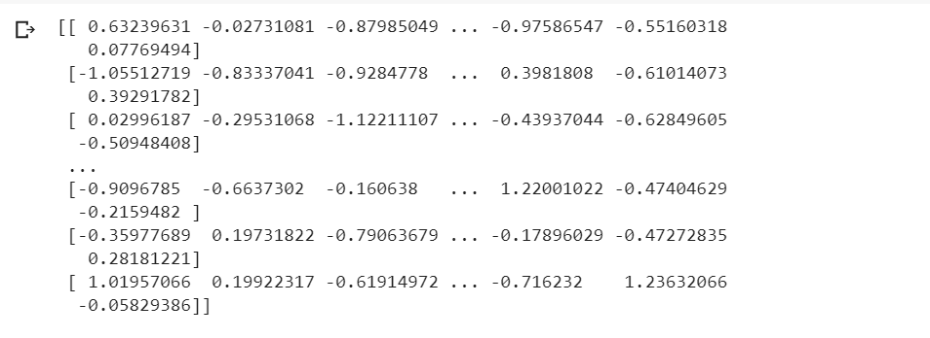

Slide 16
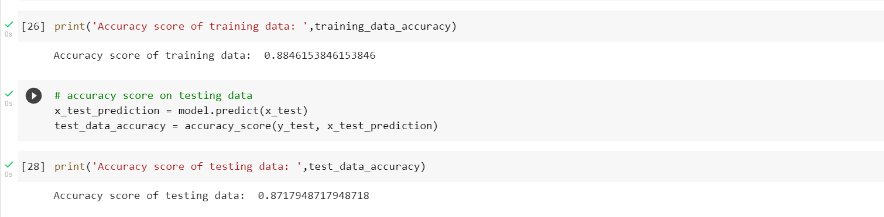
ACCURACY PREDICTION
As we can see we are using accuracy_score function from sklearn metrics to find the accuracy of our trained data and test data. There is no Overfitting and Underfitting in our model as there is not much difference between the accuracy of trained and test data, so our Machine learning model can accurately predict the desired result and thus performed well.

Slide 17
TOOLS AND TECHNOLOGIES USED
STREAMLIT:
Streamlit is an open-source app framework in python language. It helps us create beautiful web apps for data science and machine learning in a little time. It is compatible with major python libraries such as scikit-learn, Keras, PyTorch, latex, NumPy, pandas, matplotlib, etc.
PYTHON:
Python is an interpreted, object-oriented, high-level programming language with dynamic semantics. Its high-level built-in data structures, combined with dynamic typing and dynamic binding, make it very attractive for Rapid Application Development, as well as for use as a scripting or glue language to connect existing components

Slide 18
SPYDER:
Python is an interpreted, object-oriented, high-level programming language with dynamic semantics. Its high-level built-in data structures, combined with dynamic typing and dynamic binding, make it very attractive for Rapid Application Development, as well as for use as a scripting or glue language to connect existing components.
GOOGLE COLABORATORY:
Colab is a free Jupyter notebook environment that runs entirely in the cloud. Most importantly, it does not require a setup and the notebooks that you create can be simultaneously edited by your team members - just the way you edit documents in Google Docs. Colab supports many popular machine learning libraries which can be easily loaded in your notebook.

Slide 19
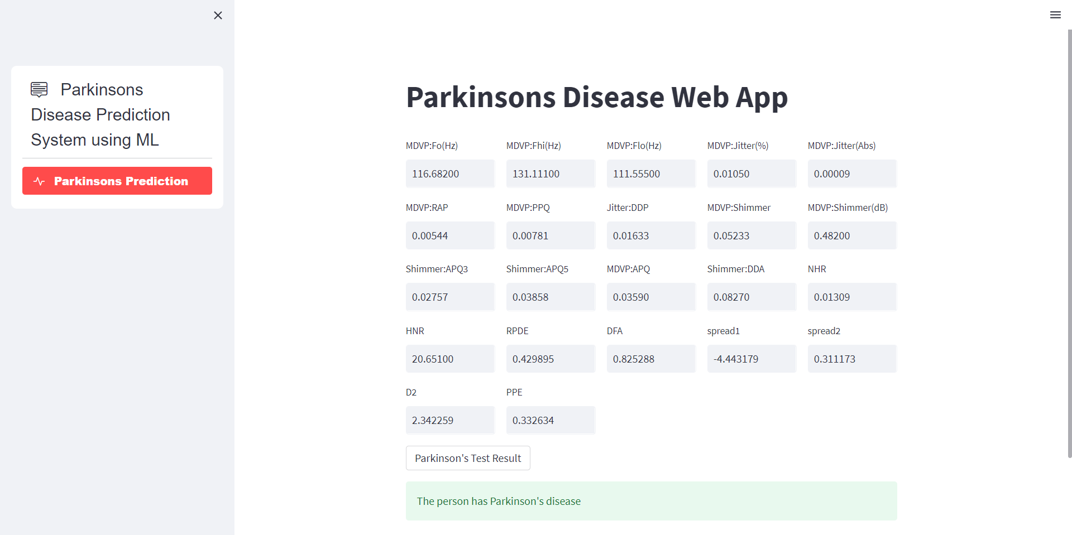
DEPLOYING OUR MACHINE LEARNING MODEL AS A WEB APP

Slide 20
CONCLUSION
At the end we build a Predictive/Detective system which is efficient ,that means it can predict or detect the person having Parkinson’s disease at the early stage accurately, so that the person having Parkinson’s disease can take some remedies to overcome the disease by a web app using streamlit.

Slide 21
FUTURE WORK:
In future, these models can be trained with different datasets that have best features and can be predicted more accurately. If the accuracy rate increases, it can be used by the laboratories and hospitals so that it is easy to predict in early stages. This models can be also used with different medical and disease datasets. In future the work can be extended by building a hybrid model that can find more than one disease with an accurate dataset and that dataset has common features of two diseases. In future the work can extended to build a model that may extract more important features among all features in the dataset so that it produces more accuracy.

Slide 22
REFERENCES
https://www.researchgate.net/publication/261257424_Parkinson%27s_disease_Recent_advances
https://www.researchgate.net/publication/332878981_Research_Update_on_Parkinson%27s_Disease
https://www.ncbi.nlm.nih.gov/books/NBK536722/
https://www.researchgate.net/publication/323583455_Parkinson%27s_disease_A_review
https://www.researchgate.net/publication/357448942_THE_PARKINSON%27S_DISEASE_DETECTION_USING_MACHINE_LEARNING_TECHNIQUES
https://www.researchgate.net/publication/359711136_Parkinson%27s_Disease_Detection_Analysis_through_Machine_Learning_Approaches
https://healthprep.com/parkinsons-disease/symptoms-parkinsons-disease/?utm_source=bing&utm_medium=search&utm_campaign=566134433&utm_content=1178677477741158&utm_term=what%20is%20parkinson%27s&msclkid=c55acc6458c11ccd4d24aff1a811d41a

Slide 23
Thank You!

