Slide 1
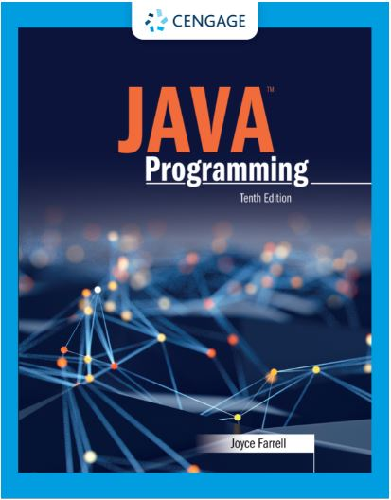
Java Programming, 10e
Chapter 02: Using Data
Joyce Farrell, Java Programming, 10th Edition. © 2023 Cengage. All Rights Reserved. May not be scanned, copied or duplicated, or posted to a publicly accessible website, in whole or in part.

Slide 2
Chapter Objectives
By the end of this chapter, you should be able to:
02.01 Declare and use constants and variables
02.02 Use integer data types
02.03 Use the boolean data type
02.04 Use floating-point data types
02.05 Use the char data type
02.06 Use the Scanner class to accept keyboard input
02.07 Use the JOptionPane class to accept GUI input
02.08 Perform arithmetic using variables and constants
02.09 Describe type conversion
Notes:
Instructions:
Briefly review with students the major concepts you will be covering during this class. There is one objective for every major A-Head section of the chapter.

Slide 3
2.1 Declaring and Using Constants and Variables (1 of 8)
Constant
Cannot be changed while program is running
Literal constant
Value taken literally at each use
Numeric constant
As opposed to a character/string constant
Unnamed constant
No identifier is associated with it

Slide 4
2.1 Declaring and Using Constants and Variables (2 of 8)
Variable
A named memory location
Used to store a value
Can hold only one value at a time
Its value can change
Data type
A type of data that can be stored
How much memory an item occupies
What types of operations can be performed on data

Slide 5
2.1 Declaring and Using Constants and Variables (3 of 8)
Primitive type
A simple data type
Examples: byte, short, int, long, float, double, char, boolean
Reference types
More complex data types
Examples: System, Scanner

Slide 6
2.1 Declaring and Using Constants and Variables (4 of 8)
Variable declaration
Statement that reserves a memory location
Includes:
Data type of variable
Identifier (variable’s name)
Optional assignment operator and value
Ending semicolon
Java is a strongly typed language
Camel casing example: lastName

Slide 7
2.1 Declaring and Using Constants and Variables (5 of 8)
Assignment operator
The equal sign (=)
The value to the right is assigned to the variable on the left
Initialization
An assignment made when declaring a variable
Assignment
An assignment made after a variable is declared
Associativity
The order in which operands are used with operators
lvalue (left) and rvalue (right)

Slide 8
2.1 Declaring and Using Constants and Variables (6 of 8)
Uninitialized variable
Declared within a method but no value assigned
Garbage value is unknown value
Named constant
Also known as symbolic constant
Has data type, name value
Preceded by keyword final
Can only be assigned a value once
Identifiers are uppercase and use underscores

Slide 9
2.1 Declaring and Using Constants and Variables (7 of 8)
Scope
The area in which a data item is visible to a program, and in which you can refer to it using its simple identifier
A variable or constant is in scope from the point it is declared
Until the end of the block of code where the declaration lies

Slide 10
2.1 Declaring and Using Constants and Variables (8 of 8)
Concatenated
A numeric variable is concatenated to a String using the plus sign
The entire expression becomes a String
Use a dialog box to display values

Slide 11
2.2 Learning About Integer Data Types (1 of 1)
Integer
Whole number without decimal places
int, byte, short and long
If you attempt to assign a value too large for the data type of variable, the compiler issues an error message
If you choose a data type larger than you need, you waste memory.
Type | Minimum Value | Maximum Value | Size in Bytes
Byte | -128 | 127 | 1
short | -232,768 | 32,767 | 2
Int | -22,147,483,648 | 2,147,483,64 | 4
Long | -9,223,372,036,854,775,808 | 9,223,372,036,854,775,808 | 8

Slide 12
2.3 Using the boolean Data Type (1 of 1)
Boolean logic
Can hold only one of two values: true or false
Relational operator (comparison operator) compares two items
Operators with two symbols cannot have whitespace
More meaningful when a variable is used for one of both of the operands in a comparison

Slide 13
2.4 Learning About Floating-Point Data Types (1 of 1)
Floating-point number
Contains decimal positions
Floating-point data types
float (single-precision floating-point number)
double (double-precision floating-point number)
Significant digits
Refers to mathematical accuracy of a value
Table 2-4: Limits on floating-point values
Type | Minimum | Maximum | Size in Bytes
float | –3.4 * 10³⁸ | 3.4 * 10³⁸ | 4
double | –1.7 * 10³⁰⁸ | 1.7 * 10³⁰⁸ | 8

Slide 14
2.5 Using the char Data Type (1 of 4)
char data type
Holds any single character
Place constant character values within single quotation mark
char myMiddleInitial = 'M’;
Can be any letter (upper or lowercase), punctuation mark, or digit

Slide 15
2.5 Using the char Data Type (2 of 4)
String
A built-in class
Stores and manipulates character strings
String constants are written between double quotation marks
String firstName = “David”
Escape sequence
Begins with a backslash followed by a character
Represents a single nonprinting character

Slide 16
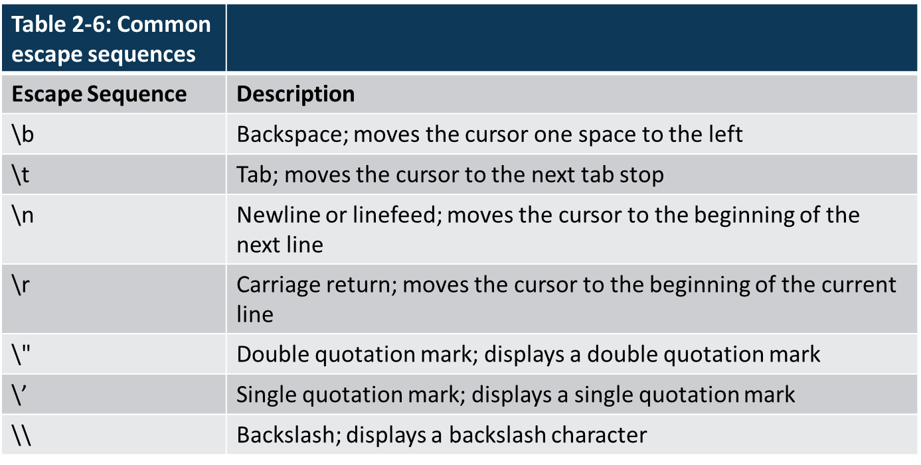
2.5 Using the char Data Type (3 of 4)

Slide 17
2.5 Using the char Data Type (4 of 4)
To produce console output on multiple lines in the command window:
Use the newline escape sequence within a single println() call
Use the println() method multiple times
Use text blocks
Text block
Multiline string literal
Avoids need for escape sequence to display output on multiple lines

Slide 18
2.6 Using the Scanner Class to Accept Keyboard Input (1 of 3)
System.in object
Standard input device
Normally the keyboard
Access using the Scanner class
Scanner object
Contains methods that retrieve values from input device called tokens
A token is a set of characters that is separated from the next set by whitespace

Slide 19
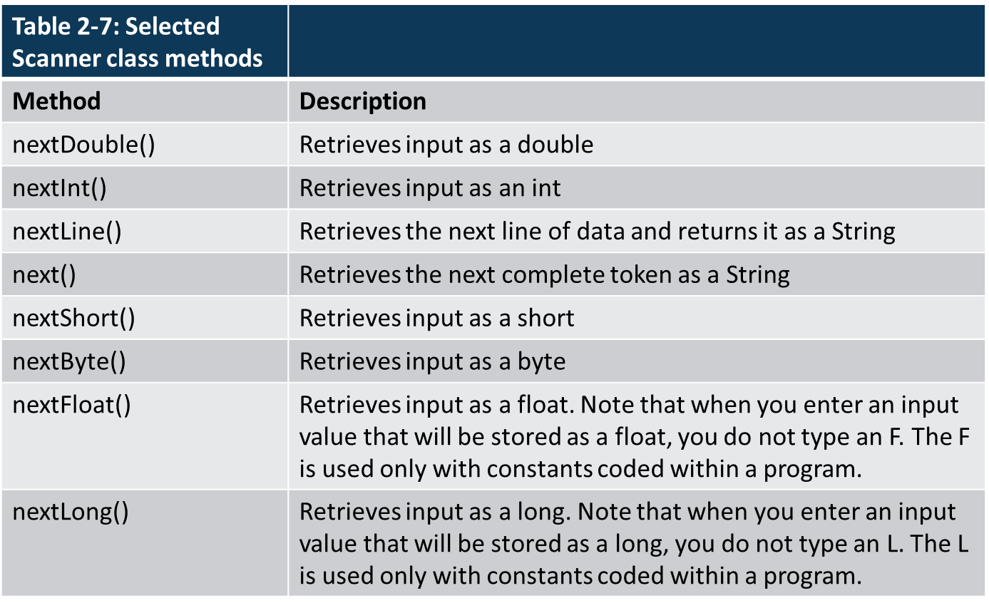
2.6 Using the Scanner Class to Accept Keyboard Input (2 of 3)

Slide 20
2.6 Using the Scanner Class to Accept Keyboard Input (3 of 3)
Pitfall: using nextLine()following one of the other scanner input methods
There is a problem when using one numeric Scanner class retrieval method or next()method before using the nextLine()method
Keyboard buffer
Location in memory that stores all keystrokes, including Enter
To avoid issues, add an extra nextLine()method call to retrieve the abandoned Enter key character after numeric or next() inputs

Slide 21
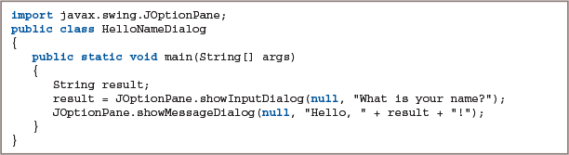
2.7 Using the JOptionPane Class to Accept GUI Input (1 of 6)
Input dialog box
InputDialog
Asks a question
Provides a text field in which the user can enter a response
Figure 2-27: The HelloNameDialog class

Slide 22
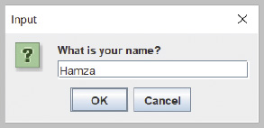
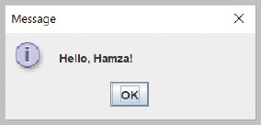
2.7 Using the JOptionPane Class to Accept GUI Input (2 of 6)
Figure 2-28: Input dialog box of the HelloNameDialog application
Figure 2-29: Output of the HelloNameDialog application

Slide 23
2.7 Using the JOptionPane Class to Accept GUI Input (3 of 6)
showInputDialog()
One version requires four arguments:
Parent component
Message
Title
Type of dialog box

Slide 24
2.7 Using the JOptionPane Class to Accept GUI Input (4 of 6)
Type-wrapper classes
Each primitive type has a corresponding class contained in the java.lang package
Include methods to process primitive type values

Slide 25
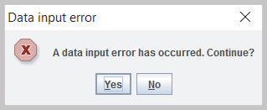
2.7 Using the JOptionPane Class to Accept GUI Input (5 of 6)
Confirm dialog box
ConfirmDialog
Asks a question
Yes, No, Cancel
Figure 2-35: Confirm dialog box with title, Yes and No buttons, and error icon

Slide 26
2.7 Using the JOptionPane Class to Accept GUI Input (6 of 6)
Confirm dialog box has five arguments
Parent component
Prompt message
Title
Integer that indicates which option button to show
Integer that describes the kind of dialog box

Slide 27
2.8 Performing Arithmetic Using Variables and Constants (1 of 4)
Standard arithmetic operators
Perform calculations with values in programs
Binary operators
+, -, *, /, %
Operand
A value used on either side of an operator

Slide 28
2.8 Performing Arithmetic Using Variables and Constants (2 of 4)
Floating-point division
When both operands are floating-point values
45.0 / 2 = 22.5
Integer division
Involves integer constants or integer variables
The result is an integer
Any fractional part of the result is lost
Remainder operator
Percent sign (%)
Value of the remainder after division

Slide 29
2.8 Performing Arithmetic Using Variables and Constants (3 of 4)
Operator precedence
The rules for the order in which parts of mathematical expressions are evaluated
First multiplication, division, and remainder (modulus), then addition or subtraction
Writing arithmetic statements efficiently
Avoid unnecessary repetition of arithmetic statements

Slide 30
2.8 Performing Arithmetic Using Variables and Constants (4 of 4)
Pitfall: not understanding imprecision in floating-point numbers
Integer values are exact
But floating-point numbers frequently are only approximations
Imprecision leads to several problems
Floating-point output might not look like what you expect or want
Comparisons with floating-point numbers might not be what you expect or want

Slide 31
2.9 Understanding Type Conversion (1 of 4)
Type conversion
• Arithmetic with variables or constants of the same type
• The result of arithmetic retains the same type
• Arithmetic operations with operands of unlike types
• Java chooses the unifying type for the result

Slide 32
2.9 Understanding Type Conversion (2 of 4)
Unifying type
The type to which all operands in an expression are converted for compatibility
Automatic type conversion
Automatically converts nonconforming operands to the unifying type
Implicit conversion or promotion

Slide 33
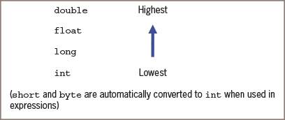
2.9 Understanding Type Conversion (3 of 4)
Figure 2-41: Order for establishing unifying data types

Slide 34
2.9 Understanding Type Conversion (4 of 4)
Explicit type conversions
Type casting
Forces a value of one data type to be used as a value of another data type
Explicit conversion
Cast operator
Place desired result type in parentheses
Using a cast operator is an explicit conversion
You do not need to perform a cast when assigning a value to a higher unifying type

Slide 35
Don’t Do It (1 of 3)
Don’t mispronounce integer
Don’t attempt to assign a literal constant floating-point number
Don’t try to use a Java keyword as an identifier for a variable or constant.
Don’t attempt to assign a constant value less than 22,147,483,648 or greater than 12,147,483,647 to a long variable
Don’t assume that you must divide numbers as a step to determining a remainder
Don’t try to use a variable or named constant that has not yet been assigned a value.

Slide 36
Don’t Do It (2 of 3)
Don’t forget to consume the Enter key after numeric input using the Scanner class when a nextLine() method call follows.
Don’t forget to use the appropriate import statement when using the Scanner or JOptionPane class
Don’t forget precedence rules
Don’t forget that integer division results in an integer
Don’t forget that floating-point numbers are imprecise
Don’t use a single equal sign in a Boolean for comparison for equality

Slide 37
Don’t Do It (3 of 3)
Don’t attempt to assign a constant decimal value to an integer using a leading 0.
Don’t use a single equal sign in a Boolean comparison for equality. The operator used for equivalency is composed of two equal signs.
Don’t try to store a string of characters, such as a name, in a char variable.
Don’t forget that when a String and a numeric value are concatenated, the resulting expression is a string.

Slide 38
Self-Assessment
What information should you include in a variable declaration? What is the purpose of each?
For what purpose would you use a boolean expression? Describe a situation in which it would be beneficial, and explain how you would use it.
What problems might you encounter when using the nextLine () when following a Scanner input method? How would you address the issue?
What is the order of operations in arithmetic expressions, and why does it matter?
Notes:
Instructions:
Use the Self-Assessment question to encourage students to evaluate their progress or goals in the course, as well as determine how they might apply their learning or grow as an individual.

Slide 39
Summary
Click the link to review the objectives for this presentation.
Link to Objectives
Notes:
Instructions:
Reiterate the learning objectives for the lesson. Students should use this information to guide their studies and reinforcement of new concepts.

