Slide 1
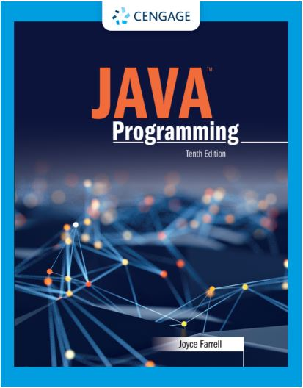
Java Programming, 11e
Chapter 13: Collections and Generics
Joyce Farrell, Java Programming, 11th Edition. © 2023 Cengage. All Rights Reserved. May not be scanned, copied or duplicated, or posted to a publicly accessible website, in whole or in part.

Slide 2
Chapter Objectives
By the end of this chapter, you should be able to:
13.3 Use the ArrayList class
Notes:
Instructions:
Briefly review with students the major concepts you will be covering during this class. There is one objective for every major A-Head section of the chapter.

Slide 3
13.3 Using the ArrayList Class (1 of 4)
ArrayList
Concrete class
Extends Collection abstract classes
Descends from AbstractList
Used to create containers that store lists of objects

Slide 4
13.3 Using the ArrayList Class (2 of 4)
Advantage of ArrayList over Arrays
ArrayList is dynamically resizable
You can add or remove an item at any point and the array size changes to accommodate
Capacity of an ArrayList
Number of items it can hold without having to increase its size
Capacity is greater than or equal to its size
You can specify a capacity

Slide 5
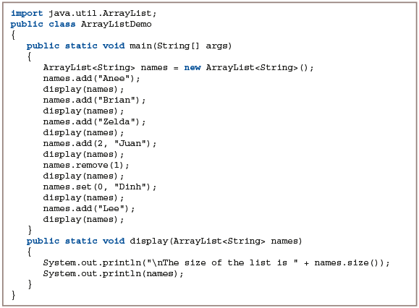
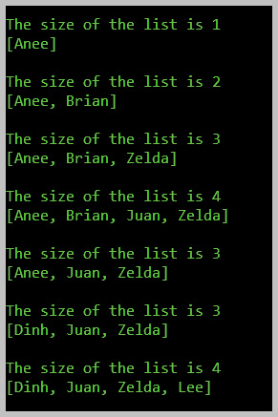
13.3 Using the ArrayList Class (3 of 4)
Figure 13-1: The ArrayListDemo application
Figure 13-2: Execution of the ArrayListDemo application

Slide 6
13.3 Using the ArrayList Class (4 of 4)
Using the ArrayList class
Can hold any reference type, but not a primitive type
Can use with objects instantiated from your own classes
Class natural ordering
Sort, such as Strings to alphabetical order
compareTo() method
Must be named compareTo(), accept parameter that indicates comparison object type, return an int

Slide 7
Summary
Click the link to review the objectives for this presentation.
Link to Objectives
Notes:
Instructions:
Reiterate the learning objectives for the lesson. Students should use this information to guide their studies and reinforcement of new concepts.

