Slide 1
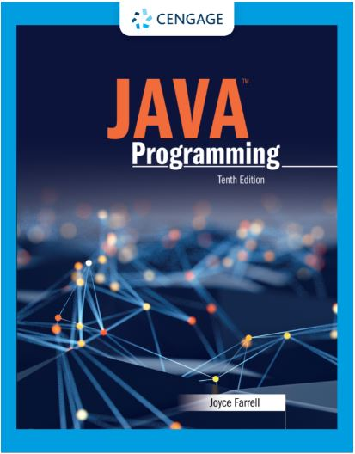
Java Programming, 10e
Chapter 03: Using Methods
Joyce Farrell, Java Programming, 10th Edition. © 2023 Cengage. All Rights Reserved. May not be scanned, copied or duplicated, or posted to a publicly accessible website, in whole or in part.

Slide 2
Chapter Objectives
By the end of this chapter, you should be able to:
03.01 Describe method calls and placement
03.02 Identify the parts of a method
03.03 Add parameters to methods
03.04 Create methods that return values
03.05 Describe blocks and scope
03.06 Overload a method
03.07 Avoid ambiguity
Notes:
Instructions:
Briefly review with students the major concepts you will be covering during this class. There is one objective for every major A-Head section of the chapter.

Slide 3
3.1 Understanding Method Calls and Placement (1 of 3)
Method
A program module
Contains a series of statements
Carries out a task
Execute a method
Invoke or call from another method
Calling method (client method)
Makes a method call
Called method
Invoked by a calling method

Slide 4
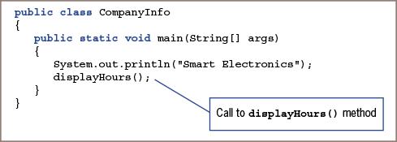
3.1 Understanding Method Calls and Placement (2 of 3)
Figure 3-3: CompanyInfo class that calls the displayHours() method

Slide 5
3.1 Understanding Method Calls and Placement (3 of 3)
The advantages to creating a separate method instead of adding a statement to the original application include:
Keeps the main () method short and easy to follow
Using a well-named method makes it easy to see the overall intent
A method is easily reusable

Slide 6
3.2 Understanding Method Construction (1 of 5)
Every method must include two parts:
Method header
Provides information about how other methods can interact with it
Also called method declaration
Method body
Contains statements that carry out the work of the method
Between a pair of curly braces
Called its implementation

Slide 7
3.2 Understanding Method Construction (2 of 5)
Method header
Optional access specifiers
Optional static modifier
A return type
An identifier
Parentheses (may or may not be empty)

Slide 8
3.2 Understanding Method Construction (3 of 5)
Access Specifiers
public, private, protected, or package (default)
Any method that can be used without instantiation an object requires the static modifier

Slide 9
3.2 Understanding Method Construction (4 of 5)
Return Type
Describes the type of data the method sends back to the calling method
If no data is returned to the method, the return value is void
Method Name
Can be any legal identifier
Must be one word
No embedded spaces
Cannot be a Java keyword

Slide 10
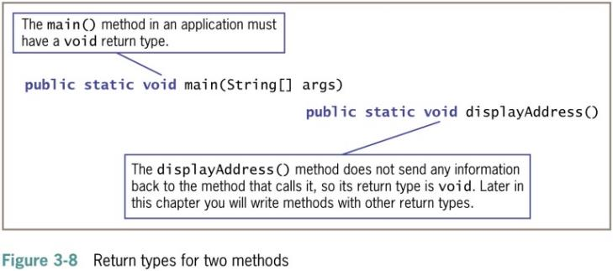
3.2 Understanding Method Construction (5 of 5)
Parentheses
Every method header contains a set of parentheses that follow the identifier
May contain data to be sent to the method
Fully qualified identifier
A complete name that includes the class

Slide 11
3.3 Adding Parameters to Methods (1 of 5)
Arguments
Data items you use in a call to a method
Parameters
Data items received by the method
Methods that receive data produce different results depending on data received

Slide 12
3.3 Adding Parameters to Methods (2 of 5)
Implementation hiding
Encapsulation of method details within a class
The calling method needs to understand only the interface to the called method
Interface
The only part of a method that the client sees or with which it interacts

Slide 13
3.3 Adding Parameters to Methods (3 of 5)
Creating a method that receives a single parameter
If a method receives a parameter, two additional items are required within the parentheses:
Parameter type
Local name for parameter
Local variable
Known only within the boundaries of the method

Slide 14
3.3 Adding Parameters to Methods (4 of 5)
Creating a Method That Requires Multiple Parameters
A method can require more than one parameter
List the arguments within the call to the method
Separate with commas
Each parameter requires a data type and identifier
Signature
Combination of method name and number, types, and order of arguments

Slide 15
3.3 Adding Parameters to Methods (5 of 5)
Arguments sent to the method must match the parameters listed in the method declaration by:
Number
Type
Method signature
Method name
Number, types, and order of the arguments

Slide 16
3.4 Creating Methods That Return Values (1 of 3)
A method ends when any of the following events occur:
Method completes all of its statements
Method throws an exception
Method reaches a return statement

Slide 17
3.4 Creating Methods That Return Values (2 of 3)
Return statement
Causes a value to be sent from the called method back to the calling method
The return type can be any type used in Java
Method’s type
Common name for method’s return type

Slide 18
3.4 Creating Methods That Return Values (3 of 3)
Unreachable statements
A statement placed after a method’s return statement
Can never execute
Dead code

Slide 19
3.5 Understanding Blocks and Scope (1 of 5)
Block of code
Any code between a pair of curly braces
Also called a block

Slide 20
3.5 Understanding Blocks and Scope (2 of 5)
Outer block
Begins at first opening curly brace
Ends at last closing curly brace at end of method
Inner block
Begins with second opening curly brace
Ends with first closing curly brace
Contains two executable statements:
Nested within outer block

Slide 21
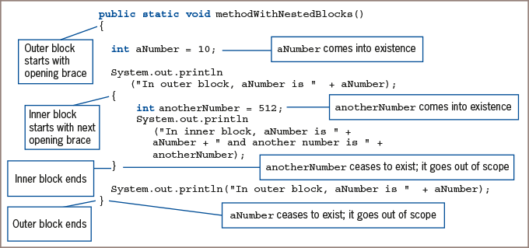
3.5 Understanding Blocks and Scope (3 of 5)
Figure 3-20: A method with nested blocks

Slide 22
3.5 Understanding Blocks and Scope (4 of 5)
Come into scope
When a variable comes into existence
After it is declared
Goes out of scope
At the end of the block in which it is declared
Scope level
A variable’s block

Slide 23
3.5 Understanding Blocks and Scope (5 of 5)
Redeclare a variable
Declare a variable more than once in a block
Illegal action
You can declare a variable within one method of a class and use the same variable name in another method of the class

Slide 24
3.6 Overloading a Method (1 of 2)
Overloading
Allows you to use one identifier to execute diverse tasks
Writing multiple methods in the same scope with the same name but different parameter lists
Lists must have different numbers of parameters
Lists must have parameter data types in different orders
Multiple methods share a name
Compiler understands which to use based on arguments in the method call

Slide 25
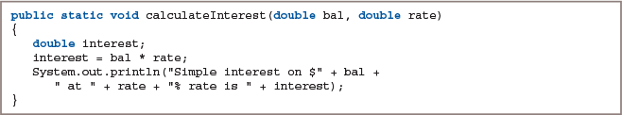
3.6 Overloading a Method (2 of 2)
Figure 3-28: The calculateInterest() method with two double parameters

Slide 26
3.7 Learning about Ambiguity (1 of 1)
Ambiguous situation
Where the compiler cannot determine which method to use
Caused by overloading
If a program contains potentially ambiguous situations, it will run problem-free if you do not make ambiguous method calls

Slide 27
Don’t Do It
Don’t place a semicolon at the end of a method header.
Don’t try to use a variable that is out of scope.
Don’t assume that a constant is still a constant when passed to a method’s parameter.
Don’t try to overload methods by giving them different return types.

Slide 28
Self-Assessment
Does the order in which methods appear in a class affect the order in which methods are called or executed?
What type of information should you include in the method header?
How does creating a method that receives a single parameter differ from creating a method that receives multiple parameters?
What makes a statement an unreachable statement? Why should you avoid them?
What happens when you redeclare a variable?
Notes:
Instructions:
Use the Self-Assessment question to encourage students to evaluate their progress or goals in the course, as well as determine how they might apply their learning or grow as an individual.

Slide 29
Summary
Click the link to review the objectives for this presentation.
Link to Objectives
Notes:
Instructions:
Reiterate the learning objectives for the lesson. Students should use this information to guide their studies and reinforcement of new concepts.

