Slide 1
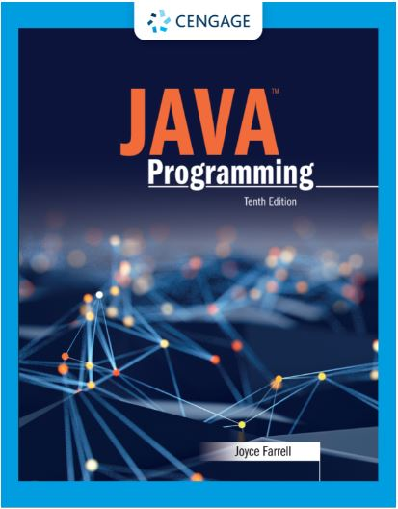
Java Programming, 10e
Chapter 05: Making Decisions
Joyce Farrell, Java Programming, 10th Edition. © 2023 Cengage. All Rights Reserved. May not be scanned, copied or duplicated, or posted to a publicly accessible website, in whole or in part.

Slide 2
Chapter Objectives
By the end of this chapter, you should be able to:
05.01 Plan decision-making logic
05.02 Make decisions with the if and if…else statements
05.03 Use multiple statements in if and if…else clauses
05.04 Nest if and if…else statements
05.05 Use AND and OR operators
05.06 Make accurate and efficient decisions
05.07 Use switch
05.08 Use the conditional and NOT operators
05.09 Assess operator precedence
05.10 Make constructors more efficient by using decisions in other methods
Notes:
Instructions:
Briefly review with students the major concepts you will be covering during this class. There is one objective for every major A-Head section of the chapter.

Slide 3
5.1 Planning Decision-Making Logic (1 of 5)
Pseudocode
Use paper and a pencil
Plan a program’s logic by writing plain English statements
Accomplish important steps in a given task
Use everyday language

Slide 4
5.1 Planning Decision-Making Logic (2 of 5)
Flowchart
Steps in diagram form
A series of shapes connected by arrows
Programmers use a variety of shapes for different tasks
Rectangle to represent any unconditional step
Diamond to represent any decision

Slide 5
5.1 Planning Decision-Making Logic (3 of 5)
Sequence structure
One step follows another unconditionally
Cannot branch away or skip a step
Decision structure
Involves choosing among alternative courses of action
Based on some value within a program

Slide 6
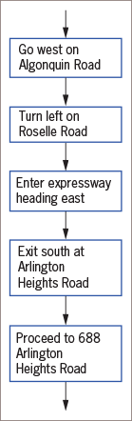
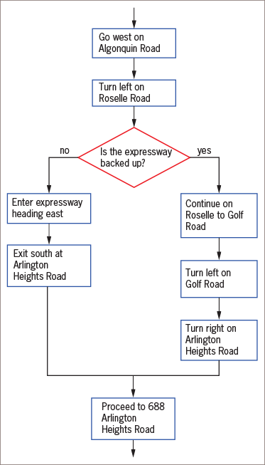
5.1 Planning Decision-Making Logic (4 of 5)
Figure 5-1: Flowchart of a series of sequential steps
Figure 5-2: Flowchart including a decision

Slide 7
5.1 Planning Decision-Making Logic (5 of 5)
All computer decisions are yes-or-no decisions
Boolean values
true and false values
Used in every computer decision

Slide 8
5.2 The if and if…else Statements (1 of 6)
if statement
Sometimes called a single-alternative decision
The simplest statement to make a decision
A Boolean expression appears within parentheses
No space between the keyword if and the opening parenthesis
Execution always continues to the next independent statement
Use a double equal sign ( == ) to determine equivalency

Slide 9
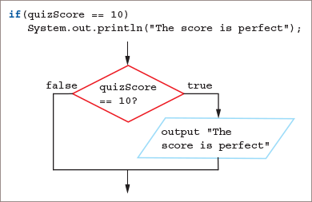
5.2 The if and if…else Statements (2 of 6)
Figure 5-3: A Java if statement and its logic

Slide 10
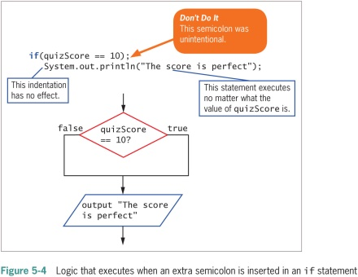
5.2 The if and if…else Statements (3 of 6)
Pitfall: misplacing a semicolon in an if statement
There should be no semicolon at the end of the first line of the if statement
The statement does not end there
An empty statement contains only a semicolon
Execution continues with the next independent statement

Slide 11
5.2 The if and if…else Statements (4 of 6)
Pitfall: using the assignment operator instead of the equivalency operator
A single equal sign instead of a double
Instead of comparing, it attempts to assign a value
Illegal because only Boolean expressions are allowed

Slide 12
5.2 The if and if…else Statements (5 of 6)
Pitfall: attempting to compare objects using the relational operators
Use standard relational operators to compare values of primitive data types
Cannot use them to compare objects because the program won’t compile
To compare values of objects, write specialized methods

Slide 13
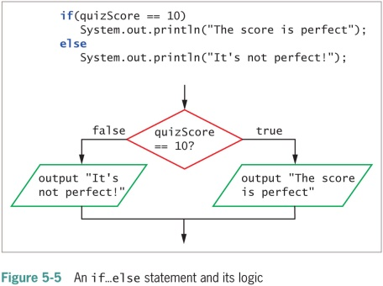
5.2 The if and if…else Statements (6 of 6)
The if…else statement
Used for a dual-alternative selection
You can code an if without an else, but it is illegal to code an else without an if
Only one of the resulting actions takes place depending on the evaluation of the Boolean expression
Each statement ends with a semicolon

Slide 14
5.3 Using Multiple Statements in if and if…else Clauses (1 of 2)
You can take more than one action following the evaluation of a Boolean expression within an if statement
For example, to display several lines of output or perform several mathematical calculations
Use curly braces correctly
If you fail to block statements that should depend on an if, and you also use an else clause, the program will not compile
You can also block statements to depend on an else

Slide 15
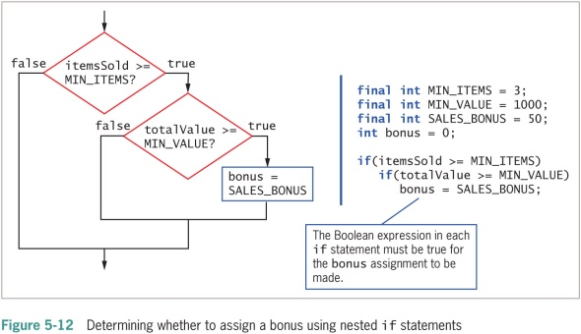
5.4 Nesting if and if…else Statements (1 of 1)
Nested if statements
Statements in which an if structure is contained inside another if structure
Two conditions must be met before some action is taken
Pay careful attention to the placement of else clauses
else statements are always associated with if on a “first in-last out” basis

Slide 16
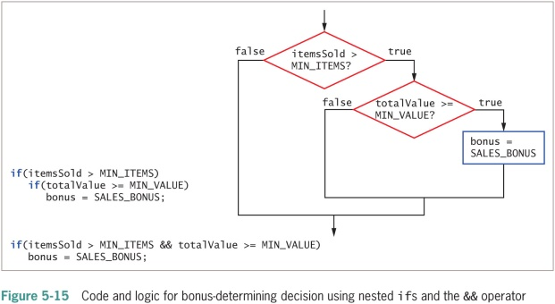
5.5 Using Logical AND and OR Operators (1 of 3)
Compound Boolean expression
Also called compound condition
Combine Boolean tests into a single expression using AND and OR
AND Operator
&&
Alternative to some nested if statements
true when both of its operands are true
Must include a complete Boolean expression on each side of &&

Slide 17
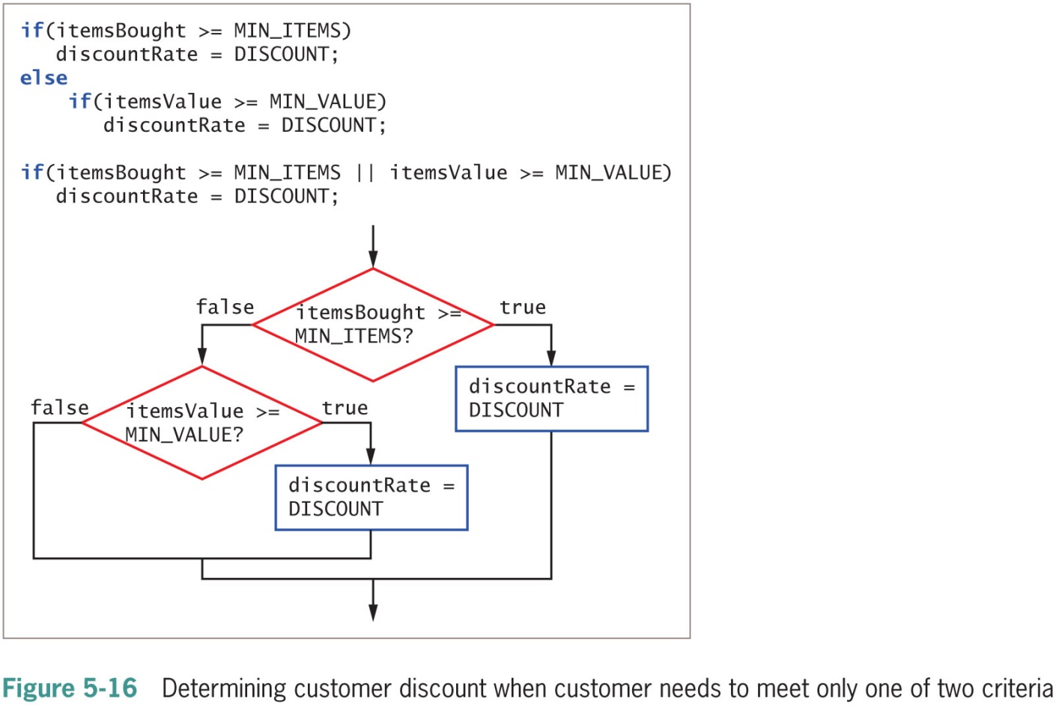
5.5 Using Logical AND and OR Operators (2 of 3)
OR operator
||
Alternative to nested if statements
true when at least one of its operands are true
Makes your code more concise, less error-prone, and easier to understand

Slide 18
5.5 Using Logical AND and OR Operators (3 of 3)
Short-circuit evaluation
The expressions on each side of the && and || operators are evaluated only as far as necessary to determine whether the entire expression is true or false
With the && operator, if the first expression is false, the second is never evaluated because it doesn’t matter
With the || operator, if the first expression is true, the second is never evaluated, but if the first is false, it is

Slide 19
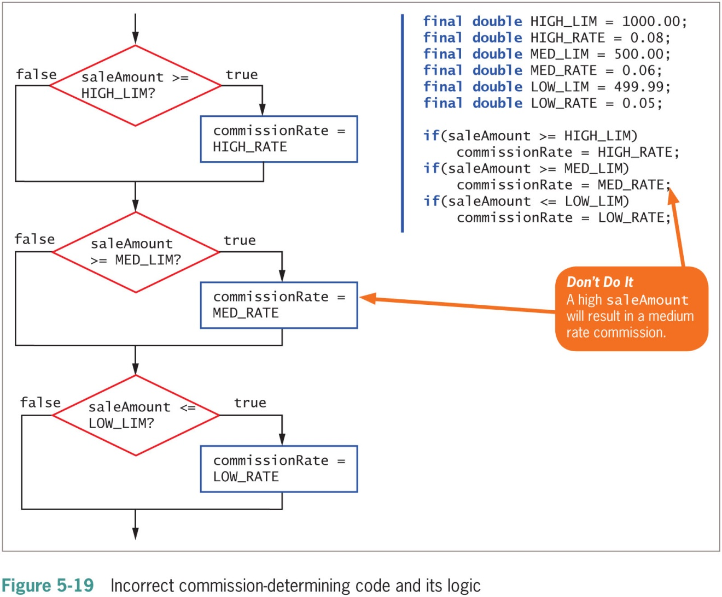
5.6 Making Accurate and Efficient Decisions
Range check
A series of if statements that determine whether a value falls within a specified range
It is most efficient to first ask the question that is most likely to be true
Beginning programmers often && or || when they mean to use the other

Slide 20
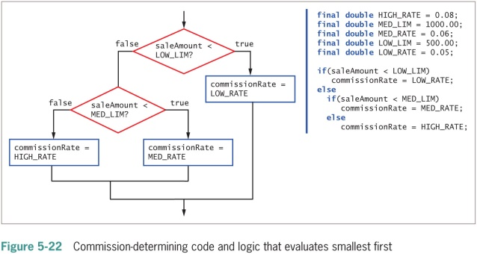
5.6 Making Accurate and Efficient Decisions

Slide 21
5.7 Using switch (1 of 3)
switch statement
Alternative to a series of nested if statements
Useful when you need to test a single variable against a series of exact integer, character, or string values
Uses four keywords:
switch (start of statement, followed by a test expression in parentheses)
case (followed by one of the possible values for the test expression and a colon)
break (optionally terminates a switch statement at the end of each case)
default (optionally used prior to any action that should occur if the test variable does not match any case)

Slide 22
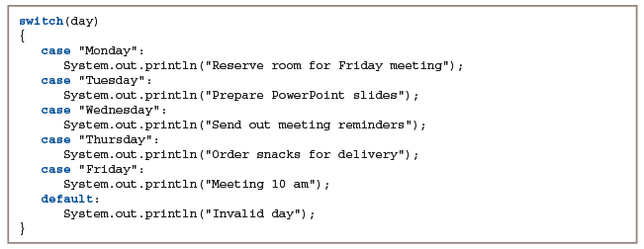
5.7 Using switch (2 of 3)
Figure 5-25: Determining all the tasks left for the week using a switch statement

Slide 23
5.7 Using switch (3 of 3)
switch expression
Java 14 or later
When all cases result in an assignment to the same variable
Multiple case labels are separated by commas
The arrow operator (->) is used instead of the assignment operator to assign a value
Each case does not have to end with the keyword break

Slide 24
5.8 Using the Conditional and NOT Operators (1 of 3)
Conditional operator
Requires three expressions (ternary operator) separated with a question mark and colon
An abbreviation of the if…else statement
You are never required to use the conditional operator
The disadvantage is that it is more difficult to read
The advantage is the conciseness of the statement

Slide 25
5.8 Using the Conditional and NOT Operators (2 of 3)
NOT operator
!
To negate the result of any Boolean expression
Any expression that evaluates as true becomes false, and the reverse
Harder to read because of double parentheses
Can be clearer when the value of a Boolean variable is tested

Slide 26
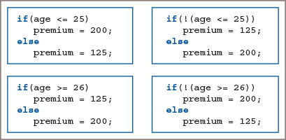
5.8 Using the Conditional and NOT Operators (3 of 3)
Figure 5-33: Four if…else statements that all do the same thing

Slide 27
5.9 Understanding Operator Precedence (1 of 2)
Operator precedence
You can combine as many && or || operators in an expression as you need to make a decision
An operator’s precedence makes a difference in how an expression is evaluated
You can use parentheses to change precedence or make intentions clear

Slide 28
5.9 Understanding Operator Precedence (2 of 2)
Order of precedence from highest to lowest
Logical NOT operator
Multiplication, division, modulus
Addition, subtraction
Relational
Equality
Logical AND
Logical OR
Conditional
Assignment

Slide 29
5.10 Making Constructors More Efficient by Using Decisions in Other Methods (1 of 1)
Control values assigned to fields
You often will need to restrict values assigned to fields
One way is to have the rules governing appropriate values be the same as those used in the constructor by coding the decisions once in the set methods and having the constructors use the set method logic

Slide 30
Don’t Do It
Don’t ignore subtleties in boundaries used in decision making.
Don’t use the assignment operator instead of the comparison operator when testing for equality.
Don’t insert a semicolon after the Boolean expression in an if statement; insert the semicolon after the entire statement is completed.
Don’t forget to block a set of statements with curly braces when several statements depend on the if or the else clause.
Don’t forget to include a complete Boolean expression on each side of an && or || operator in a compound Boolean expression.
Don’t try to use a switch statement to test anything other than a byte, short, char, int, or String.
Don’t forget a break statement if one is required by the logic of your switch statement.
Don’t use the standard relational operators to compare objects; use them only with the built-in Java types.

Slide 31
Self-Assessment
What is the difference between pseudocode and a flowchart?
What might happen if you misplace a semicolon in an if statement?
What techniques can you use to make sure that multiple statements and/or operators are used correctly?
Differentiate between the AND, OR, conditional, and NOT operators.
For what purpose would you use a range check?
List the four keywords a switch statement might use.
How might you make constructors more efficient?
Notes:
Instructions:
Use the Self-Assessment question to encourage students to evaluate their progress or goals in the course, as well as determine how they might apply their learning or grow as an individual.

Slide 32
Summary
Click the link to review the objectives for this presentation.
Link to Objectives
Notes:
Instructions:
Reiterate the learning objectives for the lesson. Students should use this information to guide their studies and reinforcement of new concepts.

