Slide 1
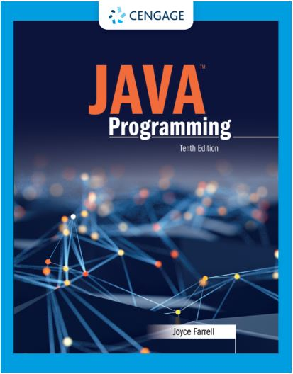
Java Programming, 10e
Chapter 06: Looping
Joyce Farrell, Java Programming, 10th Edition. © 2023 Cengage. All Rights Reserved. May not be scanned, copied or duplicated, or posted to a publicly accessible website, in whole or in part.

Slide 2
Chapter Objectives
By the end of this chapter, you should be able to:
06.01 Describe the loop structure
06.02 Create while loops
06.03 Use shortcut arithmetic operators
06.04 Create for loops
06.05 Create do…while loops
06.06 Nest loops
06.07 Improve loop performance
Notes:
Instructions:
Briefly review with students the major concepts you will be covering during this class. There is one objective for every major A-Head section of the chapter.

Slide 3
6.1 Learning About the Loop Structure (1 of 3)
Loop
A structure that allows repeated execution of a block of statements
Loop body
A block of statements
Executed repeatedly
Iteration
One execution of any loop

Slide 4
6.1 Learning About the Loop Structure (2 of 3)
Three types of loops
while
The loop-controlling Boolean expression is the first statement
for
A concise format in which to execute loops
do…while
The loop-controlling Boolean expression is the last statement

Slide 5
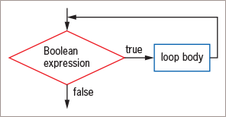
6.1 Learning About the Loop Structure (3 of 3)
Figure 6-1: Flowchart of a loop structure

Slide 6
6.2 Creating while Loops (1 of 9)
while loop
Executes a body of statements continually
As long as the Boolean expression that controls entry into the loop continues to be true
Consists of:
The keyword while
Followed by a Boolean expression within parentheses
Followed by the body of the loop; can be a single statement or a block of statements surrounded by curly braces

Slide 7
6.2 Creating while Loops (2 of 9)
Definite loop
Also called counted loop
Programmer knows exact number of iterations
Indefinite loop
Programmer cannot predict number of iterations

Slide 8
6.2 Creating while Loops (3 of 9)
Initialize the loop control variable
The variable whose value determines whether loop execution continues
While the loop control variable does not pass a limiting value, the program continues to execute the body of the while loop
The body of the loop must include a statement that alters the loop control variable
Infinite loop
A loop that never ends
Can result from a mistake in the while loop
Do not write intentionally
xx

Slide 9
6.2 Creating while Loops (4 of 9)
Suspect an infinite loop when:
The same output is displayed repeatedly
The screen remains idle for an extended period of time
To exit an infinite loop, press and hold Ctrl, then press C or Break

Slide 10
6.2 Creating while Loops (5 of 9)
Pitfall: Failing to Alter the Loop Control Variable Within the Loop
Prevent the while loop from executing infinitely
The named loop control variable is initialized to a starting value
The loop control variable is tested in the while statement
If the test expression is true, the body of the while statement takes action
Alters the value of the loop control variable
The test of the while statement must eventually evaluate to false

Slide 11
6.2 Creating while Loops (6 of 9)
Pitfall: Unintentionally Creating a Loop with an Empty Body
Loop control variable
A variable that is altered and stored with a new value
loopCount = loopCount + 1
The equal sign assigns a value to the variable on the left
The variable should be altered within the body of the loop
Empty body
A body with no statements
Caused by misplaced semicolons

Slide 12
6.2 Creating while Loops (7 of 9)
Altering a Definite Loop’s Control Variable
Incrementing the variable
Alter the value of the loop control variable by adding 1
Decrementing the variable
Subtract 1 from the loop control variable
Clearest and best method
Start the loop control variable at 0 or 1
Increment by 1 each time through the loop
Stop when the loop control variable reaches the limit

Slide 13
6.2 Creating while Loops (8 of 9)
Writing an Indefinite while Loop
Event-controlled loop
Altered by user input
Controlled by the user
Executed any number of times

Slide 14
6.2 Creating while Loops (9 of 9)
Validating data
Ensure a value falls within a specified range
Use indefinite loops to validate input data
If a user enters incorrect data, the loop repeats
Priming read (priming input)
Input retrieved before the loop is entered
Within a loop, the last statement retrieves the next input value and checks the value before the next entrance of the loop

Slide 15
6.3 Using Shortcut Arithmetic Operators (1 of 3)
Accumulating
Repeatedly increasing a value by some amount
Java provides shortcuts for incrementing and accumulating
+= add and assign operator
-= subtract and assign operator
*= multiply and assign operator
/= divide and assign operator
%= remainder and assign operator

Slide 16
6.3 Using Shortcut Arithmetic Operators (2 of 3)
Prefix increment operator and postfix increment operator
++someValue, someValue++
Use only with variables
Unary operators
Use with one value
Increase a variable’s value by 1
No difference between operators (unless other operations are in the same expression)

Slide 17
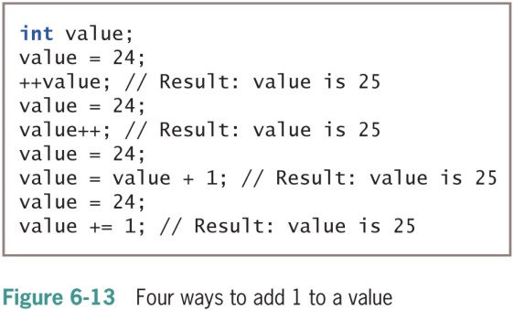
6.3 Using Shortcut Arithmetic Operators (3 of 3)
Prefix ++
The result is calculated and stored
Then the variable is used
Postfix ++
The variable is used
Then the result is calculated and stored

Slide 18
6.4 Creating a for Loop
for loop
Used when a definite number of loop iterations is required
Three sections usually used to initialize, test, and update the loop control variable
One convenient statement indicates:
The starting value for the loop control variable
The test condition that controls loop entry
The expression that alters the loop control variable

Slide 19
6.4 Creating a for Loop
Variations in for loops
Initialization of more than one variable
Place commas between separate statements
Performance of more than one test using AND or OR operators
Decrementing or performance of some other task
Altering more than one value

Slide 20
6.4 Creating a for Loop
Unconventional for loops
Initialization of more than one variable
Place commas between separate statements
for(g = 0, h = 1; g < 6; ++g)
Performance of more than one test using AND or OR operators
for(g = 0; g < 3 && h > 1; ++g)
Decrementing or performance of some other task
for(g = 5; g >= 1; --g)
Altering more than one value
for(g = 0; g < 10; ++g, ++h, sum += g)
You can leave one or more portions of a for loop empty
Two semicolons are still required as placeholders
for(; x < 10; ++x)

Slide 21
6.4 Creating a for Loop
Use method calls in any section of the for statement
for(x = initMethod(); isFinished(); x = alter(x))
Use the same loop control variable in all three parts of a for statement

Slide 22
6.4 Creating a for Loop
You can leave one or more portions of a for loop empty
Two semicolons are still required as placeholders
Use the same loop control variable in all three parts of a for statement
Do-nothing loop
Performs no actions in its body
Occupies the CPU for thousands of processing cycles

Slide 23
6.4 Creating a for Loop
To pause a program:
Use the for loop that contains no body (do-nothing loop)
for(x = 0; x < 100000; ++x);
Or use the built-in sleep() method

Slide 24
6.5 Learning How and When to Use a do…while Loop (1 of 2)
Pretest loop
In which the loop control variable is tested before the loop body executes
do...while loop
A posttest loop
In which the loop control variable is tested after the loop body executes
Performs a task at least one time
You are never required to use this type of loop
Use curly braces to block the statement even with a single statement

Slide 25
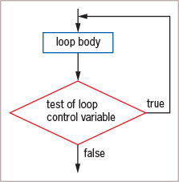
6.5 Learning How and When to Use a do…while Loop (2 of 2)
Figure 6-22: General structure of a do…while loop

Slide 26
6.6 Learning About Nested Loops (1 of 2)
Nested loop
When a loop is coded inside another loop
Can combine different types of loops
Includes an inner loop and outer loop
An inner loop must be entirely contained in an outer loop
Loops can never overlap
Outer loop is all-encompassing and its variable changes more infrequently

Slide 27
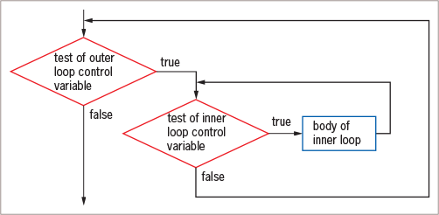
6.6 Learning About Nested Loops (2 of 2)
Figure 6-25: Nested loops

Slide 28
6.7 Improving Loop Performances (1 of 5)
To improve loop performance:
Make sure a loop does not include unnecessary operations or statements
Consider the order of evaluation for short-circuit operators
Make comparisons to zero (0)
Employ loop fusion to combine loops

Slide 29
6.7 Improving Loop Performances (2 of 5)
Avoiding Unnecessary Operations
Do not use unnecessary operations or statements:
Within a loop’s tested expression
Within the loop body
Avoid:
while (x < a + b)
// loop body
Instead use:
int sum = a + b;
while(x < sum)
// loop body

Slide 30
6.7 Improving Loop Performances (3 of 5)
Considering the Order of Evaluation of Short-Circuit Operators
Short-circuit evaluation
Each part of an AND or an OR expression is evaluated only as much as necessary to determine the value of the expression
Important to consider the number of evaluations that take place
When a loop might execute many times

Slide 31
6.7 Improving Loop Performances (4 of 5)
Comparing to Zero
Making a comparison to zero (0) is faster than making a comparison to any other value
To improve loop performance, compare the loop control variable to zero (0)
Do-nothing loop performs no actions other than looping

Slide 32
6.7 Improving Loop Performances (5 of 5)
Employing Loop Fusion
A technique of combining two loops into one
Will not work in every situation
Err in favor of programs that are more readable and easier to maintain, even if they execute more slowly

Slide 33
Don’t Do It
Don’t insert a semicolon at the end of a while clause
Don’t forget to block multiple statements that should execute in a loop
Don’t make the mistake of checking for invalid data using a decision instead of a loop
Don’t ignore subtleties in the boundaries used to stop loop performance
Don’t repeat steps within a loop that could just as well be placed outside the loop

Slide 34
Self-Assessment
Differentiate between the three types of loops: while, for, and do…while.
What do you do to prevent a while loop from executing infinitely?
What effect do the prefix and postfix operators have in a calculation?
List different variations in a for loop.
Explain the basic structure of a do…while loop.
What considerations should you make when deciding which loop in a nest is the inner and which is the outer loop?
How might you improve loop performance?
Notes:
Instructions:
Use the Self-Assessment question to encourage students to evaluate their progress or goals in the course, as well as determine how they might apply their learning or grow as an individual.

Slide 35
Summary
Click the link to review the objectives for this presentation.
Link to Objectives
Notes:
Instructions:
Reiterate the learning objectives for the lesson. Students should use this information to guide their studies and reinforcement of new concepts.

