Slide 1
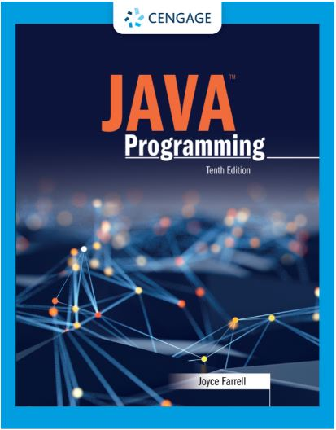
Java Programming, 10e
Chapter 07: Characters, Strings, and the StringBuilder
Joyce Farrell, Java Programming, 10th Edition. © 2023 Cengage. All Rights Reserved. May not be scanned, copied or duplicated, or posted to a publicly accessible website, in whole or in part.

Slide 2
Chapter Objectives
By the end of this chapter, you should be able to:
07.01 Identify string data problems
07.02 Use Character class methods
07.03 Declare and compare String objects
07.04 Use a variety of String methods
07.05 Use the StringBuilder and StringBuffer classes
Notes:
Instructions:
Briefly review with students the major concepts you will be covering during this class. There is one objective for every major A-Head section of the chapter.

Slide 3
7.1 Understanding String Data Problems (1 of 3)
String data problems
Manipulating characters and groups of characters provides some challenges for the beginning Java programmer
A String is a class
Each created String is a class object
The String variable name is not a simple data type
Reference is a variable that holds a memory address

Slide 4
7.1 Understanding String Data Problems (2 of 3)
To compare two strings:
Use the == operator
Not comparing values
Comparing computer memory locations
Compare contents of memory locations more frequently than memory locations themselves

Slide 5
7.1 Understanding String Data Problems (3 of 3)
Classes to use when working with character data
Character
Instances hold a single character value
Defines methods that can manipulate or inspect single-character data
String
A class for working with fixed-string data
Unchanging data composed of multiple characters
StringBuilder and StringBuffer
Classes for storing and manipulating changeable data composed of multiple characters

Slide 6
7.2 Using Character Class Methods (1 of 2)
Character class
Contains standard methods for testing the values of characters
Methods that begin with “is”
Such as isUpperCase()
Return a Boolean value that can be used in comparison statements
Methods that begin with “to”
Such as toUpperCase()
Return a character that has been converted to the stated format

Slide 7
7.2 Using Character Class Methods (2 of 2)
Method | Description
isUpperCase () | Tests if character is uppercase
toUpperCase () | Returns the uppercase equivalent of the argument; no change is made if the argument is not a lowercase letter
islowerCase () | Tests if character is lowercase
tolowerCase () | Returns the lowercase equivalent of the argument; no change is made if the argument is not an uppercase letter
isDigit() | Returns true if the argument is a digit (0–9) and false otherwise
isletter() | Returns true if the argument is a letter and false otherwise
isletterOrDigit() | Returns true if the argument is a letter or digit and false otherwise
isWhitespace () | Returns true if the argument is whitespace and false otherwise; this includes the space, tab, newline, carriage return, and form feed
Table 7-1 Commonly used methods of the Character class
Table 7-1 Commonly used methods of the Character class

Slide 8
7.3 Declaring and Comparing String Objects (1 of 8)
Literal string
A sequence of characters enclosed within double quotation marks
An unnamed object, or anonymous object, of the String class
String variable
A named object of the String class
Class String
Defined in java.lang.String
Automatically imported into every program

Slide 9
7.3 Declaring and Comparing String Objects (2 of 8)
Declare a String variable
The String itself is distinct from the variable used to refer to it
Create a String object
String aGreeting = new String("Hello");
String aGreeting = "Hello";
You can create a String object without:
Using the keyword new
Explicitly calling the class constructor

Slide 10
7.3 Declaring and Comparing String Objects (3 of 8)
String is a class
Each created String is a class object
String variable name
A reference variable
Refers to a location in memory rather than to a particular value
Assign a new value to a String
The address held by the String is altered

Slide 11
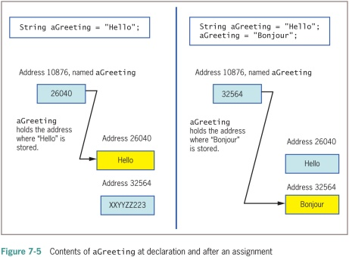
7.3 Declaring and Comparing String Objects

Slide 12
7.3 Declaring and Comparing String Objects (4 of 8)
Immutable
Objects that cannot be changed, such as a String
Making simple comparisons between Strings often produces misleading results
Comparing Strings using the == operator compares memory addresses, not values

Slide 13
7.3 Declaring and Comparing String Objects (5 of 8)
equals() method
Evaluates the contents of two String objects to determine if they are equivalent
Returns true if objects have identical contents
public boolean equals(String s)
equalsIgnoreCase() method
Ignores case when determining if two Strings are equivalent
Useful when users type responses to prompts in programs

Slide 14
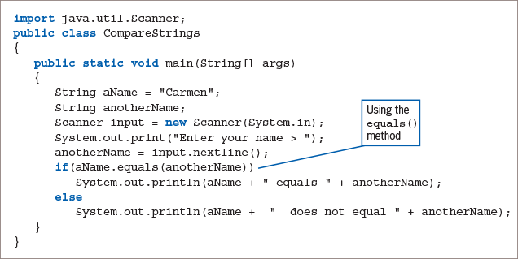
7.3 Declaring and Comparing String Objects (6 of 8)
Figure 7-6: The CompareStrings application

Slide 15
7.3 Declaring and Comparing String Objects (7 of 8)
compareTo() method
Compares two Strings and returns:
Zero: If two Strings refer to the same value
Negative number: If the calling object is “less than” the argument
Positive number: If the calling object is “more than” the argument

Slide 16
7.3 Declaring and Comparing String Objects (8 of 8)
Empty Strings
Reference a memory address with no characters
Can be used in String methods
null Strings
Use the null Java keyword
Strings are set to null by default
Cannot be used in String methods

Slide 17
7.4 Using a Variety of String Methods (1 of 7)
toUpperCase() and toLowerCase() methods
Convert any String to its uppercase or lowercase equivalent
length() method
Returns the length of a String
indexOf() method
Determines whether a specific character occurs within a String
Returns the position of the character
The first position of a String is zero
The return value is –1 if the character does not exist in the String

Slide 18
7.4 Using a Variety of String Methods (2 of 7)
charAt() method
Requires an integer argument
Indicates the position of the character that the method returns
endsWith() method and startsWith() method
Each takes a String argument
Return true or false if a String object does or does not end or start with the specified argument, respectively

Slide 19
7.4 Using a Variety of String Methods (3 of 7)
replace() method
Replaces all occurrences of some character within a String
contains() method
Allows you to determine whether one String contains another
Case sensitive

Slide 20
7.4 Using a Variety of String Methods (4 of 7)
toString() method
Not part of the String class
Converts any object to a String
Converts primitive data types to Strings
Concatenation
Join a simple variable to a String
String aString = "My age is " + myAge;
Use the + operator

Slide 21
7.4 Using a Variety of String Methods (5 of 7)
substring() method
Extracts part of a String
Takes two integer arguments
Start position
End position
The length of the extracted substring is the difference between the second integer and the first integer

Slide 22
7.4 Using a Variety of String Methods (6 of 7)
regionMatches() method
Two variants that can be used to test if two String regions are equal
In one, a substring of the specified String object is compared to a substring of the other
If the substrings contain the same character sequence, then the expression is true
Otherwise, the expression is false
A second version uses an additional boolean argument
Determines whether case is ignored when comparing characters

Slide 23
7.4 Using a Variety of String Methods (7 of 7)
Converting String Objects to Numbers
Integer class
Part of java.lang
Automatically imported into programs
parseInt() method
Takes a String argument
Returns its integer value
Wrapper
A class or an object “wrapped around” a simpler element
Double class
Converts a String object to a double value

Slide 24
7.5 Learning About the StringBuilder and StringBuffer Classes (1 of 7)
The value of a String is fixed
After a String is created, it is immutable
StringBuilder and StringBuffer classes
An alternative to the String class
Used when a String will be modified
Can use anywhere you would use a String
Part of the java.lang package
Automatically imported into every program

Slide 25
7.5 Learning About the StringBuilder and StringBuffer Classes (2 of 7)
StringBuilder
• More efficient
StringBuffer
Thread safe
Use in multithreaded programs

Slide 26
7.5 Learning About the StringBuilder and StringBuffer Classes (3 of 7)
Creating a StringBuilder or StringBuffer object
The keyword new
The constructor name (i.e. StringBuilder)
An initializing value between the constructor’s parentheses

Slide 27
7.5 Learning About the StringBuilder and StringBuffer Classes (4 of 7)
Buffer
A memory block
Might or might not contain a String
The String might not occupy the entire buffer
The length of a String can be different from the length of the buffer
Capacity
The actual length of the buffer

Slide 28
7.5 Learning About the StringBuilder and StringBuffer Classes (5 of 7)
setLength() method
Changes the length of a String in a StringBuilder object
length property
An attribute of the StringBuilder class
Identifies the number of characters in the String contained in the StringBuilder
capacity() method
Finds the capacity of a StringBuilder object

Slide 29
7.5 Learning About the StringBuilder and StringBuffer Classes (6 of 7)
Using StringBuilder objects
Provides improved computer performance over String objects
Can insert or append new contents into StringBuilder
append() method
Adds characters to the end of a StringBuilder object
insert() method
Adds characters at a specific location within a StringBuilder object

Slide 30
7.5 Learning About the StringBuilder and StringBuffer Classes (7 of 7)
SetCharAt() method
Changes a character at a specified position within a StringBuilder object
charAt() method
Accepts an argument that is the offset of the character position from the beginning of a String
Returns the character at that position

Slide 31
Don’t Do It
Don’t attempt to compare String objects using the standard comparison operators
Don’t forget that startsWith(), endsWith(), replace(), and contains() are case sensitive
Don’t forget to use the new operator and the constructor when declaring initialized StringBuilder or StringBuffer objects
Don’t use StringBuilder or StringBuffer objects unless you have a good reason

Slide 32
Self-Assessment
What does it mean to say that a String variable is a reference?
How are character comparisons evaluated?
What problems might arise when you make simple comparisons using String references? Why?
If vegetable is a String that refers to broccoli, what is the value of vegetable.charAt (1)?
What are some examples of wrapper classes? What are they used for?
Notes:
Instructions:
Use the Self-Assessment question to encourage students to evaluate their progress or goals in the course, as well as determine how they might apply their learning or grow as an individual.

Slide 33
Summary
Click the link to review the objectives for this presentation.
Link to Objectives
Notes:
Instructions:
Reiterate the learning objectives for the lesson. Students should use this information to guide their studies and reinforcement of new concepts.

