Slide 1
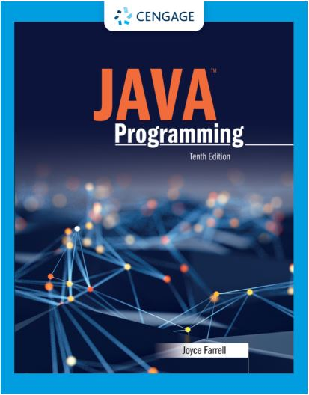
Java Programming, 10e
Chapter 08: Arrays
Joyce Farrell, Java Programming, 10th Edition. © 2023 Cengage. All Rights Reserved. May not be scanned, copied or duplicated, or posted to a publicly accessible website, in whole or in part.

Slide 2
Chapter Objectives
By the end of this chapter, you should be able to:
08.01 Declare an array
08.02 Initialize an array
08.03 Use variable subscripts with an array
08.04 Declare and use arrays of objects
08.05 Search an array and use parallel arrays
08.06 Pass arrays to and return arrays from methods
08.07 Sort array elements
08.08 Use two-dimensional and other multidimensional arrays
08.09 Use the Arrays class
08.10 Create enumerations
Notes:
Instructions:
Briefly review with students the major concepts you will be covering during this class. There is one objective for every major A-Head section of the chapter.

Slide 3
8.1 Declaring an Array (1 of 4)
Array
Named list of data items with the same data type
Each data item is an element of the array
Used when storing just one value at a time in memory does not meet your needs
Declared in the same way as any simple variable
But you insert a pair of square brackets after the data type
Double [] salesFigures;

Slide 4
8.1 Declaring an Array (2 of 4)
Naming arrays
You can provide any legal identifier for an array
Programmers conventionally name arrays using the same rules for variables
Start with lowercase letters
Uppercase letters for subsequent words
To show that the name represents a group of items
Use plural nouns
Add a word that implies a group: salesList, salesTable, salesArray

Slide 5
8.1 Declaring an Array (3 of 4)
Memory space
After you create an array variable you still need to reserve memory space
Use same procedure to create arrays as objects
Can use one statement or two
The size of the array follows the data type:
Double [] salesFigures = new double [20];

Slide 6
8.1 Declaring an Array (4 of 4)
Subscript
An integer contained within square brackets
Specifies one of an array’s elements
Elements are numbered beginning with 0
Also called an index
Out of bounds
When a subscript is too small or large
An error message is generated

Slide 7
8.2 Initializing an Array (1 of 2)
A variable with a reference type, such as an array, holds a memory address where a value is stored
Array names
Represent computer memory addresses
Contain references
Declaring an array name
No computer memory address is assigned
The array has the special value null

Slide 8
8.2 Initializing an Array (2 of 2)
Initialization list
List of values separated by commas
Enclosed with curly braces
Populating the array
int [] multsOfTen = {10, 20, 30, 40, 50, 60};
Size is assigned based on number of values in list
You do not need to use the keyword new when initializing
You cannot directly initialize part of an array
Every element or none

Slide 9
8.3 Using Variable Subscripts with an Array (1 of 4)
Power of arrays
Becomes apparent when you begin to use subscripts that are variables not constants
Reduce the amount of code needed by using a variable as the subscript
If you preform the loop too many times, the subscript will be out of bounds
If the loop is not performed enough times some elements in the list will miss processing

Slide 10
8.3 Using Variable Subscripts with an Array (2 of 4)
Instance variable
A field automatically assigned a value for every array you create
The length field contains the number of elements in the array
If you modify the array size and recompile, the value in the field changes appropriately
With an array, length is not a method; it is a field
An instance variable or object field also is called a property of the object

Slide 11
8.3 Using Variable Subscripts with an Array (3 of 4)
Using the Enhanced for Loop
Allows you to cycle through an array
Do not need to specify the start or end points of the loop control variable
foreach loop
Using Part of an Array
For example, AverageOfQuizzes
Students may enter fewer than the 10-quiz maximum
A while loop continues until user quits or 10th quiz is entered

Slide 12
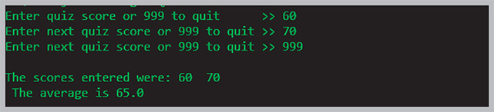
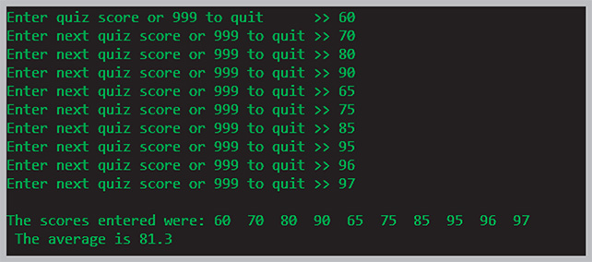
8.3 Using Variable Subscripts with an Array (4 of 4)
Figure 8-5: Typical execution of the AverageOfQuizzes application

Slide 13
8.4 Declaring and Using Arrays of Objects (1 of 2)
Arrays of objects
An array that holds elements of objects
Employee [] emps = new Employee [7];
Holds enough memory for seven Employee objects emps [0] to emps [6]
To use a method that belongs to an object that is part of an array:
Use the appropriate subscript notation after the array name and before the dot that precedes the method name

Slide 14
8.4 Declaring and Using Arrays of Objects (2 of 2)
Using the enhanced for loop with objects
Use to cycle through an array of objects
Eliminates the need to use:
A limiting value for the loop
Subscript following each element
Manipulating arrays of Strings
Arrays use a length field to indicate the number of elements in the array
String objects use a length() method to indicate the number of characters in the String

Slide 15
8.5 Searching an Array and Using Parallel Arrays (1 of 2)
Flag
A variable that holds a value as an indicator of whether or not a condition has been met
Searching an array
A process that compares a variable to a list of values in an array
You can initialize the array with the valid values
Then use a for statement to loop through the array
Set a Boolean variable to true when a match is found

Slide 16
8.5 Searching an Array and Using Parallel Arrays (2 of 2)
Using parallel arrays
One with the same number of elements as another
The values in the corresponding elements are related
Searching an array for a range match
Create two corresponding arrays
Perform an array match
Compare a value to the endpoints of numerical ranges
Find the category in which a value belongs

Slide 17
8.6 Passing Arrays to and Returning Arrays from Methods (1 of 2)
Passed by value
A copy of a value is made and used within the receiving method
When any primitive type is passed to a method, the value is passed
Arrays are reference types
Object holds a memory address where values are stored
Cannot assign another array to a name using the = operator
Cannot compare another array to a name using the == operator
When you pass an array to a method the receiving method gets a copy of the array’s memory address and can alter the original values

Slide 18

8.6 Passing Arrays to and Returning Arrays from Methods (2 of 2)
Returning an array from a method
When a method returns an array reference include square brackets with the return type in the method header
Figure 8-20: The getArray() method

Slide 19
8.7 Sorting Array Elements (1 of 4)
Sorting
The process of arranging a series of objects in a logical order
Ascending: starting with lowest value
Descending: start with largest value
Sorting more than two values is complicated
Use a sorting algorithm
Algorithm
Process or set of steps that solve a problem

Slide 20
8.7 Sorting Array Elements (2 of 4)
Using the Bubble Sort algorithm
Repeatedly compare pairs of items
Swap if they are out of order
Eventually create a sorted list
Not the fastest or most efficient method
Simple to comprehend and
Continue to pass through list until the list is sorted
At most, pass through as many times as the length minus one

Slide 21
8.7 Sorting Array Elements (3 of 4)
Improving Bubble Sort efficiency
The second pass there is no need to check the last pair of values since the largest value will be at the bottom
Use a new control variable to limit the repetitions
Reduce the value by one on each cycle

Slide 22
Bubble Sort
public static void bubbleSort(int[] arr) {
int comparisons = arr.length-1;
int temp;
for(int a=0; a<arr.length-1;a++) {
for(int b=0;b<comparisons;b++) {
if(arr[b] > arr[b+1]) {
temp = arr[b];
arr[b] = arr[b+1];
arr[b+1] = temp;
} //end if
} //end inner for
--comparisons;
}//end outer for
} // end method

Slide 23
8.7 Sorting Array Elements (4 of 4)
Using the Insertion Sort algorithm
Look at each list element one at a time
If an element is out of order relative to the items earlier in the list, you move each earlier item down one position and insert the tested element
Similar to manual sorting

Slide 24
Insertion Sort
public static void insertionSort(int[] arr) {
int a = 1, temp, b;
while(a < arr.length) {
temp = arr[a];
b= a -1;
while(b>=0 && arr[b]>temp)
{
arr[b+1] = arr[b];
--b;
} //end inner while
arr[b+1] = temp;
++a;
} // end outer while
} // end methods

Slide 25
8.8 Using Two-Dimensional and Other Multidimensional Arrays (1 of 4)
One-dimensional array
Also called single-dimensional
Can be pictured as a column of values
Elements you can access with a single subscript
Size of the array is its height
Two-dimensional array
Two or more columns of values
Height and width
Matrix or table
Two sets of brackets after the array type

Slide 26
8.8 Using Two-Dimensional and Other Multidimensional Arrays (2 of 4)
Passing a two-dimensional array to a method
A method that receives a two-dimensional array uses two bracket pairs following the data type
No need to insert numbers in the brackets in the method header
Each passed array name is a starting memory address
How to manipulate subscripts determines how rows and columns are accessed

Slide 27
8.8 Using Two-Dimensional and Other Multidimensional Arrays (3 of 4)
Using the length field with a two-dimensional array
length field hold the number of rows in the array
Each row has a length field that holds number of columns
Understanding jagged arrays
Rows of different lengths
Also called ragged array
Define the number of rows, but not columns

Slide 28
8.8 Using Two-Dimensional and Other Multidimensional Arrays (4 of 4)
Using other multidimensional arrays
Any array with more than one dimension
Examples of three-dimensional arrays
Store daily rainfall: rainfall [year][month][day]
Store color values: colors[redComponent][greenComponent][blueComponent]
As long as you keep track of the order of the variables needed as subscripts or exhaust computer memory you can create an array of any size

Slide 29
8.9 Using the Arrays Class (1 of 2)
Arrays class
Contains useful methods for manipulating arrays
Fill, sort, or search, and more
static methods
Use them with the class name without instantiating an Arrays object

Slide 30
8.9 Using the Arrays Class (2 of 2)
binarySearch() methods
Provide ways to search through sorted lists of values of various data types
Based on array size, you determine the middle position
Compare the item you are looking for with the middle item
Decide whether your item is above that point i the array
Look for middle position in top or bottom half of the array
Continue until find the element or determine it is not in the array

Slide 31
8.10 Creating Enumerations (1 of 3)
Enumerated data type
Finite set of legal values
First position is 0
Keyword enum
enum constants are allowed values for the type
Identifier begins with uppercase letter
Constants are all uppercase
Not in quotes
Java identifiers

Slide 32
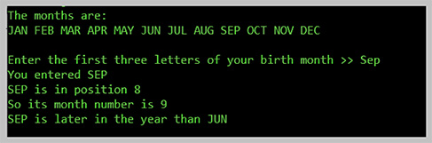
8.10 Creating Enumerations (2 of 3)
Figure 8-41: Typical execution of the EnumDemo application

Slide 33
8.10 Creating Enumerations (3 of 3)
Advantages to enumeration types
If you used another type (int or Strings) for month values, any value could be assigned but only 12 values are allowed to a Month
Invalid behavior could be applied to the values, such as adding or dividing two months.
Type-safe describes a data type for which only appropriate behaviors are allowed
A form of self-documentation
Can add methods and other fields to an enum type

Slide 34
Don’t Do It (1 of 2)
Don’t forget that the lowest array subscript is 0
Don’t forget that the highest array subscript is one less than the length of the array
Don’t forget that a semicolon follows the closing curly brace in an array initialization list
Don’t forget that length is an array property and not a method. Conversely, length() is a String method, and not a property
Don’t place a subscript after an object’s field or method name when accessing an array of objects

Slide 35
Don’t Do It (2 of 2)
Don’t assume that an array of characters is a string
Don’t forget that array names are references
Don’t use brackets with an array name when you pass it to a method
Don’t forget that the first subscript used with a two-dimensional array represents the row, and that the second subscript represents the column
Don’t think enum constants are strings; they are not enclosed in quotes

Slide 36
Self-Assessment (1 of 2)
What do you need to know in order to declare an array?
What do you need to know in order to initialize an array?
What types of variable subscripts are used with arrays? How are they used?
What is the value in using an array of objects?
What are parallel arrays used for?
Notes:
Instructions:
Use the Self-Assessment question to encourage students to evaluate their progress or goals in the course, as well as determine how they might apply their learning or grow as an individual.

Slide 37
Self-Assessment (2 of 2)
Define the term, passed by value.
Describe how a bubble sort is used, and list ways to improve it.
What do you need to know about using multidimensional arrays? List examples of different types.
Describe how the binarySearch() method works
Define and describe the uses of an enumerated data type. Give examples.
Notes:
Instructions:
Use the Self-Assessment question to encourage students to evaluate their progress or goals in the course, as well as determine how they might apply their learning or grow as an individual.

Slide 38
Summary
Click the link to review the objectives for this presentation.
Link to Objectives
Notes:
Instructions:
Reiterate the learning objectives for the lesson. Students should use this information to guide their studies and reinforcement of new concepts.

