Slide 1
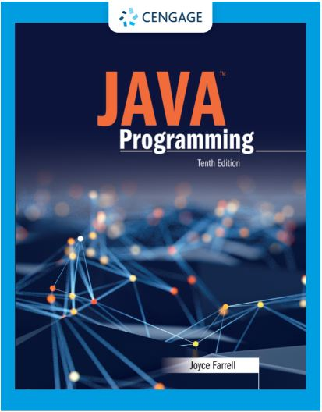
Java Programming, 10e
Chapter 04: Using Classes and Objects
Joyce Farrell, Java Programming, 10th Edition. © 2023 Cengage. All Rights Reserved. May not be scanned, copied or duplicated, or posted to a publicly accessible website, in whole or in part.

Slide 2
Chapter Objectives
By the end of this chapter, you should be able to:
04.01 Describe classes and objects
04.02 Create a class
04.03 Create instance methods in a class
04.04 Declare objects and use their methods
04.05 Compare classes to data types
04.06 Create and use constructors
04.07 Use the this reference
04.08 Use static fields
04.09 Use imported, prewritten constants and methods
04.10 Use composition and nest classes
Notes:
Instructions:
Briefly review with students the major concepts you will be covering during this class. There is one objective for every major A-Head section of the chapter.

Slide 3
4.1 Learning About Classes and Objects (1 of 2)
Java Classes can be differentiated into two types
Classes from which objects are not instantiated
Classes from which you create objects
In object-oriented programming:
Everything is an object
Every object is a member of a class

Slide 4
4.1 Learning About Classes and Objects (2 of 2)
is-a relationship
A relationship in which the object “is a” concrete example of the class
An object is an instantiation, or tangible example, of a class
Objects and classes
Classes provide reusability
Objects get their attributes from their classes
You don’t need to create every class you use
Class client or Class user
An application or class that instantiates objects of another class

Slide 5
4.2 Creating a Class (1 of 4)
Class header
An optional access specifier
The keyword class
Any legal identifier
Public class
Accessible by all objects
Can be extended as a basis for another class

Slide 6
4.2 Creating a Class (2 of 4)
Data fields
The data components of a class
Distinguished from other variables you might use
Instance variable
One copy exists for each object instantiation
Each object gets its own copy of each nonstatic data field in its class

Slide 7
4.2 Creating a Class (3 of 4)
Private access
No other classes can access the field’s values
Only methods of the same class are allowed to use private variables
Information hiding
Principle used in creating private access
Private data can be changed only by a class’s own methods

Slide 8
4.2 Creating a Class (4 of 4)
When you create classes from which you will instantiate objects
The class’s data fields are most often private
The class’s methods are most often not static

Slide 9
4.3 Creating Instance Methods in a Class (1 of 6)
Classes from which you intend to instantiate objects typically contain
Fields
Methods
Mutator methods
Set or change field values
Accessor methods
Retrieve values
Called setters (start with prefix set)

Slide 10
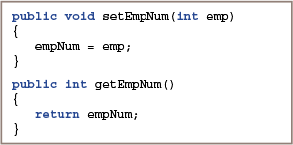
4.3 Creating Instance Methods in a Class (2 of 6)
Figure 4-2: The setEmpNum() and getEmpNum() methods

Slide 11
4.3 Creating Instance Methods in a Class (3 of 6)
Nonstatic methods
Used with object instantiations
Called instance methods
You can use either a static or nonstatic method
Only nonstatic methods behave uniquely for each object

Slide 12
4.3 Creating Instance Methods in a Class (4 of 6)
Static
Nonstatic
Static is a keyword that can be used as an adjective
Static fields in a class are called class fields
Static methods in a class are calls class methods
When you use a static field or method you do not need to use an object
When you create a static method and instantiate 100 objects, only one copy exists in memory and the method does not receive a this reference
Static class variables are not instance variables
Unless you declare a field or method static, it is nonstatic by default
Nonstatic fields in a class are called instance variables
Nonstatic methods in a class are called instance methods
When you use a nonstatic field or method you must use an object
When you create a nonstatic method and instantiate 100 objects, only one copy of the method exists in memory, but the method receives a this reference that contains the address of the object currently using it.
Instance fields and methods are nonstatic

Slide 13
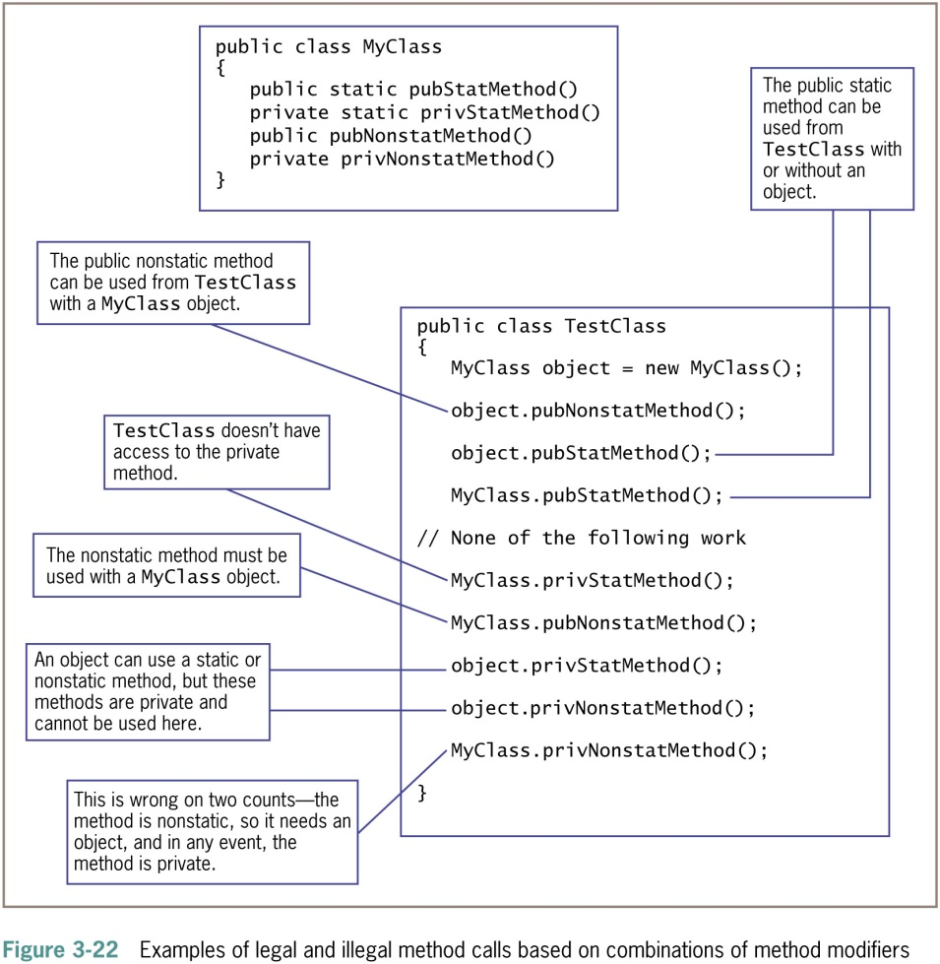
4.3 Creating Instance Methods in a Class (5 of 6)

Slide 14
4.3 Creating Instance Methods in a Class (6 of 6)
Most programmers place data fields in logical order
At beginning of the class
There is no requirement to do so
Unique identifiers are similar to a database’s primary key
You can place a class’s data fields and methods in any order

Slide 15
4.4 Declaring Objects and Using Their Methods (1 of 2)
Declaring a class
Does not create any actual objects
A class is a description of what an object will be like when instantiated
Creating an object that is an instance of a class
Supply a type and identifier
Allocate computer memory for the object
Use a new operator
Reference to an object
Constructor
Method that creates and initializes objects

Slide 16
4.4 Declaring Objects and Using Their Methods (2 of 2)
Data hiding
Using encapsulation
Data fields should be private and inaccessible from a client application
Can rewrite a method to prevent invalid data
Some fields clients should not be able to alter
Assigned values
Set directly using calculations

Slide 17
4.5 Understanding That Classes Are Data Types (1 of 3)
Abstract data type (ADT)
A class you create
Implementation is hidden and accessed through public methods
Also called programmer-defined data type
Not built into the language

Slide 18
4.5 Understanding That Classes Are Data Types (2 of 3)
Composite type
A class composite of smaller parts
Java’s 8 built-in data types are not composite
Such as int and double
Primitive types can also be called scalar
Java’s creators have already defined

Slide 19
4.5 Understanding That Classes Are Data Types (3 of 3)
When creating types, programmers ask:
What shall we call it?
What are its attributes
What methods are needed
When you declare a primitive type object
You provide its type and identifier

Slide 20
4.6 Creating and Using Constructors (1 of 3)
Constructor
Establishes an object
Default constructor requires no arguments
Automatically created by compiler if you don’t write a constructor
When you write a constructor
Must have the same name as the class it constructs
Cannot have a return type (even void)
Normally declared to be public

Slide 21
4.6 Creating and Using Constructors (2 of 3)
The default constructor provides specific initial values to an object’s data fields
Numeric fields
Set to 0 (zero)
Character fields
Set to Unicode ‘\u0000’
Boolean fields
Set to false
Nonprimitive object fields
Set to null

Slide 22
4.6 Creating and Using Constructors (3 of 3)
Creating Constructors with Parameters
Often parameters are used to initialize data fields for an object
When the constructor executes, the integer within the calls is passed as the parameter
When you write a constructor you no longer receive the default
Overloading constructors lets you create objects with different initializing arguments (or none)

Slide 23
4.7 Learning About the this Reference (1 of 4)
Classes can become large very quickly
Each class can have many methods, including overloaded methods
When you instantiate an object from a class, memory is reserved for each instance field
Fortunately, objects can share some variables and methods
In Java, just one copy of each nonstatic method in a class is stored
All instantiated objects can use that copy

Slide 24
4.7 Learning About the this Reference (2 of 4)
this reference
The reference to an object that is passed to any object’s nonstatic method
A reference is an object’s memory address
this is a reserved word in Java
Only nonstatic instance methods can have a this reference
When you use a nonstatic method, you use the object name, a dot, and the method name
Usually, you neither want nor need to refer to the this reference within the instance method

Slide 25
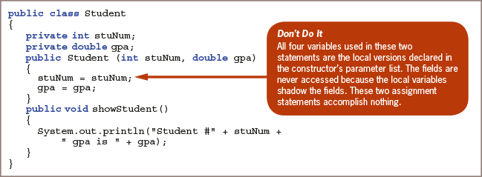
4.7 Learning About the this Reference (3 of 4)
Figure 4-19: A Student class whose constructor does not work

Slide 26
4.7 Learning About the this Reference (4 of 4)
Using the this reference to make overloaded constructors more efficient
You can reduce the amount of repeated code and make it less error-prone by calling one constructor version from the others
Use the this reference from one constructor version to call another version
You cannot call this() from other methods in a class, only from constructors
If you call this() from a constructor, it must be the first statement

Slide 27
4.8 Using static fields (1 of 2)
static fields
Methods you create to use without objects are static
Most methods you create within a class from which objects will be instantiated are nonstatic
Static methods are called class methods because they don’t have an object associated

Slide 28
4.8 Using static fields (2 of 2)
Class variables
Class variables are shared by every instantiation of a class
There is only one copy of each static class variable per class
Using constant fields
Sometimes data in a class should be constant
For a static field, all objects share a single memory location for a field
A nonstatic final field’s value can be assigned a value in a constructor
A static final field’s value must be set at the declaration

Slide 29
4.9 Using Imported, Prewritten Constants and Methods (1 of 4)
Library of classes
A package or folder that groups like prewritten classes together
java.lang package contains fundamental classes and is implicitly imported into every program you write
All other Java packages are optional classes and must be explicitly named within a program

Slide 30
4.9 Using Imported, Prewritten Constants and Methods (2 of 4)
math class
The class java.lang.Math contains constants and methods to preform mathematical functions
PI is a commonly used Math class constant
PI is public, final, static, and double

Slide 31
4.9 Using Imported, Prewritten Constants and Methods (3 of 4)
Importing Classes
To use a prewritten class use one of three methods
Use the entire path with the class name
Import the class
Import the package that contains the class using a wildcard symbol (*)

Slide 32
4.9 Using Imported, Prewritten Constants and Methods (4 of 4)
Using the LocalDate Class
Use statements that use the static methods now() and of()
Don’t use the new operator and class a constructor when creating LocalDate objects
Specific data field values can retrieve an integer using getYear(), getMonthValue(), and getDayOfMonth() methods
Enumeration is a data type that consists of a list of values: getMonth(), and getDayOfWeek()
Used in personnel, inventory, and billing systems

Slide 33
4.10 Understanding Composition and Nested Classes (1 of 2)
Composition
The relationship between classes when an object of one class is a data field within another class
Need to supply values for the contained object if it has no default constructor
A “has-a relationship” is one in which one class has an instance of another

Slide 34
4.10 Understanding Composition and Nested Classes (2 of 2)
Nested Classes
A class withing another class
The containing class is the top-level class
static member classes have access to all static methods of the top-level class
Nonstatic member classes (inner classes) require an instance and have access to all data and methods of the top-level class
Local classes are local to a block
Anonymous classes have no identifier

Slide 35
Don’t Do It
Don’t think that default constructor means only the automatically supplied version.
Don’t think that a class’s methods must accept its own fields’ values as parameters or return values to its own fields.
Don’t forget to write a default constructor for a class that has other constructors if you want to be able to instantiate objects without using arguments.
Don’t assume that a wildcard in an import statement works like a DOS or UNIX wildcard. The wildcard works only with specific packages and does not import embedded packages.

Slide 36
Self-Assessment
What is an is-a relationship?
What is the purpose of information hiding?
What values are provided in a default constructor?
How can you use a this reference to make overloaded constructors more efficient?
How do you use a prewritten class? Why might you use one?
What are the four types of nested classes?
Notes:
Instructions:
Use the Self-Assessment question to encourage students to evaluate their progress or goals in the course, as well as determine how they might apply their learning or grow as an individual.

Slide 37
Summary
Click the link to review the objectives for this presentation.
Link to Objectives
Notes:
Instructions:
Reiterate the learning objectives for the lesson. Students should use this information to guide their studies and reinforcement of new concepts.

