Slide 1
Working with Events and Styles

Slide 2

Const Keyword
When you declare a variable with the const keyword, that variable cannot be reassigned.
That is why we refer to it as a constant.
So technically, it is not a variable because it cannot change. It is a constant.

Slide 3
Window Prompt()
The prompt() method displays a dialogue box that prompts the user for input.
The prompt() method returns the input value if the user clicks "OK", otherwise it returns null.
<input type="submit" value="Click it" onclick="func()">
<p id="demo2"></p>
function func(){
let person = prompt("Enter your name");
if(person != null)
document.getElementById("demo2").textContent = "Hello " + person;
}

Slide 4
Window Confirm()
The confirm() method displays a dialogue box with a message, an OK button, and a Cancel button.
The confirm() method returns true if the user clicks "OK", otherwise false.
<input type="submit" value="Click it" onclick="funcConfirm()">
<p id="demo3"></p>
function funcConfirm() {
let text = "Press a button either OK or Cancel.";
if (confirm(text) == true) {
text = "You pressed OK!";
} else {
text = "You canceled!";
}
document.getElementById("demo3").innerHTML = text;
}

Slide 5
DOM (Document Object Model)
The HTML DOM is a standard object model and programming interface for HTML
The HTML DOM is a standard for how to get, change, add, or delete HTML elements and add events handlers too
The most common way to access an HTML element is to use the id of the element using getElementById method
The easiest way to get the content of an element is by using the innerHTML property

Slide 6
DOM Forms
<form name="myForm" action=“example.com" onsubmit="validateForm()" method="post">
Name: <input type="text" name="fname" id="fname">
<input type="submit" value="Submit">
</form>
-----------------------------------------------
function validateForm() {
let x = document.getElementById("fname").value;
if (x == "") {
alert("Name must be filled out");
return false;
}
}

Slide 7
DOM Forms
<p>Please input a number between 1 and 10:</p>
<input id="numb">
<button type="button" onclick="myFunction()">Submit</button>
<p id="demo"></p>
-------------------------------------------------------------
function myFunction() {
let x = document.getElementById("numb").value;
let text;
if (isNaN(x) || x < 1 || x > 10) {
text = "Input not valid";
} else {
text = "Input OK";
}
document.getElementById("demo").innerHTML = text;
}

Slide 8
JavaScript HTML DOM Events
Event
Specific circumstances monitored by JavaScript
Script can respond to in some way
Allows users to interact with Web pages
Common events: actions performed by users
Can also monitor events not resulting from user actions

Slide 9
JavaScript HTML DOM Events
Examples of HTML events:
When a user clicks the mouse
When a web page has loaded
When an image has been loaded
When the mouse moves over an element
When an input field is changed
When an HTML form is submitted
When a user strokes a key

Slide 10
JavaScript HTML DOM Events
Working with elements and events
Events: associated with HTML elements
Event handler
Code that executes in response to a specific event
HTML allows event handler attributes (e.g., onclick), with JavaScript code, to be added to HTML elements.
JavaScript code for an event handler
Contained within the quotation marks following the name of the JavaScript event handler

Slide 11
JavaScript HTML DOM Events
<h2 onclick="this.innerHTML='This is new text'">Click to change the text</h2>
Or
<h2 onclick="changeText(this)">Click to change the text</h2> -- HTML code
//JavaScript function
function changeText(id) {
id.innerHTML = "This is new text";
}
<h2 onclick="this.style.color='red'">Click to change the color</h2>

Slide 12
Event Handlers: onload
Execute a JavaScript immediately after a page has been loaded:
<body onload=" welcomeMsgFun()">
function welcomeMsgFun(){
alert("Welcome to my webpage");
}

Slide 13
Event Handlers: onmouseover and onmouseout
The onmousemove event occurs when the pointer moves over an element.
<h2 id="demo4" onmouseover="function1()" onmouseout="function2()">Click this text</h2>
function function1(){
document.getElementById("demo4").style.color = "red";
}
function function2() {
document.getElementById("demo4").style.color = "black";
}

Slide 14
The addEventListener() method
<button id="btn">Click it</button>
<p id="demo1"></p>
-----------------------------------
document.getElementById("btn").addEventListener("click", displayDate);
function displayDate() {
document.getElementById("demo1").innerHTML = Date();
}

Slide 15
Manipulating Strings
String
Text contained within double or single quotation marks
Used as literal values or assigned to a variable
Begin and end with the same type of quotation mark
Example:
document.getElementById("mainHeading").innerHTML = "24-Hour Forecast";
let highSurfAdvisory = "Watch out for high waves and strong rip currents.";

Slide 16
Manipulating Strings (cont’d.)
At times, it is necessary to parse the text strings in your script
Parsing
Extracting characters or substrings from a larger string
Use methods and properties of String class to parse text strings in scripts
Represents all literal strings and string variables in JavaScript
Contains methods for manipulating text strings

Slide 17
Formatting Strings
Using special characters
For basic types of special characters(quotation marks): use escape sequences
let mainHead = 'Today\'s Forecast';
For other special characters: use Unicode
Standardized set of characters from many of the world’s languages
A number represents each character in the Unicode character set.
For instance, the Unicode numbers for the uppercase letters A, B, and C, are 65, 66, and 67, respectively.

Slide 18
Formatting Strings (cont’d.)
Unicode:
We can use HTML numeric character references or character entities to represent Unicode characters in text strings.
For example, the copyright symbol (©) can be represented in HTML by the numeric character reference &#169; and the character entity is &copy;.
copyrightInfo = "<p>&#169; 2006-2023</p>";
^{// numeric character ref.}
copyrightInfo = "<p>&copy; 2006-2023</p>";
^{// character entity}

Slide 19
Formatting Strings (cont’d.)
Changing case
toLowerCase() and toUpperCase() methods
Append these to string variables or literal strings
Examples:
^{let agency = "noaa";}
agencyName.innerHTML = agency.toUpperCase();
// browser displays "NOAA" but value of agency is still "noaa"
^{let agency = "noaa";}
agency = agency.toUpperCase(); // value of agency is "NOAA"
agencyName.innerHTML = agency; // browser displays "NOAA"

Slide 20
Counting Characters in a String
length property
Returns the number of characters in a string
Only property of String class.
Example:
^{let country = “Canada";}
let stringLength = country.length; // value of stringLength is 18

Slide 21
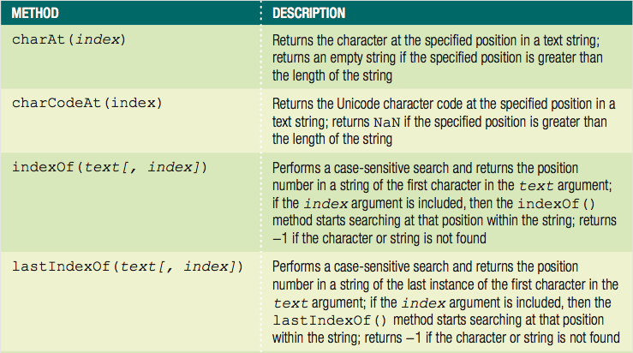
Finding and Extracting Characters and Substrings
Table: Search and extraction methods of the String class (continues)

Slide 22
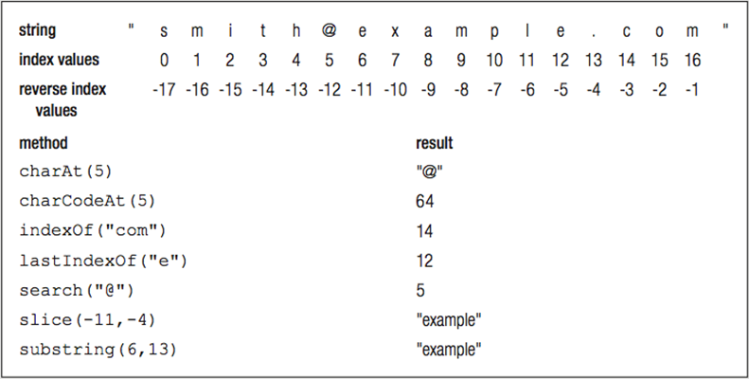
Finding and Extracting Characters and Substrings (cont’d.)
Figure: Example uses of String class methods

Slide 23
Finding and Extracting Characters and Substrings (cont’d.)
Types of string search methods
Those that return a numeric position in a text string
Character position in text string begins with a value of zero
Can pass a second optional argument specifying the position in the string to start searching to the indexOf() method

Slide 24
Finding and Extracting Characters and Substrings (cont’d.)
Types of string search methods (cont'd.)
Those that return a numeric position in a text string (cont'd.)
Example: indexOf() method
let email = "president@whitehouse.gov";
let atIndex = email.indexOf("@", 10); // returns -1

Slide 25
Finding and Extracting Characters and Substrings (cont’d.)
Types of string search methods (cont’d.)
Those that return a character or substring
substring() or slice() method
let email = "president@whitehouse.gov";
let nameEnd = email.search("@");
^{// value of nameEnd is 9}
let nameText = email.substring(0, nameEnd);
// value of nameText is "president"

Slide 26
Finding and Extracting Characters and Substrings (cont’d.)
Extracting characters from the middle or end of a string
Use the search(), indexOf(), lastIndexOf() methods along with methods that return a character or substring
lastIndexOf() method returns position of the last occurrence of one string in another string
Example:
let email = "president@whitehouse.gov";
let startDomainID = email.lastIndexOf(".");
^{// startDomainID value is 20}
let domainID = email.substring(startDomainID + 1);
^{// domainID value is "gov"}

Slide 27
Finding and Extracting Characters and Substrings (cont’d.)
slice() method allows negative argument values for the index arguments
Specifying a negative value for the starting index
slice() method starts at the end of the text string
Specifying a negative value for the ending index
Number of characters the slice() method extracts also starts at the end of the text string
slice() method does not return the character represented by the ending index
Returns the character immediately before the ending index

Slide 28
Replacing Characters and Substrings
replace() method
Creates a new string with the first instance of a specified pattern replaced with the value of the text argument
Syntax: string.replace(pattern, text)
Example:
var email = "president@whitehouse.gov";
var newEmail = email.replace("president", "vice.president");
// value of newEmail is "vice.president@whitehouse.gov"
document.write("<p>" + newEmail + "</p>");
// prints 'vice.president@whitehouse.gov'

Slide 29
Combining Characters and Substrings
Combining strings
Use the concatenation operator (+) and compound assignment operator (+=)
Use the concat() method
Creates a new string by combining strings passed as arguments
Syntax: string.concat(value1, value2, ...)
To combine text strings
Easier to use the concatenation operator and the compound assignment operator

Slide 30
Comparing Strings
Comparison operator (===) can be used with strings
Compare individual characters according to their Unicode position
^{let x = 5;}
document.getElementById("demo").innerHTML = (x === "5");// false

Slide 31
Trimming Strings
trim()
removes the white spaces from both the ends of the given string
trimLeft()
removes the white spaces from the start of the given string.
It does not affect the trailing white spaces
trimRight()
removes the white spaces from the end of the given string.
It does not affect the white spaces at the start of the string.

Slide 32
Converting Between Data Types
Common task to convert strings and arrays to different data types
strings to arrays
arrays to strings
objects to strings
strings to objects

Slide 33
Converting Between Strings and Arrays
split() method of the String class
Splits a string into an indexed array
Syntax
array = string.split(separator[, limit]);
To split individual characters in a string into an array
Pass an empty string ("") as the separator argument

Slide 34
Converting Between Strings and Arrays (cont’d.)
let OPEC = "Algeria, Angola, Ecuador, Iran, Iraq, Kuwait,↵
Libya, Nigeria, Qatar, Saudi Arabia, United Arab Emirates, Venezuela";
// The value of OPEC is a string
let opecArray = OPEC.split(", ");
// The value of opecArray is the following array:
// ["Algeria", "Angola", "Ecuador", "Iran", "Iraq",
// "Kuwait", "Libya", "Nigeria", "Qatar", "Saudi Arabia",
// "United Arab Emirates", "Venezuela"]

Slide 35
Converting Between Strings and Arrays (cont’d.)
join() method of the Array class
Combines array elements into a string, separated by a comma or specified characters
Syntax
^{array.join(["separator"]);}
To prevent elements from being separated by any characters in the new string
Pass an empty string ("") as the separator argument

Slide 36
Converting Between Strings and Arrays (cont’d.)
let OPEC = ["Algeria", "Angola", "Ecuador", "Iran",↵
"Iraq", "Kuwait", "Libya", "Nigeria", "Qatar",↵
"Saudi Arabia", "United Arab Emirates", "Venezuela"];
^{// value of OPEC is an array}
^{let opecString = OPEC.join();}
// value of opecString is the following string:
// "Algeria, Angola, Ecuador, Iran, Iraq, Kuwait, Libya,
// Nigeria, Qatar, Saudi Arabia, United Arab Emirates,
^{// Venezuela"}

Slide 37
Converting Between Strings and Arrays (cont’d.)
Can also use the toString() and toLocaleString() method
Convert an array to a string
^{array.toString();}
^{array.toLocaleString();}

